Slide 1

Translating
Knowledge to Action (K2A):
An Organizing Framework and
A Planning Tool
Teresa J. Brady, PhD
On behalf of the NCCDPHP
Work Group on Translation

Slide 2
Agenda
Review the NCCDPHP Knowledge to Action (K2A) Framework
Describe a brief case example
Introduce the K2A Planning Tool

Slide 3
The Translation Imperative
Wealth of research knowledge not moving into hands of practitioners
Practitioners creating own interventions
Need to “use what works”
  Increase impact
  Use resources wisely
  Account for dollars spent

Slide 4
Translation
Models and Theories
Diffusion of Innovation
Complex Systems Theory
Interactive Systems Framework
Stages of Research Utilization
Knowledge Translation Process
RE-AIM
Do we really need another model???

Slide 5
Rationale for K2A Framework
Work Group on Translation (WGOT) members from various disciplines, content areas, divisions, and approaches to public health
Divisions using a variety of different translation-related theories and models
WGOT needed common language and conceptualization to work collaboratively

Slide 6
NCCDPHP Knowledge to Action Framework
Research Phase
Translation Phase
Institutional-
ization.Phase
Wilson KM, Brady TJ, Lesesne C, on behalf of the NCCDPHP Work Group on Translation. An organizing framework for translation in public health: the Knowledge to Action Framework. Prev Chronic Dis 2011;8(2). http://www.cdc.gov/pcd/issues/2011/mar/10_0012.htm.

Slide 7
NCCDPHP Knowledge to Action Framework
Research Phase
Translation Phase
Institutional-
ization Phase
Discovery
Practice-based Discovery
Efficacy
Practice-based Evidence
Effectiveness &
Implementation
Knowledge
to Products
Dissemination
Decision
to
Adopt
Decision
to
Translate
Practice
Institution-alization
Engagement
Diffusion
Supporting Structures
Supporting Structures
Supporting
Structures
Evaluation

Slide 8
K2A Framework
Captures processes at the 20,000’ high level.
  More detailed descriptions likely to vary by division and intervention
Applies regardless of disease/condition or type of intervention.
Incorporates activities of both the research and practice communities.
Can be read left to right or right to left.
Focuses on processes.

Slide 9
K2A Framework
Is NOT
A theoretical framework
Linear (but we are restricted to 2-D)
Does NOT prescribe
“Adequate evidence”
Specific activities

Slide 10
K2A Framework Glossary
Translation:
  Processes/steps needed to ensure widespread use of science-based programs, policies and practices. The entire process of putting research into practice.
Intervention:
  Evidence-based programs, policies, or practices (broadly defined)

Slide 11
NCCDPHP Knowledge to Action Framework
Research Phase
Translation Phase
Institutional-
ization Phase
Discovery
Original finding that stimulated developing of an intervention
Efficacy
Extent to which intended effects are achieved under optimal conditions
Institution-alization
Effectiveness &
Implementation
Effectiveness: Extent to which intended effects are achieved under real-world settings
Implementation Research: Understanding of the processes by which research findings are put into practice

Slide 12
NCCDPHP Knowledge to Action Framework
Research Phase
Translation Phase
Institutional-
ization Phase
Discovery
Decision to create actionable product
Decision to propel program, policy, practice into wide-spread use
Efficacy
Institution-alization
Effectiveness &
Implementation
Decision
to
Translate

Slide 13
NCCDPHP Knowledge to Action Framework
Research Phase
Translation Phase
Institutional-
ization Phase
Turning scientific evidence into
Programs
Policies
Practices
Producing
Toolkits
Guidelines
Curriculae
Discovery
Efficacy
Institution-alization
Effectiveness
Decision
to
Translate
Knowledge
to Products

Slide 14
NCCDPHP Knowledge to Action Framework
Research Phase
Translation Phase
Institutional-
ization Phase
Discovery
Targeted process of distributing info/materials to organizations and individuals who can use to improve health
Efficacy
Dissemination
Institution-alization
Effectiveness &
Implementation
Decision
to
Translate
Knowledge
to Products
Diffusion
Engagement
Active participation/collaboration of stakeholders who can mobilize resources and influence systems

Slide 15
NCCDPHP Knowledge to Action Framework
Research Phase
Translation Phase
Institutional-
ization Phase
Discovery
Decision at the organization or community level to implement program, policy, practice
Efficacy
Effectiveness &
Implementation
Knowledge
to Products
Dissemination
Decision
to
Adopt
Decision
to
Translate
Institution-alization
Engagement

Slide 16
NCCDPHP Knowledge to Action Framework
Research Phase
Translation Phase
Institutional-
ization Phase
Discovery
Performing tasks/action steps to achieve program objectives
Efficacy
Dissemination
Practice
Institution-alization
Effectiveness &
Implementation
Decision
to
Translate
Knowledge
to Products
Decision
to
Adopt
Engagement

Slide 17
NCCDPHP Knowledge to Action Framework
Research Phase
Translation Phase
Institutional-
ization Phase
Discovery
Practice-based Discovery
Efficacy
Practice-based Evidence
Effectiveness &
Implementation
Knowledge
to Products
Dissemination
Decision
to
Adopt
Decision
to
Translate
Practice
Institution-alization
Engagement
Diffusion

Slide 18
NCCDPHP Knowledge to Action Framework
Research Phase
Translation Phase
Institutional-
ization Phase
Discovery
Efficacy
Effectiveness &
Implementation
Knowledge
to Products
Dissemination
Decision
to
Adopt
Decision
to
Translate
Practice
Institution-alization
Engagement
Supporting Structures
Supporting
Structures
Supporting Structures

Slide 19
Supporting Structures
Elements that enhance organizations capacity to plan, implement, evaluate, and sustain the activity
Includes (but not limited to)
  Organizational Capacity
  Financial Resources
  Training
  Technical Assistance
  Marketing
  Political Will

Slide 20
NCCDPHP Knowledge to Action Framework
Research Phase
Translation Phase
Institutional-
ization Phase
Discovery
Practice-based Discovery
Efficacy
Practice-based Evidence
Effectiveness &
Implementation
Knowledge
to Products
Dissemination
Decision
to
Adopt
Decision
to
Translate
Practice
Institution-alization
Engagement
Diffusion
Supporting Structures
Supporting Structures
Supporting
Structures
Evaluation

Slide 21
NCCDPHP Knowledge to Action Framework
Research Phase
Translation Phase
Institution.
Phase
Discovery
Practice-based Discovery
Efficacy
Practice-based Evidence
Effectiveness
Knowledge
to Products
Dissemination
Decision
to
Adopt
Decision
to
Translate
Practice
Institution-alization
Engagement
Diffusion
Supporting Structures
Supporting Structures
Supporting
Structures
Evaluation

Slide 22
NCCDPHP Knowledge to Action Framework
Research Phase
Translation Phase
Institution.
Phase
Discovery
Practice-based Discovery
Efficacy
Practice-based Evidence
Effectiveness
Dissemination
Decision
to
Adopt
Decision
to
Translate
Knowledge
to Products
Practice
Institution-alization
Engagement
Diffusion
Supporting Structures
Supporting Structures
Supporting
Structures
Evaluation

Slide 23
NCCDPHP Knowledge to Action Framework
Research Phase
Translation Phase
Institutional-
ization Phase
Discovery
Practice-based Discovery
Efficacy
Practice-based Evidence
Effectiveness &
Implementation
Knowledge
to Products
Dissemination
Decision
to
Adopt
Decision
to
Translate
Practice
Institution-alization
Engagement
Diffusion
Supporting Structures
Supporting Structures
Supporting
Structures
Evaluation

Slide 24
Uses of K2A Framework
Foster communication and collaboration
Guide planning for translation
Structure self assessment
Guide developmental activities

Slide 25
Agenda
Review the NCCDPHP Knowledge to Action (K2A) Framework
Describe a brief case example
Introduce the K2A Planning Tool

Slide 26


Translation Example:
Community-based group exercise program
Lead by trained fitness instructors
Classes that meet 3x/week, in a variety of settings
Components:
  moderate-intensity aerobic conditioning
  strength training
  flexibility
  balance

Slide 27
Translation Example:
Research Phase
Translation Phase
Institution.
Phase
EnhanceFitness (AKA Lifetime Fitness)
Discovery
Prevention Research Center
Efficacy
1998
Effectiveness &
Implementation
2003, 2006, 2008, in process
Institution-alization
Supporting Structures

Slide 28


Translation Example
Research Phase
Translation Phase
Institution.
Phase
Discovery
Prevention Research Center
Efficacy
Decision
to
Translate
Knowledge
to Products
Dissemination
Effectiveness &
Implementation
Engagement
Diffusion
Supporting Structures
Supporting Structures

Slide 29
Initial EnhanceFitness Sites (1994)

Slide 30
EnhanceFitness: Early Spread(2005)

Slide 31
Translation Example
Research Phase
Translation Phase
Institution.
Phase
Discovery
Efficacy
CDC Arthritis Program
Effectiveness &
Implementation
Knowledge
to Products
Dissemination
Decision
to
Adopt
Decision
to
Translate
Practice
Institution-alization
Engagement
Diffusion
Supporting Structures
Supporting Structures

Slide 32
Translation Example
Research Phase
Translation Phase
Institution.
Phase
Discovery
Efficacy
CDC Arthritis Program
Effectiveness &
Implementation
Knowledge
to Products
Dissemination
Decision
to
Adopt
Decision
to
Translate
Practice
Institution-alization
Engagement
Supporting Structures
Supporting Structures

Slide 33
CDC Arthritis Program
Translation Support
Dissemination Strategies
Specified in continuation guidance
Satellite Broadcast
Conference calls for State HD and partners

Slide 34
CDC Arthritis Program
Translation Support
Supporting Structures
Financial support to program office
Conceptualizing program expansion capacity
Supporting on-line data entry
Sponsoring regional training
Sponsoring trainer support mechanisms
Problem-solving dissemination and quality control issues

Slide 35
Taking EnhanceFitness to Scale (2008)

Slide 36
Prevention Research Center
Research Phase
Translation Phase
Institution.
Phase
Discovery
EnhanceFitness
Advisory Group
Efficacy
Effectiveness &
Implementation
Knowledge
to Products
Dissemination
Decision
to
Adopt
Decision
to
Translate
Practice
Institution-alization
Engagement
Supporting Structures
Supporting Structures
Supporting
Structures
Evaluation

Slide 37
Agenda
Review the NCCDPHP Knowledge to Action (K2A) Framework
Describe a brief case example
Introduce the K2A Planning Tool

Slide 38
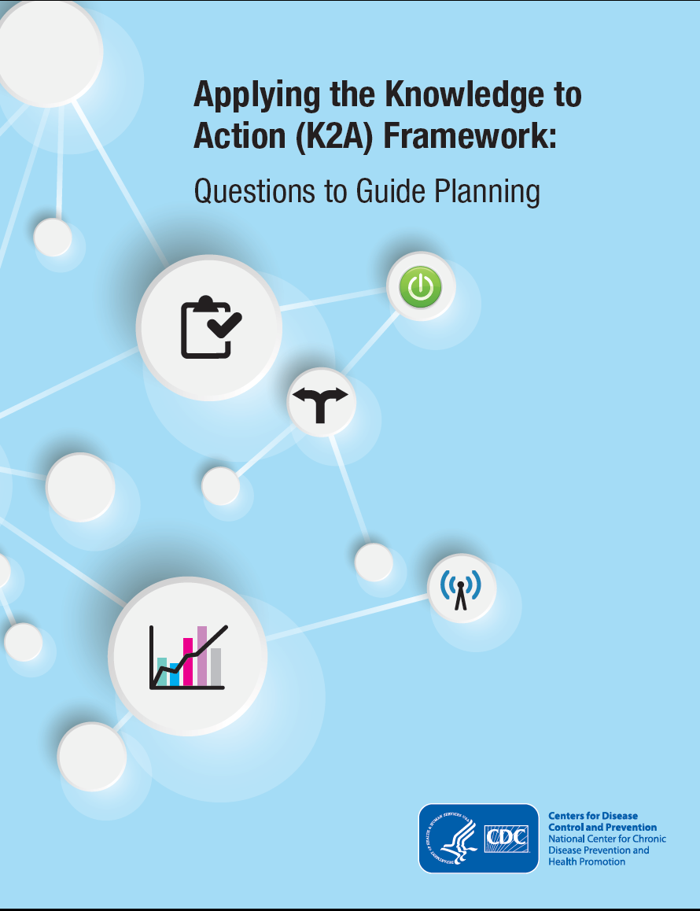

Slide 39
Background
Purpose: To facilitate use of K2A framework to foster translation of evidence-based interventions* into public health action through short set of reflective questions to guide planning for each element of the K2A Framework
*intervention = programs, policies, practices

Slide 40
Background
Target Audience: Public health professionals involved in translating evidence-based interventions into public health action
  National, state, local levels
  Public and private sectors
  Various translation-related roles

Slide 41
Planning Tool Organization
Reflective Planning Questions organized by:
  Element of the K2A Framework
  Translation-related function or role

Slide 42





Translation-related Functions
Intervention Developing and Testing
Administrative Decision Making
Disseminating
Implementing
Evaluating

Slide 43
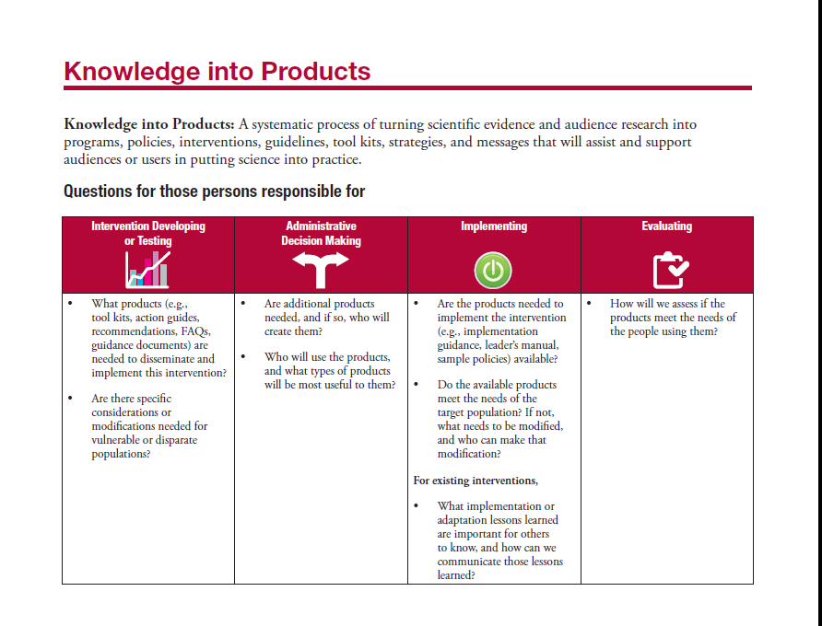
Planning Tool Sample

Slide 44
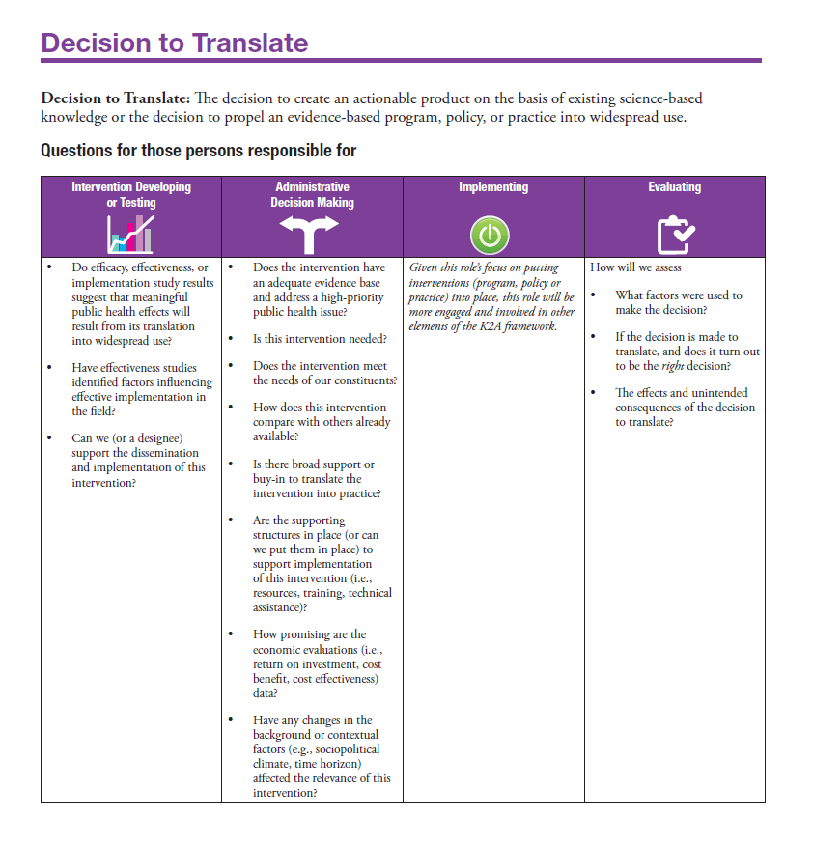

Slide 45

Using the Tool
Identify where your translation task falls on the K2A framewok
Identify your role in the K2A process

Slide 46
Example (by element):
Decision to Adopt
Intervention Developing/Testing: Have effectiveness studies identified factors influencing effective implementation in the field?
Administrative Decision-making: Does the intervention have an adequate evidence-base and address a high priority public health issue?
Evaluating (the translation process): How will we assess the effects and unintended consequences of the decision to translate.

Slide 47
Example (by element):
Engagement
Intervention Developing/Testing: Which stakeholders should be engaged (or what are characteristics of stakeholders that should be engaged) to help translate this intervention?
Administrative Decision-making: What is the stakeholders and partners motivation for engaging in the translation process, and how does this motivation impact translation decisions?
Implementing: How can we leverage stake- holder and partner resources to assist in our translation effort?

Slide 48
Example (by function):
Administrative Decision-making
Decision to Adopt: Does the intervention have an adequate evidence-base and address a high priority public health issue?
Knowledge into Products: Are additional products needed, and if so, who will create them?
Dissemination: Is there an opportunity to partner with organizations to facilitate dissemination?

Slide 49
Example (by function):
Implementing
Engagement: How can we leverage stakeholder and partner resources to assist in our translation effort?
Decision to Adopt: How will the intervention affect our existing services?
Practice: Are the tools and resources necessary to implement the intervention available?

Slide 50
Decision Tree: Practice-based Evidence or Discovery
Field based data available?
Yes—Practice-based evidence
No—Practice-based discovery
Need more rigorous research?
Lessons learned to share?
See Efficacy studies question set
See Effectiveness studies questions
See Knowledge to Products questions

Slide 51
Uses of the K2A Planning Tool
Planning for translation!
Guiding planning for each element of the K2A process
Clarifying roles for scientists, administrators, practitioners, evaluators in the translation processes

Slide 52
Reciprocal Roles for
Scientists and Practitioners across the K2A Process
Research Phase
Translation Phase
Institutional-
ization.Phase
Practitioners
Scientists

Slide 53
Agenda
Review the NCCDPHP Knowledge to Action (K2A) Framework
Describe a brief case example
Introduce the K2A Planning Tool

Slide 54
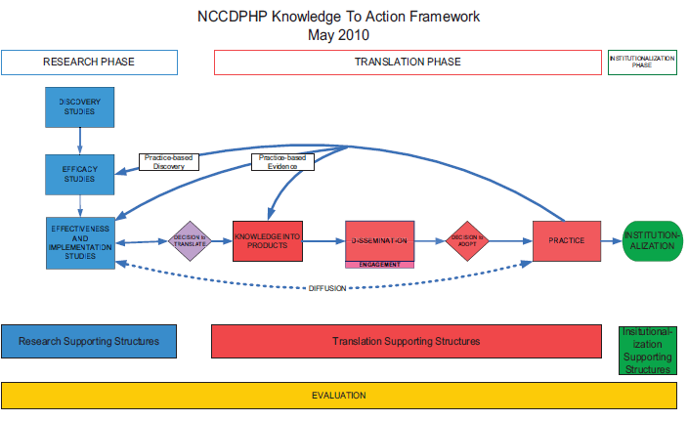
Translation Tools

Slide 55
Questions
Teresa J. Brady, PhD
  770-488-5856
  tob9@cdc.gov

