Slide 1

CPCRN:
A collaboration with NCI & CDC
Stephen Taplin MD, MPH
Deputy Associate Director
Program in transition
Last Updated September 2014
Notes:
THANKS FOR HAVING ME, ETC.
3 PURPOSES OF TALK:
PROVIDE AN OVERVIEW OF THE CURRENT STRUCTURE AND EXISTING ACTIVITIES IN HSR
OUTLINE HOW EXTRAMURAL INVESTIGATORS CAN RECEIVE SUPPORT FOR INVESTIGATOR-INITIATED GRANTS, PARTICULARLY IMPORTANT GIVEN INCREASING THE NUMBER OF FUNDED HSR GRANTS IS AN UNEQUIVOCAL PRIORITY
SHARE SOME PRELIMINARY INFORMATION ABOUT CREATION OF NEW PROGRAM AND BROADER DCCPS PLANNING & REORGANIZATION
MATERIAL INTERMINGLED RATHER THAN OFFERED IN CLEAR ORDER

Slide 2

Division of Cancer Control & Population Sciences (DCCPS)
Overarching goal: generate new knowledge and ensure that the products of cancer control research are effectively applied in all segments of the population
Mission: reduce risk, incidence, and deaths from cancer as well as enhance the quality of life for cancer survivors
http://cancercontrol.cancer.gov/
Notes:
Health Services Research was conductet in three BRANCHES IN THE DIVISION OF CANCER CONTROL & POPULATION SCIENCES
HSErvices and Economics Research Branch
Process Research Branch
Outcomes research Branch
These are being consolidated

Slide 3
Organizational Structure
Director
Intramural
Extramural
NCI
Director
5 Divisions
2 Divisions
23 Centers & Offices
Notes:
DCCPS IS ONE OF 5 NCI COMPONENTS FOCUSED ON SUPPORTING EXTRAMURAL SCIENTISTS THROUGH GRANTS, CONTRACTS, COOPERATIVE AGREEMENTS, CREATION OF RESEARCH RESOURCES, ETC. (OTHERS ARE DCB, DCP, DCTD, AND DEA)
WITHIN NCI, MOST HSR OCCURS IN DIVISION OF CANCER CONTROL AND POPULATION SCIENCE

Slide 4
Investigator-Initiated Grants (Approximate)
75 active grants
$35 million per year
Mechanisms
Program Project (P01) = 2.5%
Research Project (R01) = 60%
Exploratory/Developmental (R21) = 20%
Small (R03) = 15%
Academic Research Enhancement (R15) = 2.5%
Note: career awards are handled by the Center for Cancer Training, see
http://www.cancer.gov/researchandfunding/cancertraining
Notes:
THIS AND NEXT FEW SLIDES PROVIDE BRIEF OVERVIEW OF CURRENT ORB & HSEB EXTRAMURAL GRANT PORTFOLIO
NOTE THAT DR. VARMUS WANTS TO CONTINUE FUNDING THE SAME # OF R01, WHICH IS HAVING AN IMPACT ON OTHER MECHANISMS AND OUR OPERATING BUDGETS (COOPERATIVE AGREEMENTS & CONTRACTS)
WANT TO INCREASE # OF FUNDED INVESTIGATOR-INITIATED GRANTS, PARTICULARLY R01

Slide 5
DCCPS Structure
Office of the Director (Robert Croyle)
  Administrative & Financial
  Cancer Survivorship
  Health Disparities
  Implementation Science
Programs
  Behavioral Research (William Klein, Linda Nebling Deputy)
  Epidemiology and Genomics Research (Muin Khoury, Brit Reid Deputy)
  Surveillance Research (Lynne Penberthy, Kathy Cronin Deputy)
  Applied Research (Ann Geiger, Acting, Stephen Taplin Deputy)
Notes:
MAY WANT TO NOTE THAT OD GROUPS DO NOT SERVE AS GRANT PD
APPLIED RESEARCH INCLUDES TWO BRANCHES THAT WORK IN THE HSR AREA.
We are revitalizing and reorganizing to focus our work. I’ll talk more about this later.
The Process of Care Research Branch was also doing relevant work. Its leadership has moved into our branch and is co-leading it with me in order to focus our science.

Slide 6
We are an evolving program addressing cancer care delivery – the prevention, diagnosis, & treatment of NCI’s mission
National Cancer Institute
We have a history
  Applied Research Program
    Health Economics
    Risk factor monitoriing
    Outcomes research
We have a future
  Health care delivery research
    Health Economics -
    Process research – screening, treatment, survivorship
    Outcomes research
We are in transition – and we are listening and looking
  Intervention research
Notes:
While the NCI has broad mission, our work serves only part of it. We are not interested in causes of cancer. We are focused on prevention, diagnosis, and treatment.
Our interest is in how these activities occur in the current and future delivery system, and the scientific underpinnings of the translation of relevant research in to practice.
We have a history and future. We are in transition.

Slide 7
Health Services Research (HSR)
Health Services Research at NCI is the study of multilevel fixed and mutable factors that affect cancer care delivery and outcomes.
We are interested in understanding and intervening.
Open for discussion
Notes:
HEALTH SERVICES RESEARCH IS A HUGE SWATH OF TERRITORY TO COVER
GROUND THIS PRESENTATION IN ACADEMYHEALTH DEFINITION

Slide 8
Cancer Care Delivery is complex set of processes and sub-processes
Process of care impacts
Patient & population outcomes
Processes of Care Across the Cancer Care Continuum
Types of Care
Patient
Efficiency
Equity
Safety
Timeliness
Patient-centeredness
Sub-process effectiveness
Risk status
Biologic outcomes
Health related quality of life & well-being
Quality of death
Financial burden
Patient experience
Risk assessment
Primary prevention
Detection
Screening
Symptomatic
Diagnosis
Cancer or precursor RX
Post-treatment survivorship
End-of-life care
Population
Mortality
Morbidity
Cost-effectiveness
Transitions in Care
Each type and transition in care offers opportunities for improvement. Within and between types of care there are interfaces and steps which may be articulated to identify more opportunities.
Taplin et al 2012 JNCI (sup)
Notes:
We think there needs to be some organizational framework for the complicated task of cancer care delivery.
Here is one that identifies some of the relevant types of care and their intermediate, and long-term outcomes that link directly to the IOM’s vision for the process: That it be save, equitable, efficienct, timely, and patient centered.
We think those are good characteristics to consider. They need metrics, and we need to understand the links between the processes and these metrics.

Slide 9
We recognize that process occurs in a multilevel context
Local Community
Community Level Resources
Medical care offerings
Population SES
Lay support networks
Private cancer organizations
Local Hospital & Cancer Services
Market
Level of competition
Managed care penetration
Percent non-profit
Specialty mix
Local Professional Norms
MD practice organizations
Use of guidelines
Practice patterns
National
Policy – Affordable Care Act
Structure – Financial, Political
Culture - Expectations
National
State
State
Policy - Medicaid
Structure - Provider Mix
Culture
advocacy groups
attitude/expectations
Local
Organization and/or
Provider / Team
Knowledge, communication skills
Perceived barriers, norms, test
efficacy
Cultural competency
Staffing mix & turnover
Role definition
Teamwork
Practice Setting
Organization / Practice Setting
Leadership
Organizational structure, policies & incentives
Delivery system design
Clinical decision support
Clinical information systems
Patient education & navigation
Provider/Team
Family & Social
Supports
Individual
Patient
Individual Patient
Biological factors
Socio-demographics
Insurance coverage
Risk status
Co-morbidities
Knowledge, attitudes, beliefs
Decision-making preferences
Psychological reaction/coping
Family / Social Supports
Family dynamics
Friends, network support
Improved Quality of Cancer Care
Improved Cancer-Related Health Outcomes
Notes:
Reproduced from Taplin & rogers 2010 (10) and Adapted from Zapka et al 2003
We think about individuals, teams, and organizations because those are key levels that can be affected.
But other levels are also relevant, and the levers that allow one level to affect others need deeper assessment and research; research that must also consider interactions between levels and how those affect care.

Slide 10
The Multilevel context of care is intriguing and challenging….an example
National Cancer Institute
30% of population served by FQHCs is screened for CRC compared to close to 60% of general population
FQHCs know it and they are being committed to increasing it
  Roundtable 80 by 18
  CEO NACHC
CRC screening in FQHCs is a multilevel challenge
  National support
  Regional support (health networks, primary care assoc)
  System/clinic support
  Individual understanding & motivation

Slide 11
CPCRN
National Cancer Institute
A joint effort with CDC
  Vicki Benard/Stephen Taplin
  ….and many others including David, April, Cynthia
Priorities:
  Implementation processes for
    Colorectal cancer screening implementation
    HPV vaccination
  Multilevel perspective
    How individuals, groups, organizations & communities act and interact to adopt efficacious cancer control
    Turning our view and thoughts 90 degrees to the implementation
Notes:
While the NCI has broad mission, our work serves only part of it. We are not interested in causes of cancer. We are focused on prevention, diagnosis, and treatment.
Our interest is in how these activities occur in the current and future delivery system, and the scientific underpinnings of the translation of relevant research in to practice.
We have a history and future. We are in transition.

Slide 12
There are networks and resources for research you can use
National Cancer Institute
People
  Leadership
  Program directors
Primary data
Secondary data
Networks

Slide 13
Role of Branch Staff
Pre-application advice on program priorities, funding mechanisms, study section, and aims
Review summary statement and provide advice on next steps
Required NCI scientific oversight of award (including review of annual progress report)
Identify staff appropriate for your idea(s) through mentors, peers, published literature, meetings, web pages, etc.
Please email first (https://ned.nih.gov/search/)
Notes:
IF THEY NEED HELP IDENTIFYING SOMEONE TO TALK WITH AT THE PRE-APPLICATION STAGE, CONTACT ONE OF THE BRANCH CHIEFS OR THE ASSOCIATE DIRECTOR

Slide 14
Primary Data: National Health Interview Survey
  Leading source of population-based, self-reported health status and health care utilization data in the U.S.
Cross-sectional in-person survey of a nationally representative sample of ~ 87,500 persons
NHIS Cancer Control Supplement (CCS)
  Roughly 20 minute battery covering many topics
  New topics for 2015 include lung cancer screening, new tobacco products, and genetic counseling
Data are publicly available
> 200 publications since 2000
  http://appliedresearch.cancer.gov/nhis/
Notes:
NHIS IS DESIGNATED DATA SOURCE FOR DHHS MONITORING OF IMPACT OF AFFORDABLE CARE ACT
NHIS CANCER CONTROL SUPPLEMENT IS GOLD STANDARD FOR NATIONAL ESTIMATES OF CANCER SCREENING & PREVENTION BEHAVIORS AND IS USED TO MONITOR HEALTHY PEOPLE GOALS
PERIODICALLY ADD SURVIVORSHIP QUESTIONS
SAMPLE COMES FROM ~ 35,000 HOUSEHOLDS
QUESTIONS ARE COGNITIVELY TESTED

Slide 15
Primary Data: Medical Expenditure Panel Survey
  Medical Expenditure Panel Survey (MEPS) collects data from families and individuals on specific health services used and how frequently, plus the cost of these services and how they are paid for
  Experiences with Cancer Survivorship Supplement
    Oversamples survivors
    Adds questions such as access to care and changes in patient or caregiver work because of cancer
Data are publicly available
~ 10 publications since 2012
  http://appliedresearch.cancer.gov/meps/
Notes:
REPEAT DATA COLLECTION IN NEAR FUTURE
INCLUDES INDIVIDUALS <65 YEARS OF AGE WITH PRIVATE OR NO INSURANCE
>20 PUBLICATIONS IN NUMEROUS STAGES OF DEVELOPMENT
INTERAGENCY CONSORTIUM TO PROMOTE HEALTH ECONOMICS RESEARCH ON CANCER (HEROiC) IS AN OUTGROWTH OF COLLABORATIONS STARTED IN SUPPORT OF MEPS SUPPLEMENT

Slide 16
Primary Data: Provider Survey Initiative
Collect nationally representative data to examine cancer control knowledge, attitudes, recommendations, policies, and practices from provider perspective
  Primary Care Physicians’ Recommendations and Practices for Breast, Cervical, Colorectal, and Lung Cancer Screening (2006–2007)
  Physicians’ Perspectives on the Care of Cancer Survivors (2009)
Planned survey on physicians’ knowledge and use of genomic testing and targeted therapies for breast, colon, lung, and prostate cancer
http://appliedresearch.cancer.gov/physician_surveys/
Notes:
DIFFICULT FOR EXTRAMURAL COMMUNITY TO FIELD NATIONAL SURVEYS OF THIS MAGNITUDE
CONDUCT COMPANION METHODOLOGIC RESEARCH
NUMEROUS PUBLICATIONS FROM PRIOR SURVEYS

Slide 17
Primary Data: Patient-Centered Assessment Resource
Challenges in use of patient-reported outcomes
  Not standardized across ages, diseases, languages, populations, etc.
  4 non-comparable state-of-the-science systems developed with NIH support (PROMIS®, NIH Toolbox, Neuro-QOL, ASCQ-Me)
  Concerns about sustainability
Recently awarded Cooperative Agreement
  Goals: Integration, Dissemination, Sustainability
Notes:
More on pcar plans/goals:
Support the infrastructure and scientific standards to advance PRO measurement in clinical research
Facilitate data harmonization across studies and across disease groups
Step-down budget

Slide 18
Primary Data: PRO-CTCAE
Common Terminology Criteria for Adverse Events (CTCAE) used to document AE for inclusion in analyses of treatment efficacy and tolerability
  1 in 8 of AE are symptoms amenable to use of patient-report outcomes (PRO) measures
  126 extensively evaluated questions in a usability-tested system with web-based or interactive voice response
Next steps include analysis of a validation study in a large cohort of cancer patients and feasibility testing in two cooperative group treatment trials
http://appliedresearch.cancer.gov/pro-ctcae/

Slide 19
Primary Data: Patterns of Care (POC)
Fulfills 1987 congressional mandate
  Evaluate dissemination of therapy, biomarkers, etc.
  Compare actual practice to guideline recommendations
Expanded data abstraction and physician verification of data not collected or incompletely collected in SEER
  3 to 5 cancer sites annually since 1995
  ~1,125 patients per site
Restricted data access
~50 publications in past 10 years
http://appliedresearch.cancer.gov/poc/
Notes:
EVALUATE DISSEMINATION INCLUDES ASSESSING TEMPORAL TRENDS AND DISPARITIES IN CARE
OVERSAMPLE FOR POPULATIONS OF PARTICULAR INTEREST (FOR EXAMPLE, BLACKS)
DATA ACCESS RESTRICTED BECAUSE OF POTENTIAL TO IDENTIFY PATIENTS, PROVIDERS, AND FACILITIES

Slide 20
Secondary Data: SEER-Medicare
Clinical, demographic, and death
information on 1.6 million cancer
cases from SEER, diagnosed
beginning in 1973
All health claims from Medicare,
beginning in 1991
5% random sample of Medicare
enrollees without cancer
Updated linkage available in
December 2014
  Diagnoses through 2011
  Services through 2012
http://appliedresearch.cancer.gov/seermedicare/
Notes:
SEER = SURVEILLANCE EPIDEMIOLOGY AND END RESULTS PROGRAM (HOPEFULLY PEOPLE KNOW THIS BUT…)
PAPERS PUBLISHED IS PER YEAR – CUMULATIVE NOW OVER 1,000

Slide 21
Secondary Data: Cancer Cost Projections
Linked SEER-Medicare data used to estimate net cost of care by cancer site, gender, and phase of care
  Initial = First year after diagnosis
  Continuing = Between initial and last
  Last = Final year of life
Widely used
Update available in spring 2015
http://costprojections.cancer.gov/
Notes:
http

Slide 22
Secondary Data: SEER-MHOS
SEER data as described earlier
Medicare Health Outcomes Survey (MHOS) provides information about the health-related quality of life for enrollees sampled from 1998 to 2011
  Includes individuals with and without cancer
~15 peer-reviewed publications
http://appliedresearch.cancer.gov/seer-mhos/

Slide 23
Research Networks (Cooperative Agreements)
Cancer Research Network (CRN) http://crn.cancer.gov
  Goal: support and facilitate cancer research based on non-profit integrated health care delivery settings
  9 healthcare systems plus 6 affiliate systems
  Scholar Program and Pilot Study Funds (open)
Population-based Research Optimizing Screening through Personalized Regimens (PROSPR) http://appliedresearch.cancer.gov/networks/prospr
  Goal: support research to better understand how to improve the screening process (recruitment, screening, diagnosis, referral for treatment) for breast, colorectal, and cervical cancer
  Network of 7 research centers and a Statistical Coordinating Center

Slide 24
PROSPR
Began in September 2011
Multi-center, collaborative research program
Funded through NCI’s Division of Cancer Control and Population Sciences
Overall purpose is to promote coordinated, multidisciplinary research to evaluate and improve the cancer screening process:
  Breast, cervical, and colorectal cancer screening

Slide 25
PROSPR’s Objectives
Study the comparative effectiveness of existing and emerging screening processes in community practice;
Study the balance of benefits and harms across recognized cancer risk profiles
Conduct preliminary studies to inform future research to optimize screening processes and outcomes;
Share data and findings with potential collaborators through publications, web portals, and interaction with a consulting panel in order to foster related research.

Slide 26
Composition of PROSPR Research Centers
PROSPR Research Center | High-Risk Groups Included | System
University of New Mexico (Cervical)* | Hispanic Native American Low-income rural | State-wide registry
Group Health Cooperative (Colorectal) | Asian American Medicaid | Integrated health care delivery system
Parkland-UT Southwestern (Colorectal) | African American Hispanic Low-income urban Under- or uninsured | Safety-net clinical provider network
Kaiser Permanente Northern and Southern California (Colorectal) | African American Hispanic Asian American | Integrated health care delivery system
University of Pennsylvania (Breast) | African American Low-income urban | Integrated health care delivery system
Dartmouth Institute and Brigham and Women’s Hospital (Breast) | African American Hispanic Medicaid Low-income urban | Primary care clinical networks
University of Vermont (Breast) | Rural | State-wide registry

Slide 27
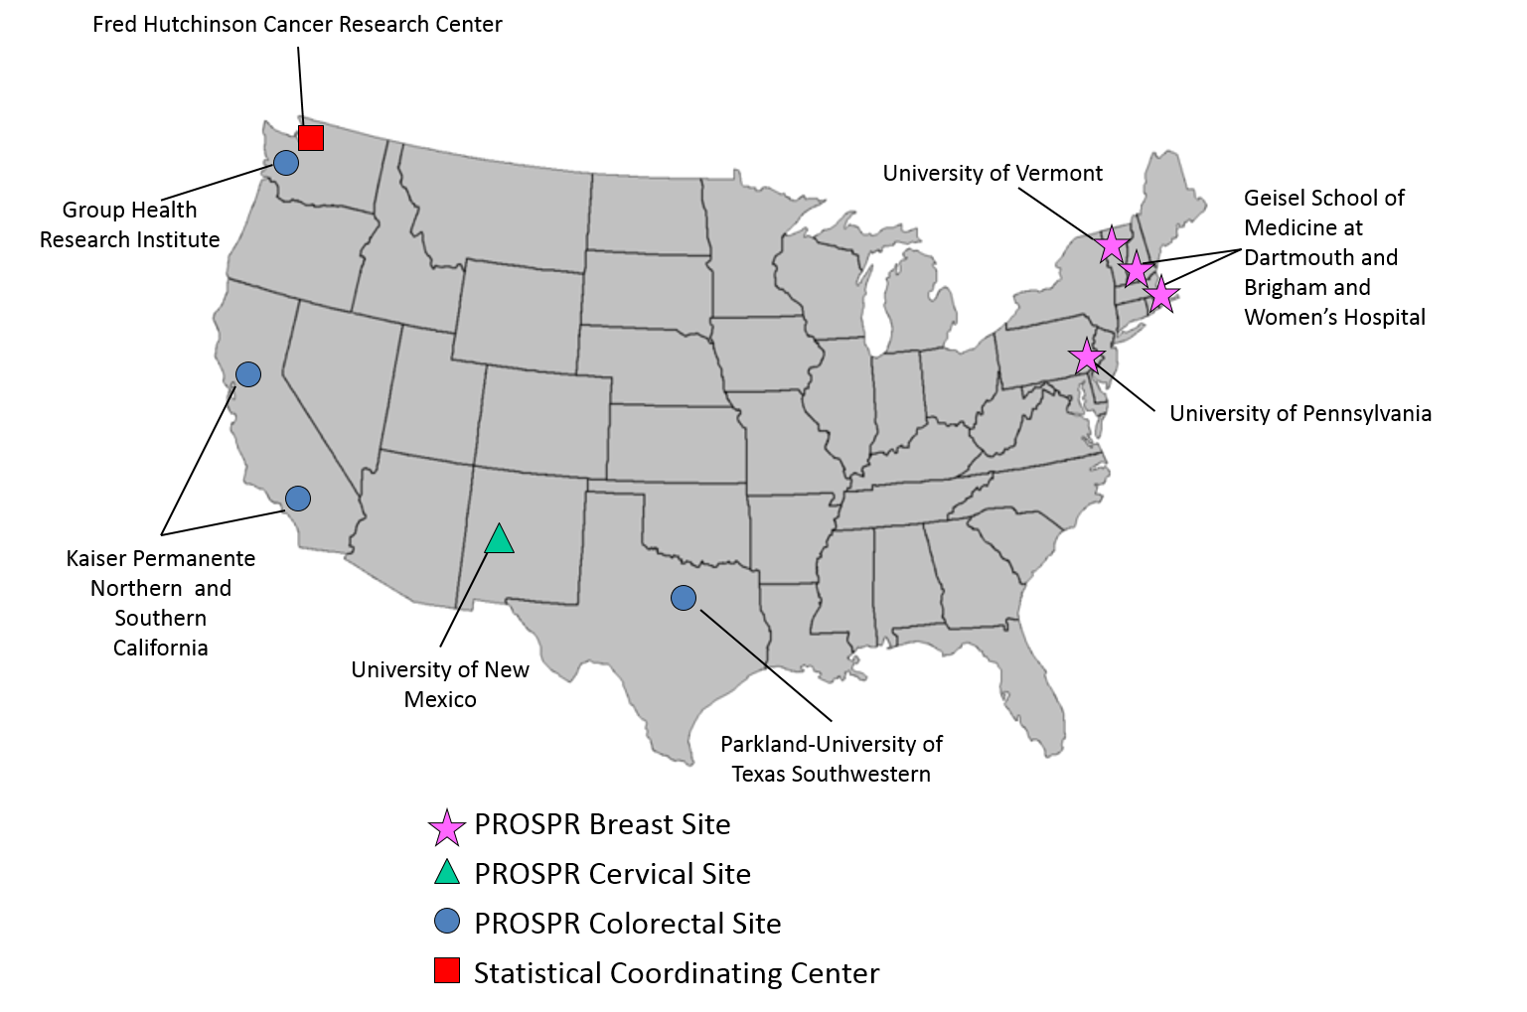
Funded PROSPR Research Centers

Slide 28
Research Networks: NCI Community Oncology Research Program Cancer Care Delivery Research
NCORP is a single network replacing NCI Community Cancer Centers and Clinical Oncology Programs
  Goal: To bring cancer clinical trials and cancer care delivery research to people in their own communities
CCDR
  Emphasizes specialty providers and provider systems in communities often characterized by more care fragmentation
  Integrates delivery research with NCI community-based clinical trials research to improve accrual or rapid dissemination of trial findings
  Includes a focus on access and disparities in care beyond organized health care systems
  http://ncorp.cancer.gov/

Slide 29
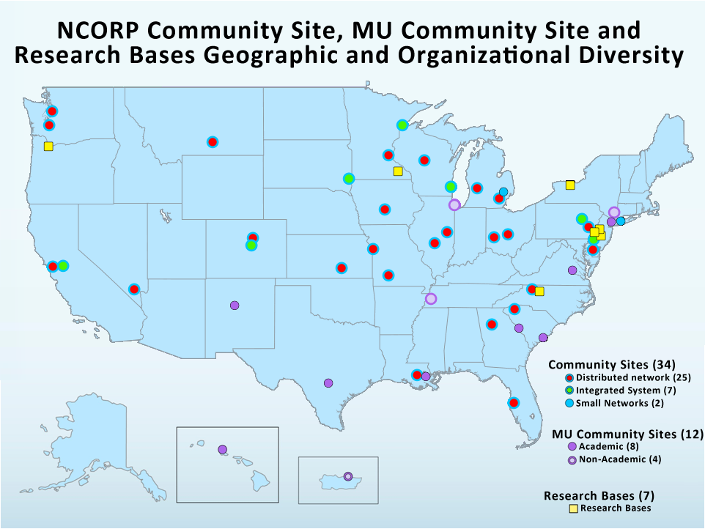

Slide 30
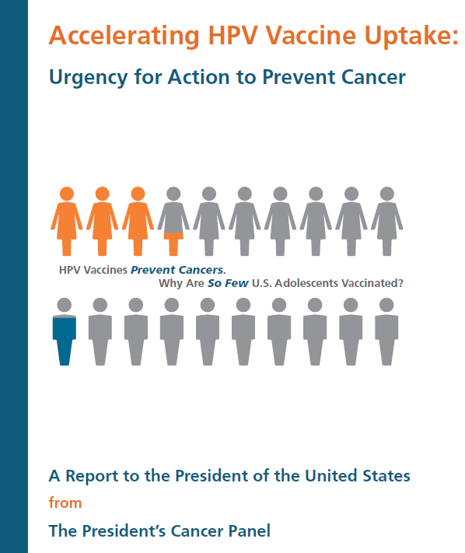
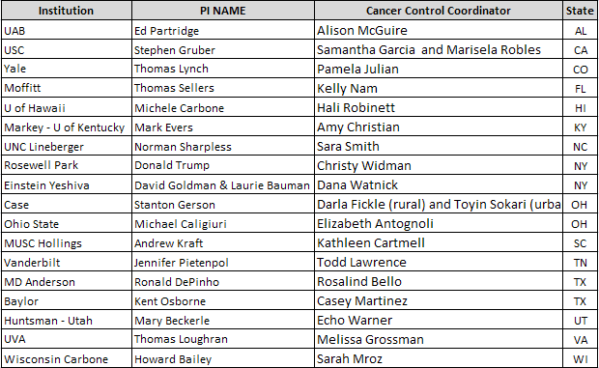
Administrative supplements for NCI cancer centers: collaborations with state and local HPV coalitions and programs

Slide 31
Revisit, Revitalize, and Reposition DCCPS
Identify most important scientific questions and cancer control objectives
Maximize ability to facilitate significant achievements
Support creation of evidence needed for decision-making
Engage extramural community

Slide 32
We live in exciting times
Call us
Take this time to do the hard work

Slide 33
ORB Staff
Ashley Wilder Smith, Chief
Erin Kent
Irene Prabhu Das
Kate Castro
Sandy Mitchell
Neeraj Arora
Notes:
HOPE TO NAME A PERMANENT BRANCH CHIEF BY OCTOBER 1
LISTING NAMES BECAUSE AUDIENCE MAY RECOGNIZE THEM AND GET BETTER ORIENTED

Slide 34
HSEB Staff
Ann Geiger, Chief
Carrie Klabunde
Janet de Moor
Joan Warren
Lindsey Enewold
Lynne Harlan
Mateo Banegas (Fellow)
Nancy Breen
Paul Doria-Rose
Robin Yabroff
Notes:
ANN WILL RETURN TO BRANCH CHIEF ROLE ONCE A PERMANENT ASSOCIATE DIRECTOR FOR HEALTH SERVICES RESEARCH IS IN PLACE
IN INTERIM, BRANCH CHIEF DUTIES WILL BE DELEGATED TO ONE OF THE THREE MOST SENIOR BRANCH MEMBERS (CARRIE, LYNNE, & JOAN)
LISTING NAMES BECAUSE AUDIENCE MAY RECOGNIZE THEM AND GET BETTER ORIENTED

Slide 35


