Slide 1
Evolving public health and health care landscape and opportunities for cancer communication
NCI Health Communication and Informatics Research Branch
CPCRN Meeting December 11-12, 2014
Atlanta, GA

Slide 2

Overview
Introduction
HCIRB Research Priorities
Interest in CPCRN
Opportunities for Collaboration

Slide 3
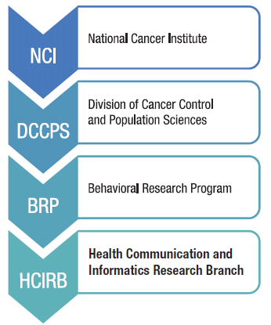
Health Communication and Informatics Research Branch
Mission: To advance research on the processes and effects of communication and informatics across the cancer control continuum.
Scientific Priorities: HCIRB is dedicated to advancing the research and development of communications and technology infrastructure that increases access to and use of cancer information, improves consumer understanding of cancer information, enhances patient-provider interaction, and translates research discoveries into clinical and public health practice.

Slide 4
HCIRB Research Interests
Local level communication surveillance and assessment
Multi-level approaches to communication about cancer prevention and control topics such as vaccination, tobacco use, diet and physical activity
Integration of socioeconomic, cultural, environmental and policy factors into message design, evaluation and dissemination
Rapid approaches to health communication and interventions (e.g. real-time data capture, social media, mobile health)
Interventions to narrow the digital divide and promote health literacy among underserved populations
Factors related to communication inequalities in cancer prevention and control

Slide 5
What are the Opportunities to Partner with CPCRNs?

Slide 6
Evolving Public Health and Health Care Landscape with ACA
ACA Community Health Needs Assessment Requirement Tax exempt hospital facilities are required to:
  Conduct a CHNA every 3 years
  Include input from the broader community
  Include input from people with special knowledge in public health
  Make the CHNA publically available
  Community Health Improvement Plan
Newly insured entering the health system may present additional health literacy and numeracy demands on public health and hospital systems.
Enhanced population connections with new technology and information systems

Slide 7
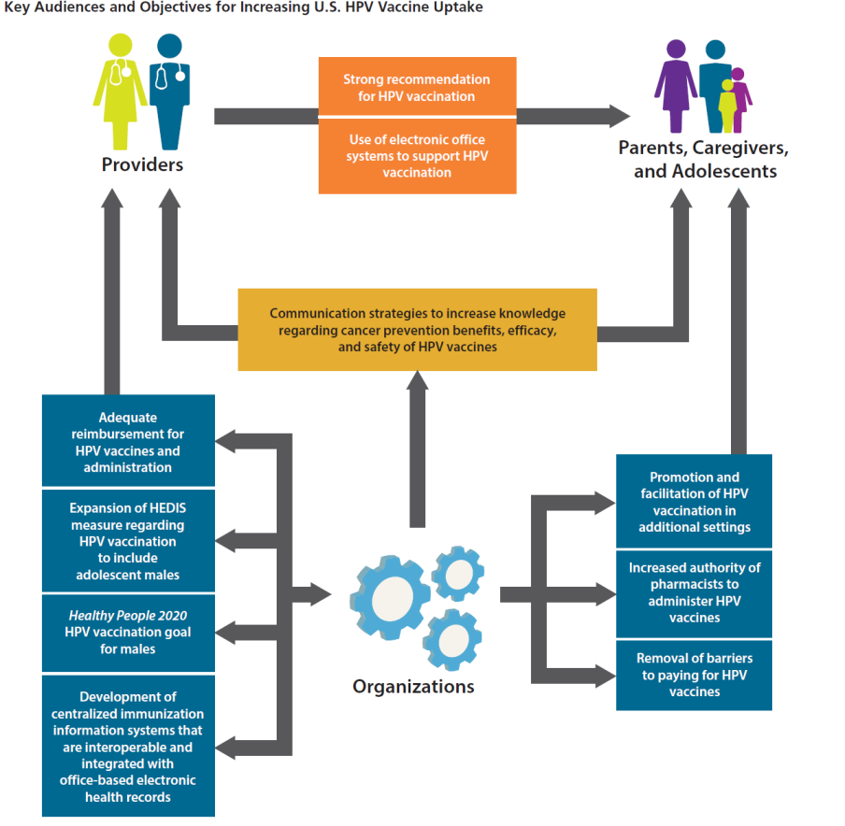
CHNA Opportunities: HPV Example
CHNA
Informs
Integration of community with the health system to reduce risk, improve care coordination and behavior change and maintenance.
Create a learning health community
Integrated, multi-level, and audience communication strategies
Community Health Improvement Plans
(Halfon, et al, Health Affairs, 2014; President’s Cancer Panel Report 2012-13)

Slide 8


Community and Health System Partnership to Meet Local Cancer Control Goals
ACA CHNA : 3 year cycle
Partnership
Needs Assessment
Intervention Identification
Implementation
Evaluation
Communication Science Opportunity:
Engagement
Health Literacy
Systems Coordination
Quantified Community

Slide 9
Questions for CPCRN
Can CHNA be leveraged to measure local communication needs in cancer prevention and control? Can these be scaled up?
  E.g. NCI HINTS Survey at the local level to inform CHNAs for cancer control and prevention
What opportunities exist to merge local epidemiology, health information systems, behavioral research to meet community needs for cancer control and prevention?
    E.g. Chicago’s HealtheRx System
Opportunity to learn about multilevel communication interventions (eg individual and hospital or community and hospital) for reducing Health Disparities/Inequalities?
    E.g. Mexico sugar-sweetened beverage multi-level communication

Slide 10
Advantages of a Network Project
Evaluation of interventions across multiple contexts (health systems and communities)
  What communication interventions for HPV work? Where? Who? When?
Sites focus on multi-level interventions
  Develop understanding of how to coordinate, deliver, evaluate and measure multi-level communication interventions
Share measures and data across sites
Leverage previously established partnerships and disseminate partnership models

Slide 11
Future Directions
National policy level changes promote local community and hospital partnerships with data collection for action
Hospital leaders report a need for capacity building and support for interventions
Evolution towards multi-level communication (simultaneous, parallel, and multiple targets– more than simply an aggregation of individuals) interventions with rapid deployment with new technology and media
CHNA offers a common ground and interest between hospitals and communities to advance cancer prevention and control

Slide 12
Contacts and Questions

