Slide 1
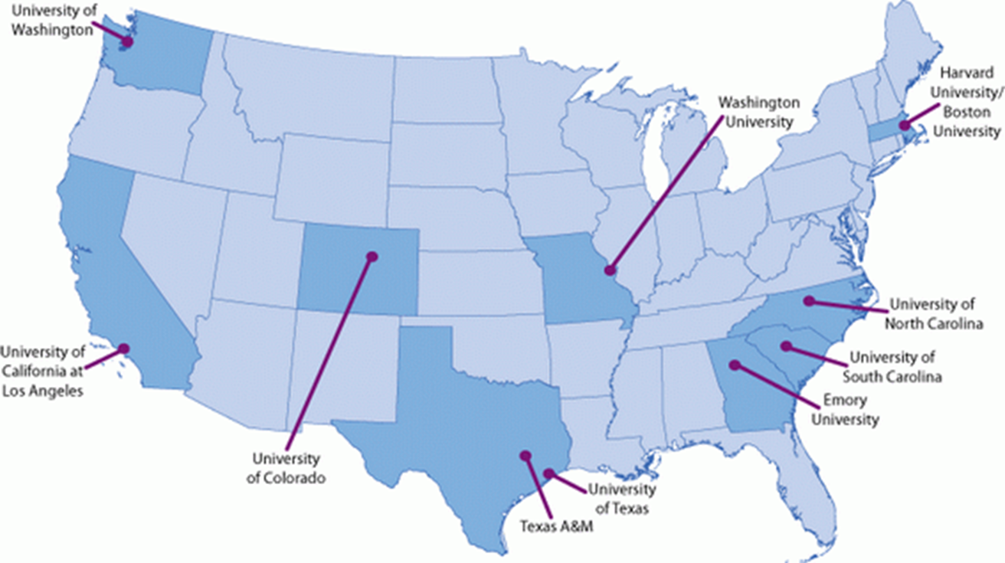
Capacity Building Training and Technical Assistance Workgroup
All 10 Centers Participated
This presentation was supported by Cooperative Agreement Number 1U48DP005017 from the Centers for Disease Control and Prevention. The findings and conclusions in this presentation are those of the author(s) and do not necessarily represent the official position of the Centers for Disease Control and Prevention.
Notes:
If you don’t use the map, be sure to use this slide with the correct grant number. I deleted your old slide with the old grant number.

Slide 2
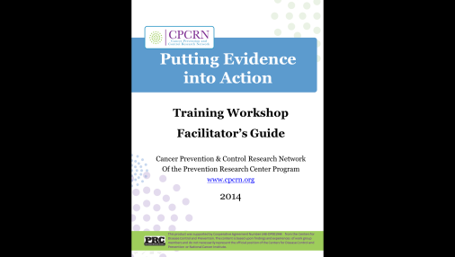
What We Did
Developed 7 module training and Facilitator’s Guide
Led 14 workshops for 600+ practitioners
Consulted with the Community Guide
  Toolbox
  Decision and Implementation Support System
Notes:
Mention
the Manual’s great D&I glossary for practitioners with references that draw on CPCRN work.
training participants at national, state and local levels.
updates related to putting it online with CDC
Also, report on status of putting it online with DAISS or CPCRN. I’m not sure what is going on at this point – but you should say something that’s concrete about when people can see it.
CBTAT will disseminate the Putting Public Health Evidence in Action curriculum, glossary, resource list, and Facilitator’s Guide online at cpcrn.org in September 2014. Materials and past content will be available for CBTAT members via Google Drive.
(NIH R01) A Tailored Aid for Communities Adapting Tested Interventions for Cancer Control (TACTICC): Members of CBTAT contributed to the content development and evaluation surveys. The online decision support system has been developed at UT and is ready for testing. Emory is leading the evaluation.
Emory, UNC and Washington University’s CBTAT members served on the Community Guide Toolbox Website for the CDC Community Guide Branch http://www.thecommunityguide.org/toolbox/
CBTAT members have provided iterative feedback on the CDC Community Guide’s Decision and Implementation Support System (DaISS) development with Price Waterhouse Cooper via in-person meetings and webinar demonstrations

Slide 3
What We Did
Papers under review
Escoffery et al. Assessment of training and technical assistance needs of Colorectal Cancer Control Program Grantees
Kegler et al. Use of mini-grants to disseminate evidence-based interventions for cancer prevention and control
Leeman et al. What strategies are used to build practitioners’ capacity to implement community-based interventions and are they effective?: A systematic review
Notes:
In talking points, say something about implications of first bullet/pub on practice or future CPCRN work. Maybe also on the 3rd bullet. Publications just aren’t enough… important to give examples of their influence on practice or other CPCRN initiatives.

Slide 4
How We Worked Together
Monthly phone conferences
Sub-workgroups
Collaborative review and input on iterative versions of curriculum and papers
Open invitations to assist with trainings
Led by Cam Escoffery with support from Michelle Carvalho (Emory)

Slide 5
What Worked
Collaboration led to shared cross-center understanding of capacity-building processes and terminology
Visibility for CPCRN via presentations at multiple venues
Provision of needed services
Partnership with Community Guide
Centers published findings from local experience delivering versions of curriculum
Notes:
Emphasize provision or needed services to CDC and community practitioners
In talking points describe some specific CDC benefit from the partnership (bullet 4)
What’s the last bullet mean?

Slide 6
What Didn’t Work
Many contributors to curriculum
  Achieving consistency across modules was a long process
Absence of a research agenda

Slide 7
Lessons Learned
Collaborate with local and national partners
Identify research questions up front
Make feasible plans for addressing your questions
List potential publications and research proposals early on
Be strategic when assigning tasks
Engage strong support staff to manage logistics, deliverables, and timelines
Notes:
I think it would be nice to use animation to group and discuss these into lessons learned about 1) collaboration with national partners; 2) research; 3) administration
You want to end on an positive note, and I think everyone would say Michelle did a good job of coordinating. The project managers, will appreciate the nod. I bet they are feeling lost in the start of the CPCRN and trying to figure out where they fit in.

