Slide 1

The Cancer Prevention and Control Research Network (CPCRN)
CPCRN Welcome & Network Progress
January 21, 2021
Stephanie B. Wheeler, PhD MPH
University of North Carolina at Chapel Hill
Principal Investigator, CPCRN Coordinating Center
@CPCRNcancer www.cpcrn.org
@StephWheelerUNC
This presentation is supported by the Centers for Disease Control and Prevention of the U.S. Department of Health and Human Services (HHS) as part of a financial assistance award with 100 percent funded by CDC/HHS (Cooperative Agreement Number U48 DP006400). The contents are those of the author(s) and do not necessarily represent the official views of, nor an endorsement, by CDC/HHS, or the U.S. Government.

Slide 2
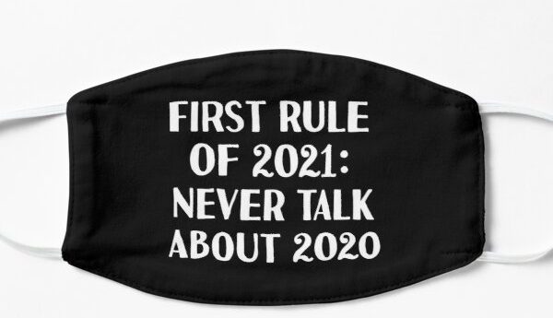

Welcome!!!
We are glad you are here.

Slide 3
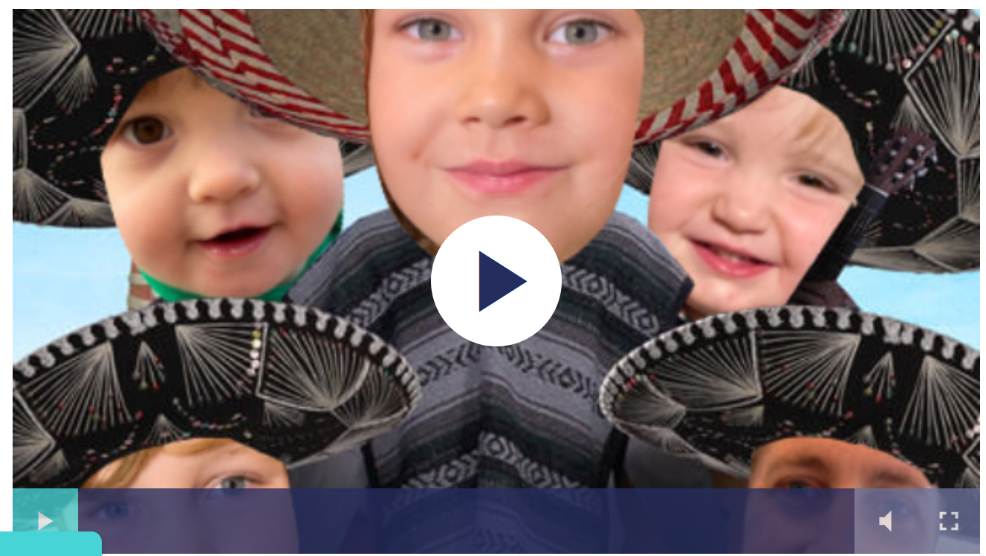
Today’s Agenda:
12:20 CDC and NCI Remarks
12:45 Group Picture (Bring wigs/hats/masks/etc!)
12:50 Break / Informal Conversations
  “Inaugural” Scavenger Hunt
  Crowdsourcing (Listen Up: Podcast Plugs)
  Open Chat/Networking
1:15 Health Equity & Social Determinants
2:00 Break
2:30 Workgroup Presentations
  Scholars; iCollab; Rural; Health Behaviors; Modeling
3:45 Adjourn Day 1

Slide 4
A Few Reminders and Thoughts…
Please remain muted unless you are talking in the meeting (note we’ll have lots of Q&A and open chat opportunities to unmute!)
We understand that life is happening all around you! We love seeing kids, pets, outdoor settings, etc. and appreciate you spending your time with us these next two days
We should be proud of what we’ve accomplished this year! Lets think about the next year…
We want this meeting to be as interactive as possible; please use the chat now to tell us your name + where you live + something people may not know about you

Slide 5
CPCRN Vision
Reduce the burden of cancer in U.S. populations and eliminate cancer disparities
CPCRN Mission
Accelerate the adoption and implementation of evidence-based cancer prevention and control strategies in communities
Enhance large-scale efforts to reach underserved populations and reduce their burden of cancer
Deepen our understanding of the predictable processes that achieve those goals
Develop the D&I workforce in cancer prevention and control

Slide 6
CPCRN Network Map
Network Geographic Map

Slide 7
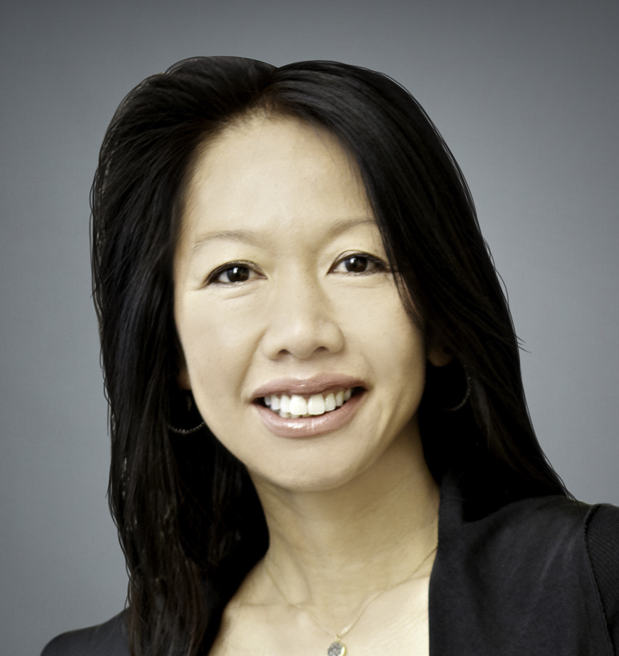
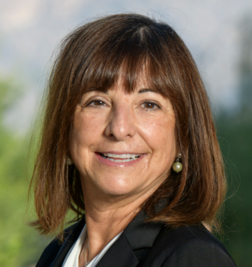
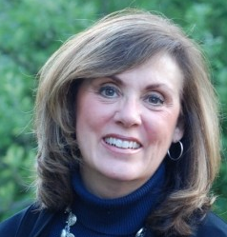
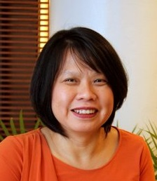
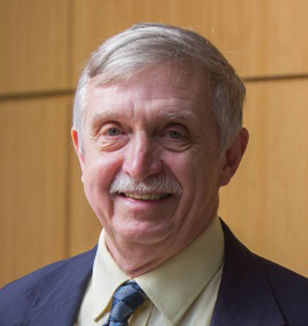
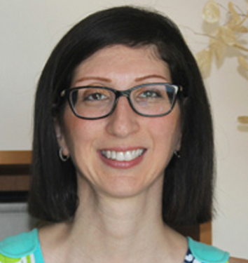
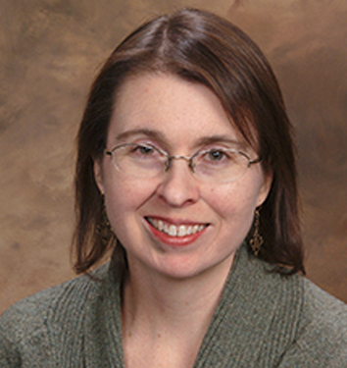
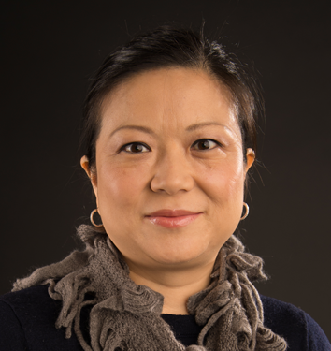
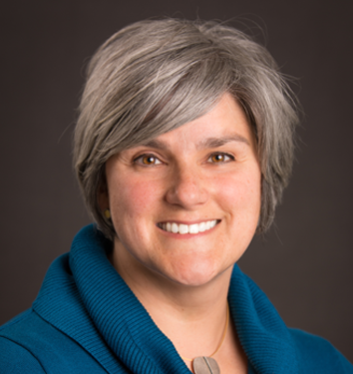
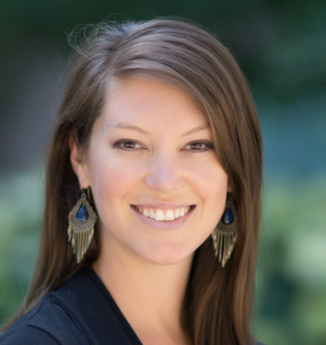
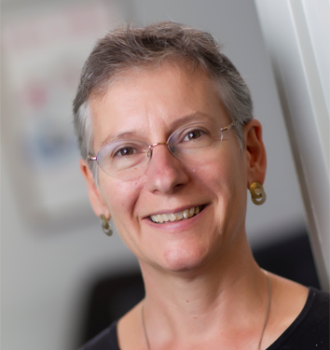
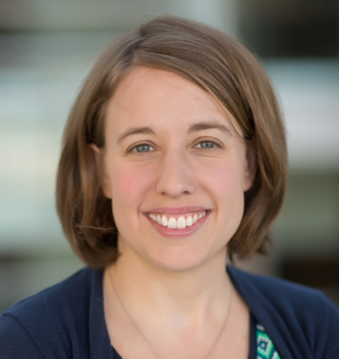
Chau Trinh-Shevrin, DrPH
New York University
Cyndi Thomson, PhD
University of Arizona
Betsy Risendal, PhD
Colorado School of Public Health
Cam Escoffery, PhD
Emory University
James R Hébert, ScD
University of South Carolina
Daniela Friedman, PhD
University of South Carolina
Peggy Hannon, PhD
University of Washington
Linda Ko, PhD
University of Washington
Natoshia Askelson, PhD
University of Iowa
Stephanie Wheeler, PhD
University of North Carolina
Jennifer Leeman, DrPH
University of North Carolina
Alison Brenner, PhD
University of North Carolina
Principal Investigators

Slide 8
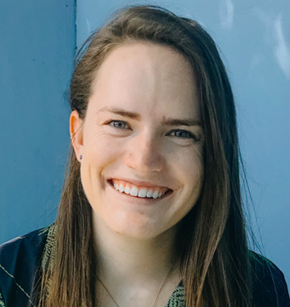
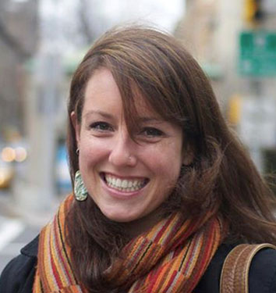
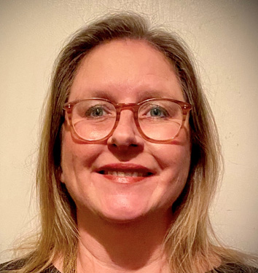
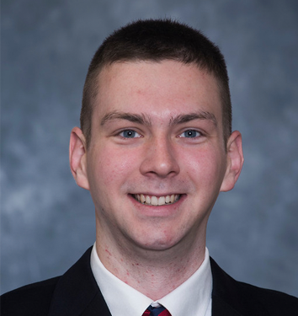
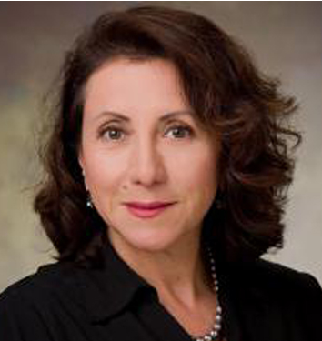
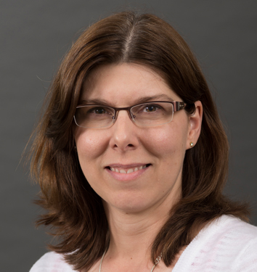
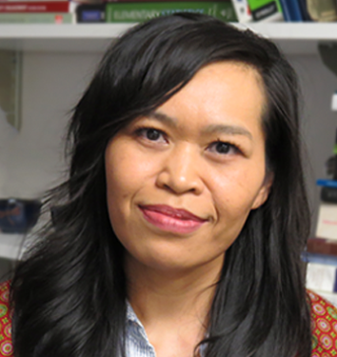
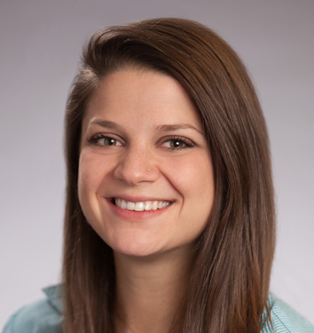
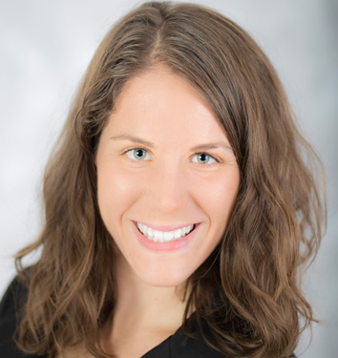
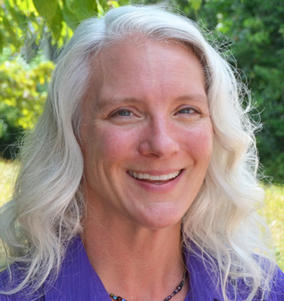
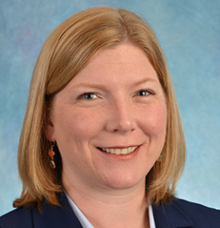
Emily Bilenduke, MA
Colorado School of Public Health
Victoria Foster, MPH
New York University
Julie Kranick, MA, MPhil
New York University
Sam Noblet, MPH
University of South Carolina
Rosi Vogel, BBA/MBA
University of Arizona
Heidi Haines, MS
University of Iowa
Thuy Vu, MPH
University of Washington
Christine Agnone, MPH
Emory University
Mary Wangen, MPH
University of North Carolina
Catherine Rohweder, DrPH
University of North Carolina
Becky Lee, MS
University of North Carolina
Project Directors

Slide 9
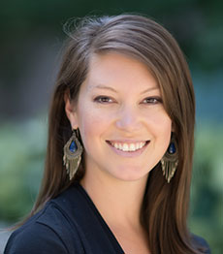
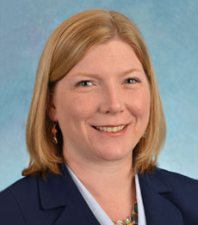
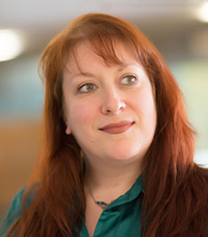
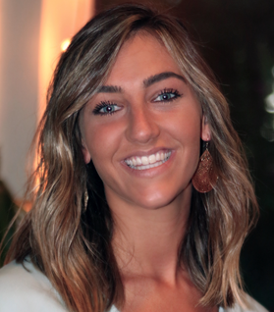
Coordinating Center Team
University of North Carolina at Chapel Hill
Agenda
Stephanie Wheeler, PhD
Principal Investigator
Becky Lee, MS
Project Director
Rebecca Williams, PhD
Co-investigator
Alexa Young, MPH
Research Associate

Slide 10
Overview of Current
Cross-Center Activities
Survivorship
Rural Cancer
iCollab
Organizational Theory for Implementation Science
CPCRN Scholars
Health Behaviors
Cancer & COVID-19
Cancer Screening Change Package
Health Equity & Social Determinants of Health
Modeling Evidence-Based
Intervention Impact
Multiple Cancer Prevention and Control
www.CPCRN.org/projects

Slide 11
Contacts for Cross-Center Activities
Activity | Project Director(s) | Email Address(es)
CPCRN Scholars | Christine Agnone Sam Noblet | christine.agnone@emory.edu noblet@mailbox.sc.edu
Health Behaviors | Thuy Vu | thuytvu@uw.edu
Health Equity & SDOH | Julie Kranick Victoria Foster | julie.kranick@nyulangone.org victoria.foster@nyulangone.org
iCollab | Catherine Rohweder Emily Bilenduke | rohweder@email.unc.edu emily.bilenduke@ucdenver.edu
Organizational Theory for Implementation Science | Mary Wangen Alex Peluso | wange062@live.unc.edu apeluso@wakehealth.edu
Rural Cancer | Heidi Haines | heidi-haines@uiowa.edu
Survivorship | Rosi Vogel | rosimvogel@arizona.edu
Cancer Screening Change Package | Lindsay Stradtman | lindsay.stradtman@unc.edu
Multiple Cancer Prevention and Control | Jade Avelis | jade.avelis@pennmedicine.upenn.edu
Modeling EBI Impact | Sarah Drier | sarah.drier@unc.edu

Slide 12
Impact of CPCRN
By the Numbers
CPCRN5 Year 1 | 150 Publications | $26.5M in Funded Grants | 111 Presentations | 16 Trainings
Since 2004 | 1,940 Publication | $695M in Funded Grants | 2,110 Presentations | 70 Trainings* *past 4 years only
Beyond the Numbers
Disseminating Science
Investigator Awards/Honors
Quotable Feedback
Funding
Awards
Partnering
Externally
COVID-19 Interest Group Manuscripts
Investigators selected to receive 12 awards
Quotes on NYU-CUNY’s Stomp Out Cancer Brooklyn
39 grants awarded to CPCRN Centers/
Investigators
Presentations to National Organizations/Partners

Slide 13
Impact of CPCRN: Beyond the Numbers Cont’d
Disseminating Science
Under the newly-formed COVID-19 CPCRN Interest Group, members collaborated on two manuscripts during the previous funding year:
COVID-19 Manuscripts Submitted to the American Journal of Preventive Medicine:
“What Can We Learn from a Decade of Cancer Prevention and Control Programs to Guide the US Response to COVID-19? Perspectives from the Cancer Prevention and Control Research Network”
“Addressing Cancer Survivorship Care under COVID-19: Perspectives from the Cancer Prevention and Control Research Network

Slide 14
Impact of CPCRN: Beyond the Numbers Cont’d
Investigator Awards and Honors
CPCRN investigators selected as award recipients
Highlight: Dr. Jan Eberth, co-I of USC, selected to receive two awards during the previous funding year:
President-Elect of the American College of Epidemiology
National Rural Health Association Outstanding Researcher Award

Slide 15
Impact of CPCRN: Beyond the Numbers Cont’d
Quotable Feedback
Positive feedback, anecdotes, or quotes CPCRN Centers or members receive as a result of their work
Highlight: Quote submitted by NYU-CUNY about Stamp Out Cancer Brooklyn (SOCB)
”SOCB [NYU's community outreach and engagement core] offers an opportunity to build trust with the community, as well as leadership buy-in for essential cancer wraparound services like financial counseling/
navigation to connect uninsured people to high quality care with cultural competency and free from shame.” – Dr. Marilyn Fraser, CEO of Arthur Ashe Institute for Urban Health, SOCB Kick-Off Retreat, 2/27/2020

Slide 16
Impact of CPCRN: Beyond the Numbers Cont’d
Funding Awards
Funded grants awarded to CPCRN Centers or members
Highlights:
“Screening More Patients for CRC through Adapting and Refining Targeted Evidence-Based Interventions in Rural Settings (SMARTER CRC)” ($5M awarded to investigators that are part of the Modeling EBI Impact Workgroup)
Rapid Acceleration of Acceptable COVID Testing and Care Options for NYC Public Housing Residents ($2M R01 awarded to investigators at NYU-CUNY)

Slide 17
Impact of CPCRN: Beyond the Numbers Cont’d
Partnering Externally
Presentations delivered to national orgs/partners
Highlights:
“Financial Incentives and Increasing Colorectal Cancer Screening in Disparity Populations”
  Green BB. Invited oral presentation presented at the National Colorectal Cancer Screening Roundtable; November 21, 2019; Baltimore, MD.
“Replicating a Successful Patient Navigation Intervention to Increase Colonoscopy Completion: Challenges & Adaptations”
  Hannon, P. Oral presentation presented at the CDC Cancer Division; November 2019; Atlanta, GA.

Slide 18

Connect with CPCRN
Questions?
Find us on the web
@www.CPCRN.org
Stephanie B. Wheeler, PhD MPH
Principal Investigator
CPCRN Coordinating Center
919.966.7374
stephanie_wheeler@unc.edu
@StephWheelerUNC
Follow us on Twitter @CPCRNCancer
Becky Lee, MS
Project Director
CPCRN Coordinating Center
919.966.2812
beckylee@unc.edu
Like us on Facebook
@CPCRN
Notes:
Thank you for taking this opportunity to learn about the Cancer Prevention and Control Research Network. I invite you to connect with CPCRN through our website, CPCRN.org as well as our Twitter and Facebook accounts. You can also reach out anytime to me or the Coordinating Center project director, Becky Lee, using the contact information on this slide.

Slide 19

CPCRN Kumu Relationship Map of Members’ Areas of Expertise
https://cpcrn.kumu.io/cpcrn-members-areas-of-expertise-2021

