Slide 1

The Cancer Prevention and Control Research Network (CPCRN)
CPCRN Orientation &
Becoming More Involved in the Network
January 21, 2021
Stephanie B. Wheeler, PhD MPH
University of North Carolina at Chapel Hill
Principal Investigator, CPCRN Coordinating Center
@CPCRNcancer www.cpcrn.org
@StephWheelerUNC
This presentation is supported by the Centers for Disease Control and Prevention of the U.S. Department of Health and Human Services (HHS) as part of a financial assistance award with 100 percent funded by CDC/HHS (Cooperative Agreement Number U48 DP006400). The contents are those of the author(s) and do not necessarily represent the official views of, nor an endorsement, by CDC/HHS, or the U.S. Government.

Slide 2
Agenda
CPCRN Overview, Stephanie Wheeler
Progress Reporting and CPCRN Website, Rebecca Williams
CPCRN Communications Plan, Alexa Young
Workgroup Engagement, Becky Lee

Slide 3
CPCRN Overview

Slide 4
CPCRN Vision
Reduce the burden of cancer in U.S. populations and eliminate cancer disparities
CPCRN Mission
Accelerate the adoption and implementation of evidence-based cancer prevention and control strategies in communities
Enhance large-scale efforts to reach underserved populations and reduce their burden of cancer
Deepen our understanding of the predictable processes that achieve those goals
Develop the D&I workforce in cancer prevention and control

Slide 5
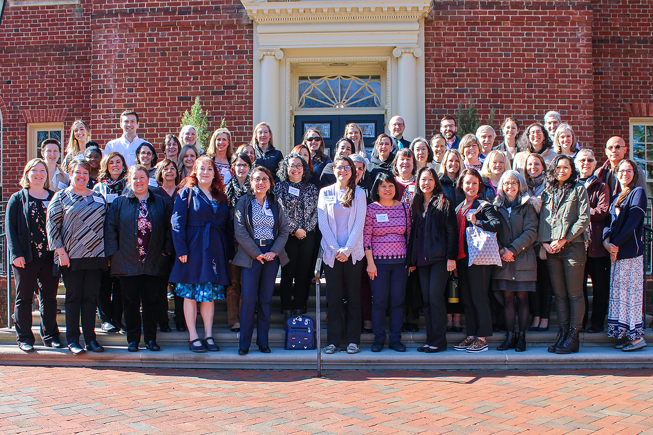
A Brief CPCRN History
The largest (and oldest) thematic research network of the CDC-funded Prevention Research Centers
Conducts community-based participatory cancer research across network centers
Pursues objectives of extending the knowledge base of research translation for evidence-based cancer control activities
A network with broad geographic reach and strong relationships among investigators allows us to achieve more than any individual center could on its own

Slide 6
Funded CPCRN Centers
CPCRN1 2002-2004 | CPCRN2 2004-2009 | CPCRN3 2009-2014 | CPCRN4 2014-2019 | CPCRN5 2019-2024
University of Washington | University of Washington | University of Washington | University of Washington | University of Washington
University of South Carolina | Morehouse School of Medicine | University of South Carolina | University of South Carolina | University of South Carolina
University of Kentucky – West Virginia University | Emory University | Emory University | University of Kentucky | Emory University
Harvard University | Harvard University | Harvard University | University of Pennsylvania | New York University - City University of New York
University of Texas, Houston | University of Texas, Houston | University of Texas, Houston | Case Western Reserve University | University of Arizona
 | University of North Carolina (Coordinating & Collaborating Centers) | University of North Carolina (Coordinating & Collaborating Centers) | University of North Carolina (Coordinating & Collaborating Centers) | University of North Carolina (Coordinating & Collaborating Centers)
 | St. Louis University/Washington University in St. Louis | Colorado School of Public Health | Oregon Health & Science University | Colorado School of Public Health
 | University of California, Los Angeles | University of California, Los Angeles | University of Iowa | University of Iowa
 |  | Washington University in St. Louis

Slide 7
CPCRN Network Map
Network Geographic Map

Slide 8
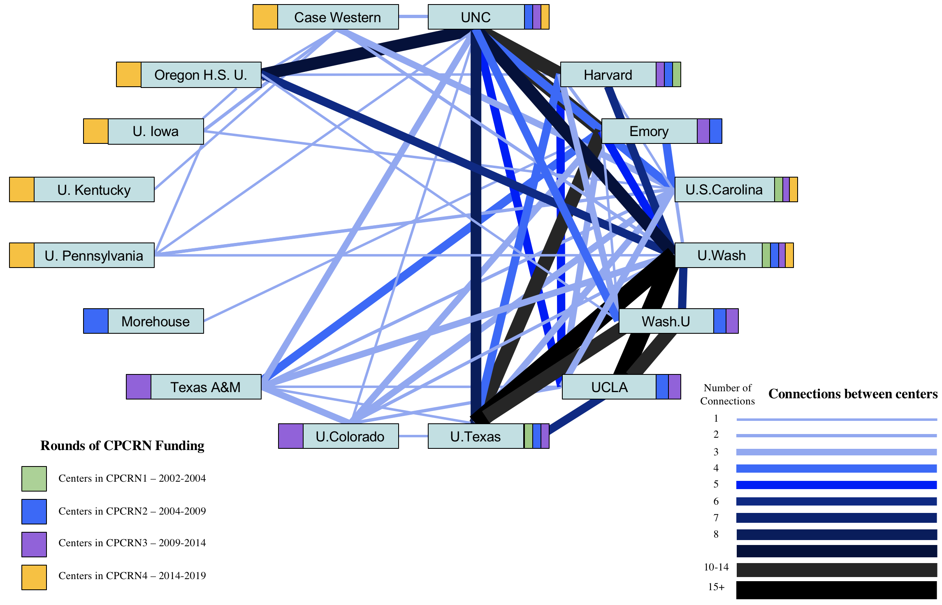
Network Diagram: CPCRN Multicenter Publications 2004-2018

Slide 9
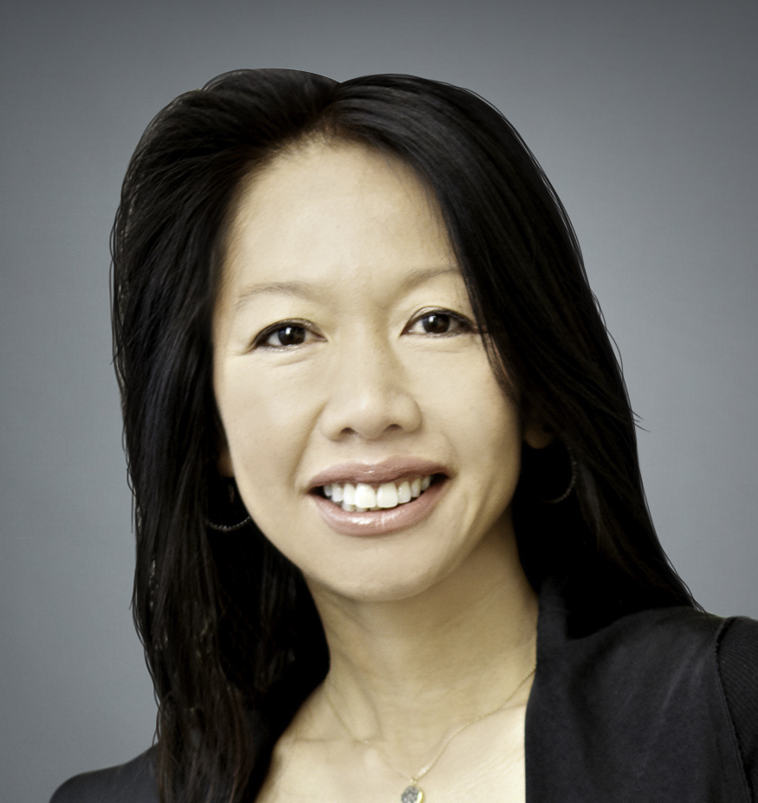
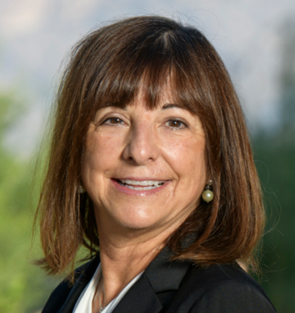
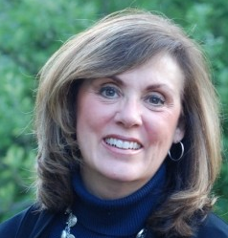
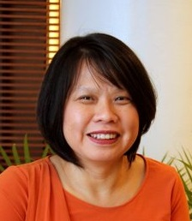
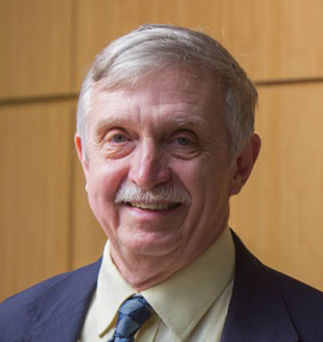
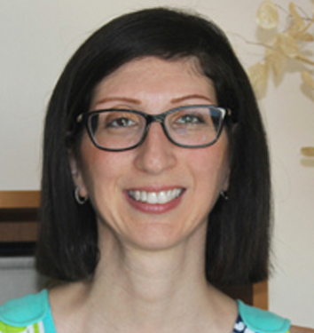
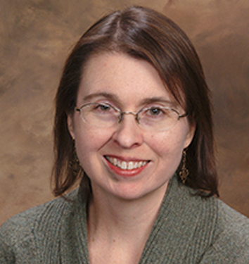
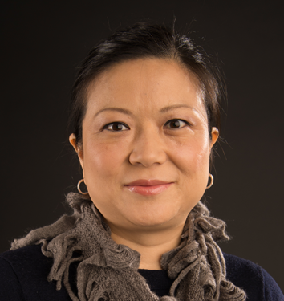
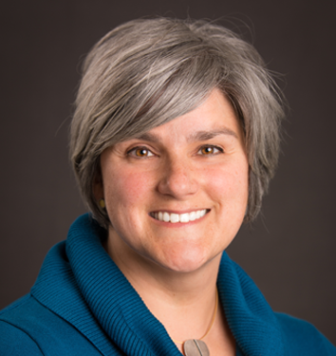
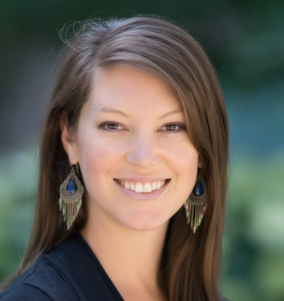
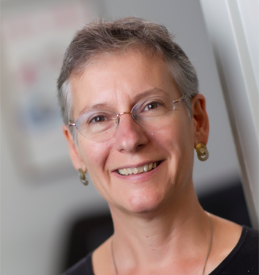
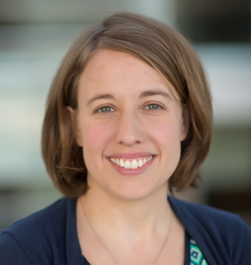
Chau Trinh-Shevrin, DrPH
New York University
Cyndi Thomson, PhD
University of Arizona
Betsy Risendal, PhD
Colorado School of Public Health
Cam Escoffery, PhD
Emory University
James R Hébert, ScD
University of South Carolina
Daniela Friedman, PhD
University of South Carolina
Peggy Hannon, PhD
University of Washington
Linda Ko, PhD
University of Washington
Natoshia Askelson, PhD
University of Iowa
Stephanie Wheeler, PhD
University of North Carolina
Jennifer Leeman, DrPH
University of North Carolina
Alison Brenner, PhD
University of North Carolina
Principal Investigators

Slide 10
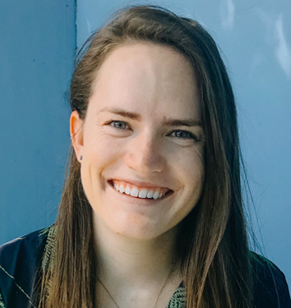
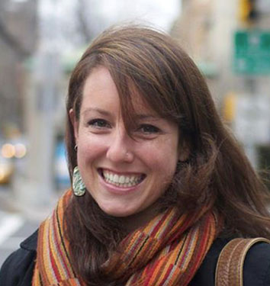
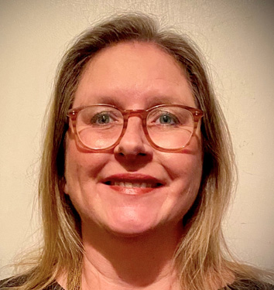
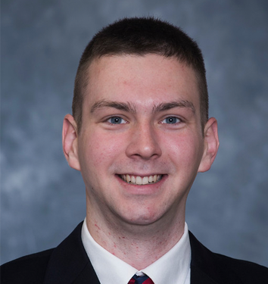
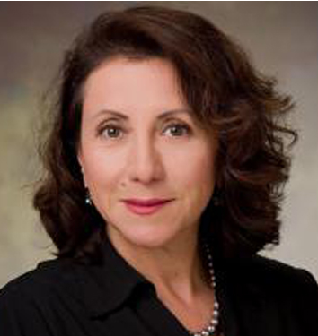
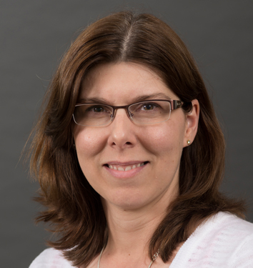
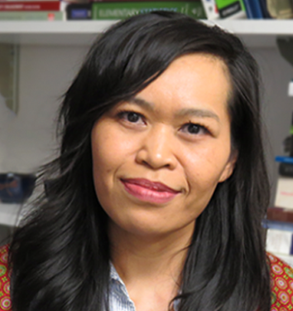
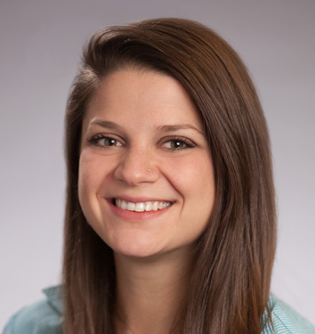
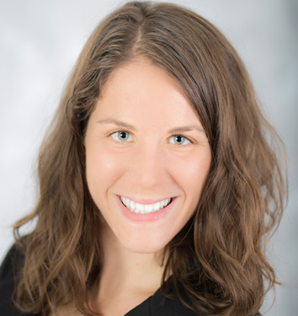
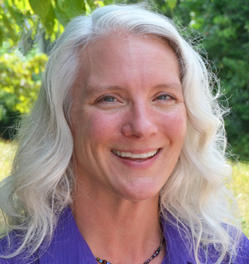
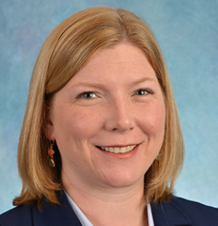
Emily Bilenduke, MA
Colorado School of Public Health
Victoria Foster, MPH
New York University
Julie Kranick, MA, MPhil
New York University
Sam Noblet, MPH
University of South Carolina
Rosi Vogel, BBA/MBA
University of Arizona
Heidi Haines, MS
University of Iowa
Thuy Vu, MPH
University of Washington
Christine Agnone, MPH
Emory University
Mary Wangen, MPH
University of North Carolina
Catherine Rohweder, DrPH
University of North Carolina
Becky Lee, MS
University of North Carolina
Project Directors

Slide 11
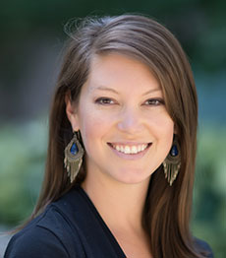
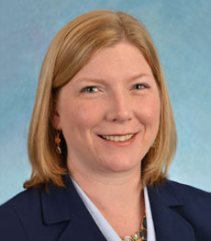
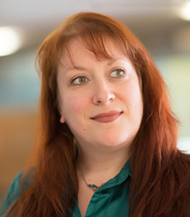
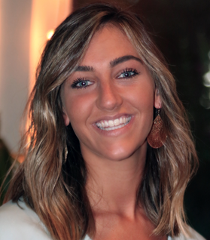
Coordinating Center Team
University of North Carolina at Chapel Hill
Agenda
Stephanie Wheeler, PhD
Principal Investigator
Becky Lee, MS
Project Director
Rebecca Williams, PhD
Co-investigator
Alexa Young, MPH
Research Associate

Slide 12
CPCRN Strategic Plan
Updated March 2018
This document is used to guide the Network moving forward and to reflect on past Network activities.

Slide 13
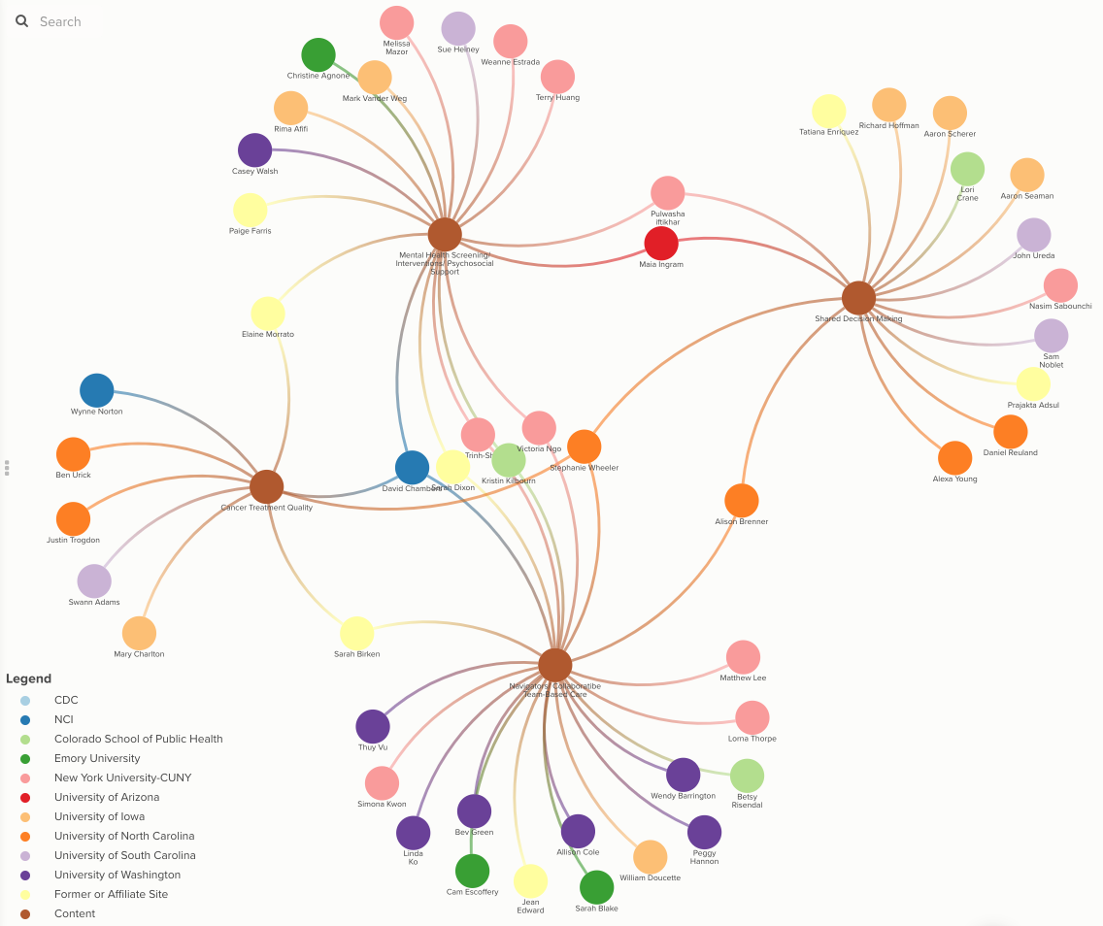
CPCRN Kumu Relationship Map of Members’ Areas of Content Expertise: Cancer Treatment
Content Expertise: Cancer Treatment
(represented by numbered brown dots; other dots represent CPCRN members)
Navigators/ Team-Based Care
Cancer Treatment Quality
Shared Decision Making
Mental Health/ Psychosocial Support
4
3
2
1

Slide 14
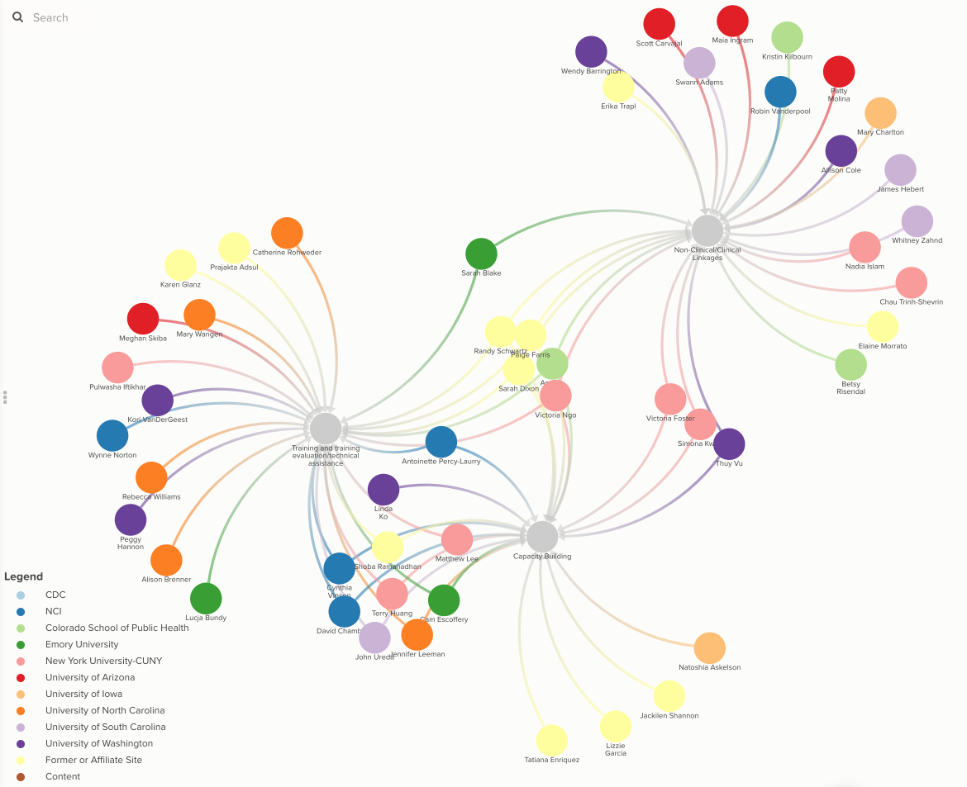
CPCRN Kumu Relationship Map of Members’ Areas of Methods Expertise:
Research Facilitation
Methods Expertise: Research Facilitation
(represented by numbered grey dots; other dots represent CPCRN members)
Training/Tech Assistance
Capacity Building
Non-Clinical Linkages
3
1
2

Slide 15
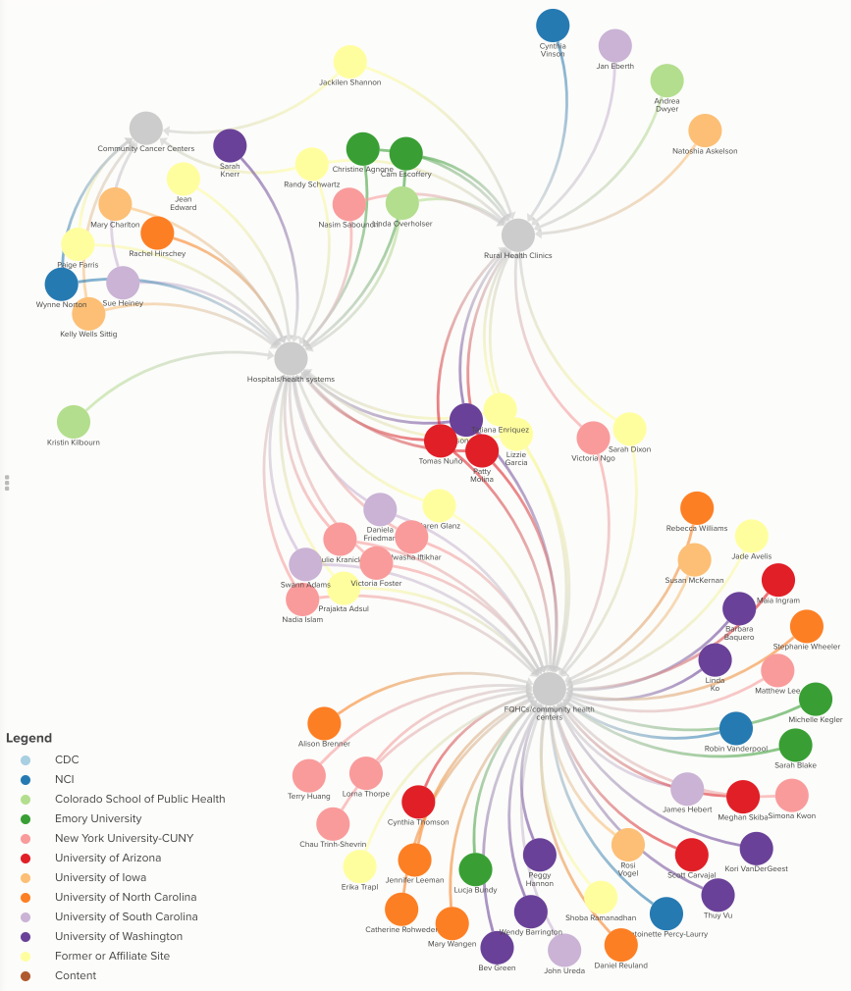
CPCRN Kumu Relationship Map of Members’ Areas of Partner Expertise: Providers
Setting/Partner Expertise: Providers
(represented by numbered grey dots; other dots represent CPCRN members)
FQHCs
Hospitals/Health Systems
Rural Health Clinics
Community Cancer Centers
4
3
2
1

Slide 16
CPCRN Organizational Structure
Federal Agency Partners
Cross-Center Activities
Coordinating Center
Collaborating Centers
Steering Committee
Affiliate Members
Notes:
Annual in-person network meeting (Spring)
Periodic in-person ‘add-on’ meetings (e.g., D&I Conference, CDC National Cancer Conference)
Monthly Steering Committee Calls
Monthly Steering Committee Co-Chair Calls
Monthly Federal Agency Partner Calls with Coordinating Center
Biweekly or monthly workgroup calls
Ad-hoc meetings as needed

Slide 17
Opportunities to Become
Involved in CPCRN
1
Through CPCRN Cross-Center Activities, Network members have an opportunity to collaborate across academic institutions and geographic boundaries around common topics of interest. Activities include Workgroups, interest groups, and ad hoc projects.
CPCRN Affiliate Membership is open to investigators outside of collaborating centers who have interest in and capability to contribute to the mission and goals of CPCRN. To apply, download the application form at www.cpcrn.org/member-resources?open_col=51, and send the completed form and a CV to beckylee@unc.edu.
2
The CPCRN Scholars Program strives to educate students, postdoctoral fellows, junior faculty, practitioners, and other health professionals in dissemination and implementation (D&I) science focused on cancer prevention & control and health equity. To learn more, email christine.agnone@emory.edu and noblet@mailbox.sc.edu.
3

Slide 18
Overview of Current
Cross-Center Activities
Survivorship
Rural Cancer
iCollab
Organizational Theory for Implementation Science
CPCRN Scholars
Health Behaviors
Cancer & COVID-19
Cancer Screening Change Package
Health Equity & Social Determinants of Health
Modeling Evidence-Based
Intervention Impact
Multiple Cancer Prevention and Control
www.CPCRN.org/projects

Slide 19
Contacts for Cross-Center Activities
Activity | Project Director(s) | Email Address(es)
CPCRN Scholars | Christine Agnone Sam Noblet | christine.agnone@emory.edu noblet@mailbox.sc.edu
Health Behaviors | Thuy Vu | thuytvu@uw.edu
Health Equity & SDOH | Julie Kranick Victoria Foster | julie.kranick@nyulangone.org victoria.foster@nyulangone.org
iCollab | Catherine Rohweder Emily Bilenduke | rohweder@email.unc.edu emily.bilenduke@ucdenver.edu
Organizational Theory for Implementation Science | Mary Wangen Alex Peluso | wange062@live.unc.edu apeluso@wakehealth.edu
Rural Cancer | Heidi Haines | heidi-haines@uiowa.edu
Survivorship | Rosi Vogel | rosimvogel@arizona.edu
Cancer Screening Change Package | Lindsay Stradtman | lindsay.stradtman@unc.edu
Multiple Cancer Prevention and Control | Jade Avelis | jade.avelis@pennmedicine.upenn.edu
Modeling EBI Impact | Sarah Drier | sarah.drier@unc.edu

Slide 20
Impact of CPCRN
By the Numbers
CPCRN5 Year 1 | 150 Publications | $26.5M in Funded Grants | 111 Presentations | 16 Trainings
Since 2004 | 1,940 Publication | $695M in Funded Grants | 2,110 Presentations | 70 Trainings* *past 4 years only
Beyond the Numbers
Disseminating Science
Creating Awareness
Effecting
Change
Dissemination Communications
CPCRN Supplemental Issue of Preventive Medicine ¹
Putting Public Health Evidence Into Action Training ²
CPCRN Scholars Program
UNC ImpSci Initiative
https://www.cpcrn.org/news?open_id=73
https://www.cpcrn.org/training
Notes:
FINISH

Slide 21
Impact of CPCRN: Beyond the Numbers Cont’d
Disseminating Science
CPCRN Supplemental Issue of Preventive Medicine
12-article issue, published in December 2019
Contributions were made by investigators from all 8 participating Collaborating Centers in CPCRN4
Examined stakeholder-engaged implementation science and population approaches to improve equity in cancer prevention and control

Slide 22
Impact of CPCRN: Beyond the Numbers Cont’d
Creating Awareness
Putting Public Health Evidence Into Action Training
Developed during CPCRN3 (2009-2014) funding cycle
Interactive training curriculum designed to build practitioners’ general capacity for evidence-based decision-making
In the last year: 1,545 total pageviews;1,079 (70%) of which were first-time visitors

Slide 23
Impact of CPCRN: Beyond the Numbers Cont’d
Effecting Change
CPCRN Scholars Program
Developed during CPCRN5, Year 1 (2020)
Established to educate students, postdoctoral fellows, junior faculty, practitioners, and other health professionals in dissemination and implementation (D&I) science, with a focus on cancer prevention & control and health equity.

Slide 24
Impact of CPCRN: Beyond the Numbers Cont’d
Dissemination Communications
UNC ImpSci Initiative
Established in the previous funding year (CPCRN5 Year 1) as an initiative to raise awareness of IS research happening within UNC
In the last year, the Twitter account, @UNCImpSci:
  Gained 1,000+ new followers
  Launched 3 major campaigns about IS-related events occurring at or in collaboration with UNC
Notes:
FINISH

Slide 25
Progress Reporting
and CPCRN Website

Slide 26
CPCRN Progress Reporting: Overview of Reporting Obligations
The network progress report includes:
Individual Network center reporting
Workgroup reporting
Coordinating Center reporting
Due yearly on December 15th for the previous September 30th-September 29th grant period.
What Needs to Be Reported:
Publications
Presentations
Research Activities
Mini-Grants
Grant Applications
Awards/ Honors
Trainings
Requests for Scientific Expertise
Activities that Catalyze Action/ Effect Change
Dissemination Communications
Reports, Plans, and Policies
Quotable Feedback and Anecdotes

Slide 27
CPCRN
Communications Plan

Slide 28
CPCRN Communications Plan
Goal: Promote broader awareness of, and engagement with CPCRN through strategic and effective dissemination of research related to cancer prevention & control and D&I science, with the aim of enhancing the reputation of the Network as a national leader in these fields.
Communications Channels:
  Scientific Publications and Presentations
  CPCRN Website (www.cpcrn.org)
  Social Media: Twitter (@CPCRNCancer); Facebook (@CPCRN)
  Quarterly CPCRN Newsletter
  CPCRN Listserv
Website
Coordinating Center
Social Media
News
Newsletter
Listserv

Slide 29
Workgroup Engagement

Slide 30
Workgroup Engagement
Workgroup member roles may include, but are not limited to:
  Development and management of IRB applications
  Research design, recruitment, qualitative/quantitative data collection/analysis
  Contacting and engaging partner organizations
  Drafting and reviewing abstracts, presentations, and manuscripts
  Grant proposals
  Trainings/workshops
  Intervention development and evaluation
  Attendance at national conferences, stakeholder meetings, and other public venues to present CPCRN work
Collaborating centers contribute resources towards Workgroup expenses (i.e. participant incentives, transcription, and publication fees, among others).

Slide 31

Connect with CPCRN:
Questions?
Find us on the web:
www.CPCRN.org
Stephanie B. Wheeler, PhD MPH
Principal Investigator
CPCRN Coordinating Center
919.966.7374
stephanie_wheeler@unc.edu
@StephWheelerUNC
Follow us on Twitter:
@CPCRNCancer
Becky Lee, MS
Project Director
CPCRN Coordinating Center
919.966.2812
beckylee@unc.edu
Like us on Facebook
@CPCRN
Notes:
Thank you for taking this opportunity to learn about the Cancer Prevention and Control Research Network. I invite you to connect with CPCRN through our website, CPCRN.org as well as our Twitter and Facebook accounts. You can also reach out anytime to me or the Coordinating Center project director, Becky Lee, using the contact information on this slide.

