Slide 1
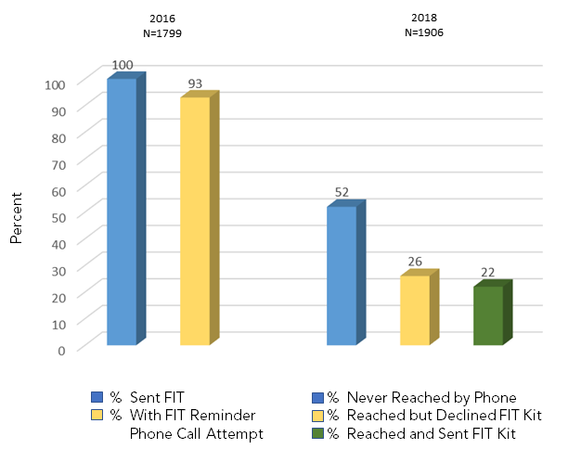
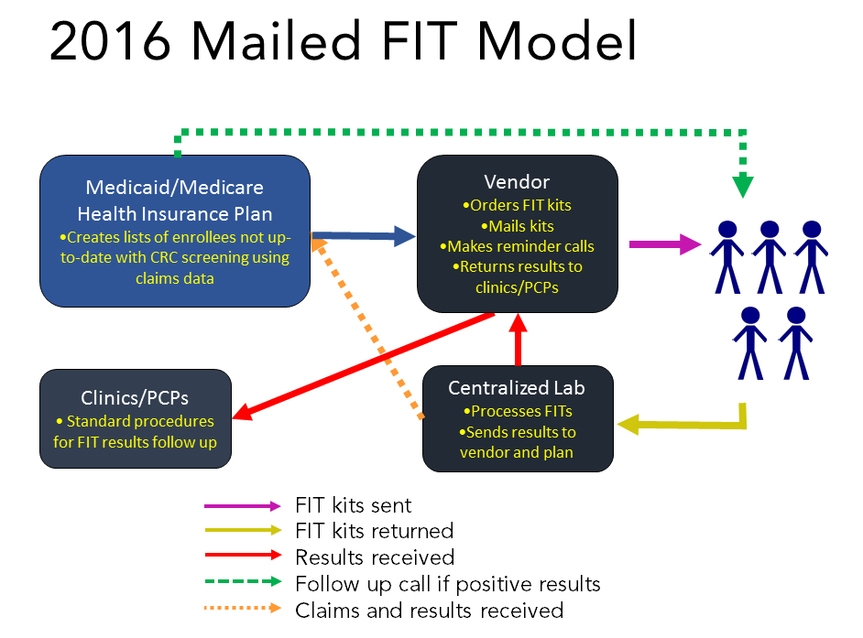
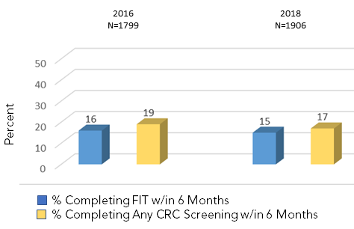
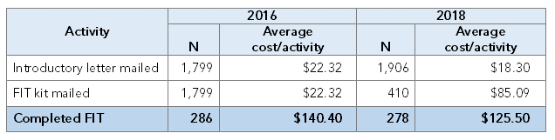
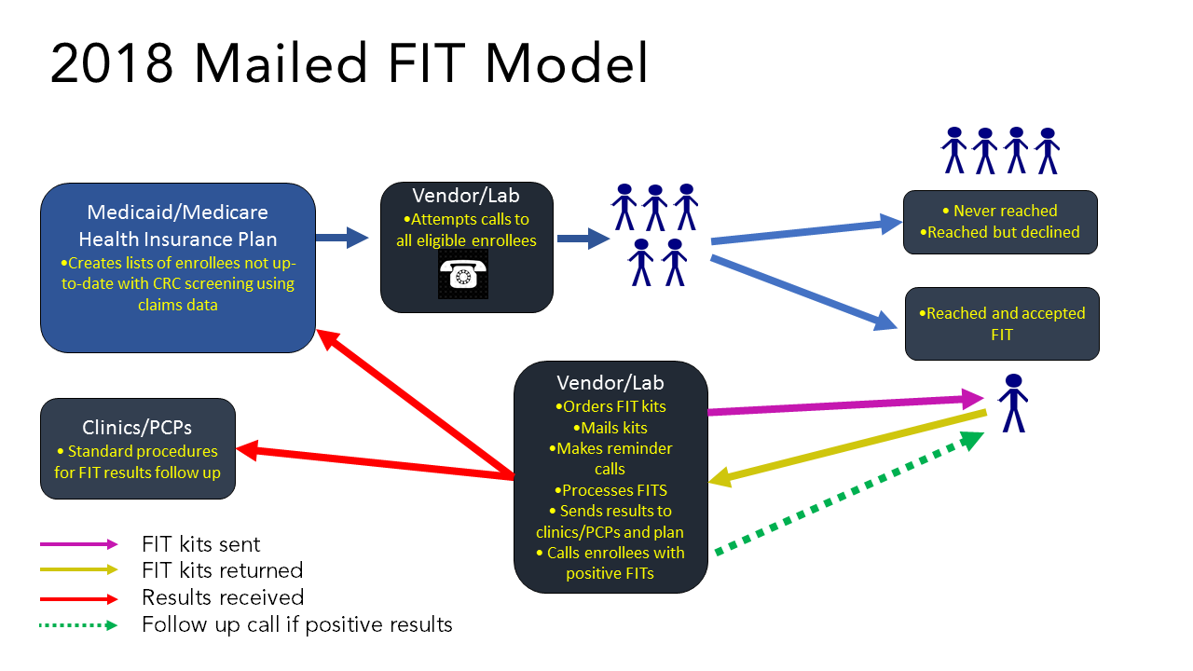




Background:
Mailed fecal immunochemical test (FIT) programs are a recognized strategy for increasing colorectal cancer (CRC) screening rates among individuals not up to date on screening.
These programs can vary in their design features, but few studies have compared outcomes of different program designs
Two Implementation Strategies for a Health Plan Based Mailed FIT Colorectal Cancer Screening Program: Influence on Process, Outcome, and Cost
Implementation Outcomes
Effectiveness Outcomes
Laura-Mae Baldwin¹ Gloria Coronado² Imara West¹ Malaika Schwartz¹ Amanda Petrik² William Vollmer² Rich Meenan² Yogini Kulkarni-Sharma³ Beverly Green⁴
¹Department of Family Medicine, University of Washington, Seattle, Washington; ²The Center for Health Research, Kaiser Permanente Northwest, Portland, Oregon; ³Molina Healthcare of Washington; ⁴Health Research Institute, Kaiser Permanente Washington, Seattle, Washington
Study Aim:
To leverage a natural experiment and compare the CRC screening rates among dual-eligible Medicaid/Medicare enrollees in a health insurance plan that delivered different mailed fecal immunochemical test (FIT) program designs across two program years
A health insurance plan attained similar colorectal cancer screening rates among dual-eligible Medicaid/ Medicare enrollees with two different mailed FIT program models, but at different costs.
Methods:
Design:
Hybrid implementation effectiveness study
Setting:
Medicaid/Medicare health insurance plan contracted with about 500 clinical organizations covering roughly 650,000 Medicaid and Medicaid/Medicare enrollees across Washington state.
Study Population:
Dual-eligible Medicaid/Medicare enrollees not up to date on CRC screening in 2016 (1st year) or 2018 (2nd year)
Data:
Mailed FIT vendor records, claims data, and activity-based costing spreadsheets
Outcomes:
Implementation: Percent of eligible enrollees reached with FIT kit
Effectiveness: Percent of eligible enrollees screened with FIT, screened with any CRC screening test
Cost: Implementation cost per introductory letter mailed, FIT kit mailed, completed FIT
Cost Outcomes
Average Implication Costs per Activity
Type by Program Year
Implications for D&I Research:
The health plan expected that the 2018 program design would be associated with higher screening rates than in 2016. However, a different, more intensive strategy will be needed to successfully increase screening rates among the highly vulnerable Medicaid/Medicare population.

