Slide 1
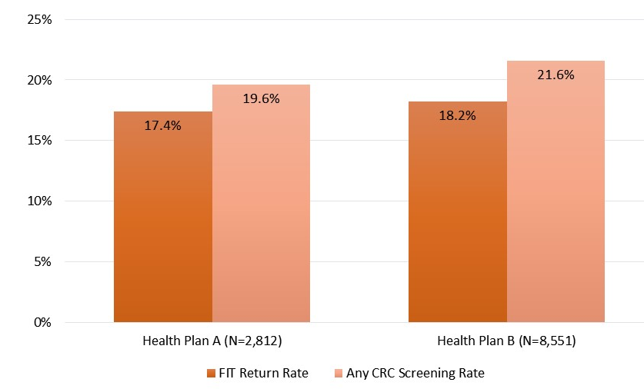
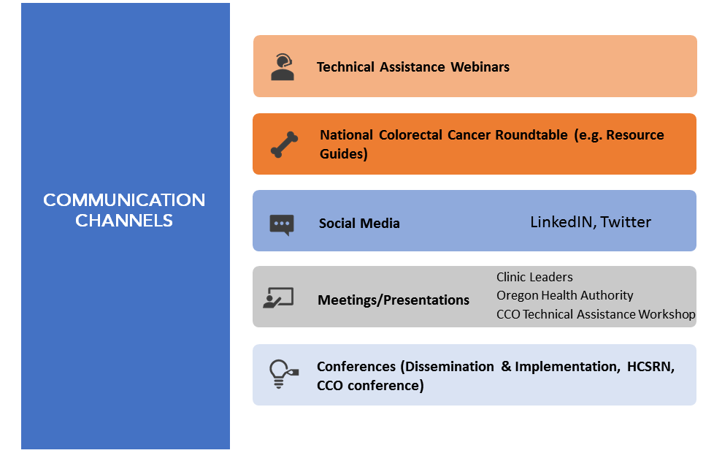
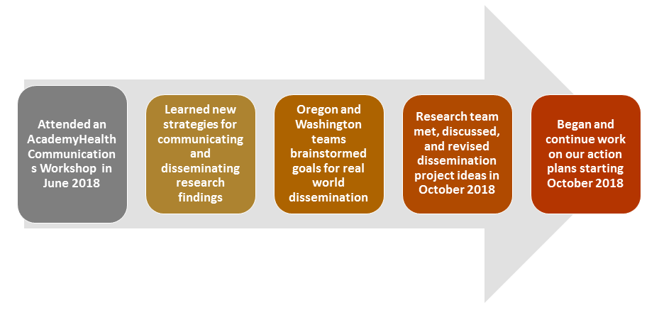
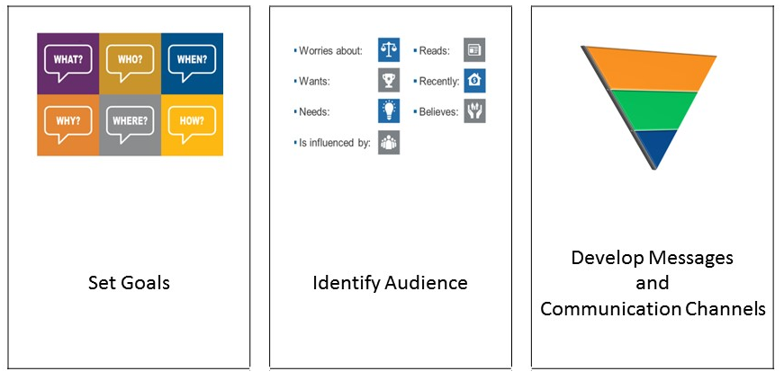
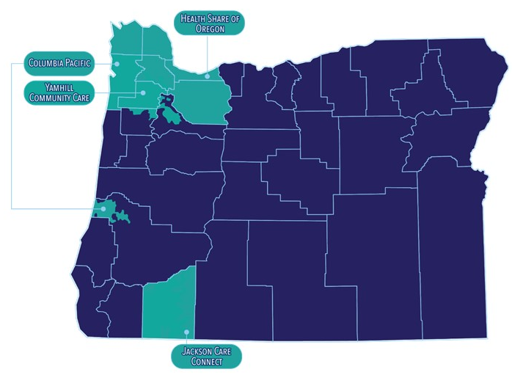
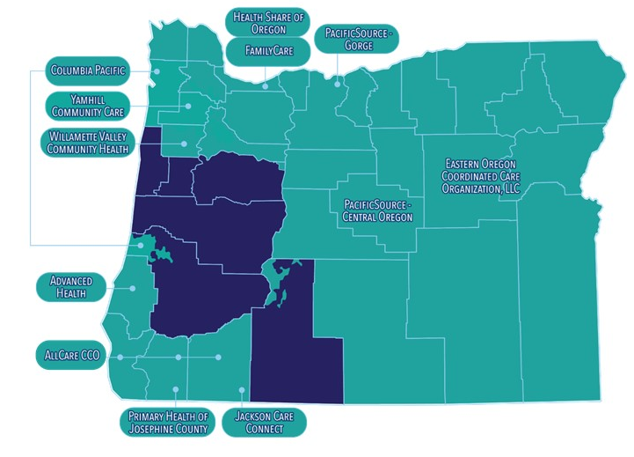
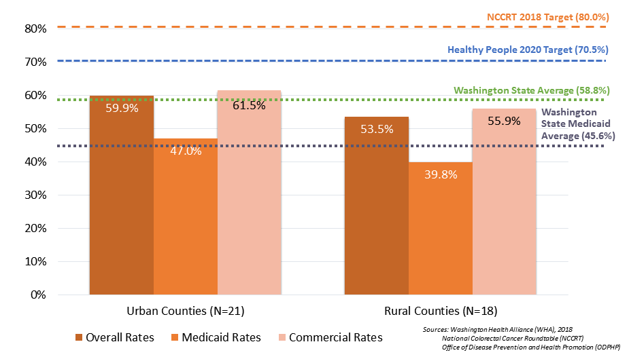
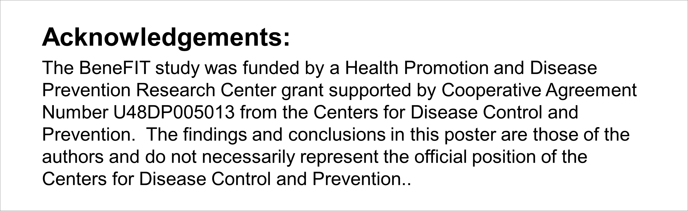
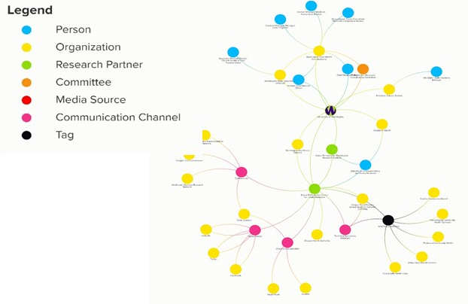




Background
A step-by-step communications/ dissemination worksheet can help research teams develop action plans to translate their research findings into local action.
Results (Cont’d)
BeneFIT studied implementation of mailed fecal immunochemical test (FIT) programs by Medicaid/ Medicare health insurance plans in Washington and Oregon.
The research team’s goal:
To increase adoption of mailed
FIT programs by Medicaid/ Medicare health plans in each state
BeneFIT INCREASED CRC SCREENNG RATES in both health plans
Oregon State’s Communications/Dissemination Plan
Goals: To raise awareness of the success of the BeneFIT program
To encourage health plans to adopt mailed FIT outreach programs
Audience:
Health Plans
Coordinated Care Organizations
Clinic and Community Leaders
Communication Channels:
Methods
Transforming our research
findings into action
BeneFIT workshop activities
Results
Washington State’s Communication/Dissemination Plan
Goal: To incentivize CRC screening for Medicaid patients in Washington state.
Audience:
Washington’s Health Care Authority (Medicaid Program)
Health plan Oregon:
Original Clinics
Spread to additional health plans
Messages:
Washington State CRC screening rates have not reached
the Healthy People 2020 or the National Colorectal
Cancer Roundtable 80 by 2018 goals
Transforming Research Findings into Action: Building a Strategy to Decrease Disparities in Colorectal Cancer Screening at the Local, Regional, and State Level
Communications Network:
Laura-Mae Baldwin¹ Amanda Petrik² Lauren Adams³ Gloria Coronado² Malaika Schwartz¹ Beverly Green⁴
¹Department of Family Medicine, University of Washington, Seattle, Washington, ²The Center for Health Research, Kaiser Permanente Northwest, Portland, Oregon, ³Communications and Public Relations, AcademyHealth, ⁴Health Research Institute, Kaiser Permanente Washington, Seattle, Washington
Further information: Please contact: Laura-Mae Baldwin at lmb@uw.edu.

