Slide 1

Maximizing State & Local Policies to Restrict Tobacco Marketing at Point of Sale
(NCI U01CA154281)
Kurt M. Ribisl, PhD
Lisa Henriksen, PhD
Douglas A. Luke, PhD
CPCRN Meeting, Seattle, WA, October 5, 2011

Slide 2
overview
Background on point-of sale
Sampling and study design
Description of study aims

Slide 3
Background
Maximizing State & Local Policies to Restrict Tobacco Marketing at POS

Slide 4
Industry marketing expenditures, 1997-2008
Annual Expenditures ($ billions)
MSA
FSPTCA
Note: POS includes POS advertising, price discounts, promotional allowances and retail value added. After 2001, POS excludes promotional allowances to wholesalers and others, and price discounts are included in POS Total and identified separately. Source: Federal Trade Commission, 2011.

Slide 5
POS Marketing and
Tobacco Retailer Density

Slide 6
Effects of POS Marketing
Increases current smokers’ daily consumption by cueing smokers to light up or buy cigarettes
  Exposure to cigarette advertising triggers cravings (cue reactivity)
  POP ads & displays boost sales
May promote relapse when quitters see their former brand
  34% of recent quitters and 38% attempters had to fight urge to buy cigarettes when seeing a POS cigarette display (Wakefield 2008)
Cigarette advertising & promotion encourages youth smoking initiation– potential future customers
Refs: Slater (2007); DiFranza et al (2006); Lee (2004); Promo; POPAI; Rogers et al., (1995), Warner (1986)

Slide 7
Retail marketing as risk factor for smoking initiation
Study Design & Sample
Shopping frequency
How often students visited any convenience stores , liquor stores or small grocery stores(visits/week)
Brand impressions
Store audits to quantify advertising and shelf space
Multiplied the frequency of visits to each store near school by the number of cigarette branded ads, functional items, and product facings in each store
Youth smoking from a longitudinal, school-based survey
Store audits to assess tobacco marketing in Tracy, CA
Where and how often students shopped in specific stores near school
Summed scores for each student for brand impressions per week.
Non-smoking adolescents 11-14 yrs at baseline
N=1681
Henriksen et al.,(2010) Pediatrics, 232-238
Notes:
A
more detailed measure combined information
about where and how often
students shopped in stores near
school and assessed the quantity of
advertising and shelf space (product
facings) for cigarettes in those stores.
Specifically, we multiplied the frequency
of visits to each store near
school by the number of cigarettebranded
ads, functional items (eg, ash
cans, clocks, counter mats) , and product
facings in each store and then
summed scores for each student to
compute cigarette brand impressions
per week.

Slide 8
Smoking initiation at follow-up, by shopping frequency at baseline
Smoking rate
Henriksen et al.,(2010) Pediatrics, 232-238

Slide 9
Odds of Smoking initiation at follow-up by shopping frequency at baseline

Slide 10
Odds of Smoking initiation at follow-up by Brand impressions at baseline
*
Henriksen et al.,(2010), Pediatrics, 232-238
*p<.05

Slide 11

Reduce the proportion of adolescents and young adults grades 6 through 12 who are exposed to tobacco advertising and promotion

Slide 12
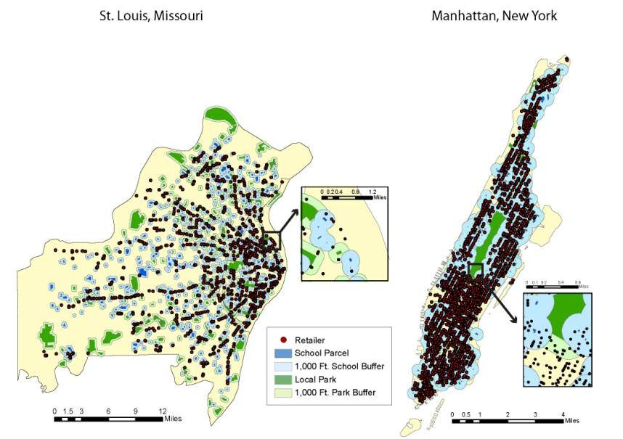
Banning outdoor cigarette ads within 1,000 ft of schools/parks may reduce 1.5million ads Luke, Ribisl 2011. AJPM
Tobacco retailer proximity to schools and parks
Disparities in number & proximity
Notes:
Note the disparities in density near the downtown section of STL. Note few in more white areas. Note close overlap of retailers with schools, and how this policy of banning sales near schools can reduce advertising and sales.

Slide 13
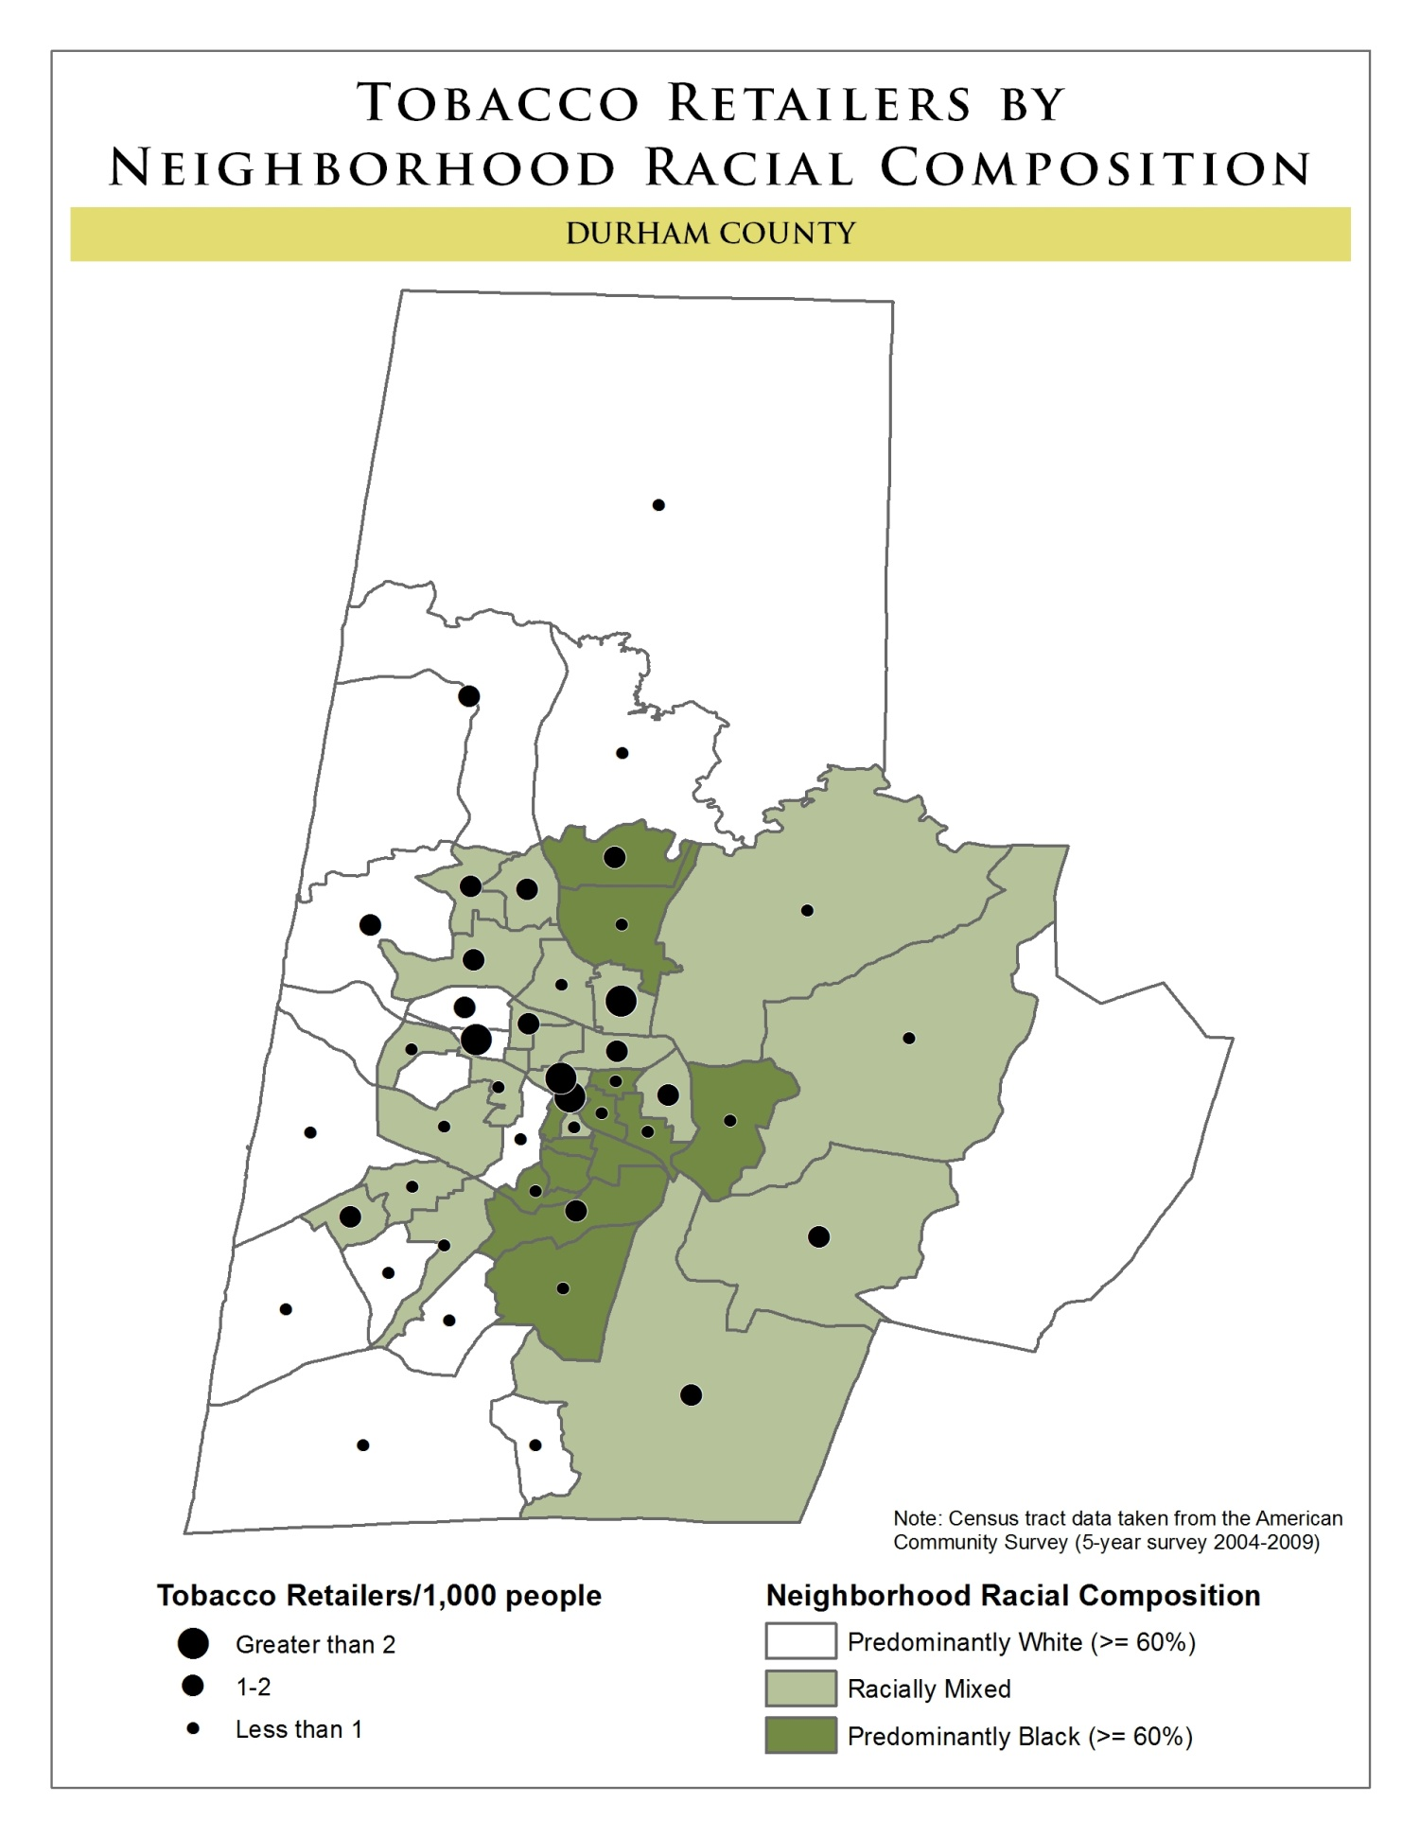
Effects of Retailer Density
Higher retailer density
makes cigarettes more accessible and available
increases environmental cues to smoke
associated with increased prevalence of smoking by adults and adolescents
may exacerbate racial/ethnic and socioeconomic disparities in tobacco use
Refs: Chuang et al (2005); Henriksen et al (2008); Hyland et al (2003); Novak et al (200?)

Slide 14
Disparities in Retailer Density, Erie, NY
Number of outlets per 10 km of roadway in a given census tract
Hyland et al. (2003), AJPH, 1075-1076
Notes:
Other studies found disparities in density. Let’s link density to youth smoking uptake.

Slide 15
Student tobacco use & tobacco retailer density near schools
Random sample of 245 middle and high schools in California
Outcomes
Major predictors
Tobacco retailer density within 1-mile radius of school (mean= 10.8, SD=8.9)
Tobacco retailer proximity
Odds of experimental smoking: Smoked at least 1 day in past 30 days, AND not smoked 100 cigarettes
Odds of established smoking: Smoked at least 1 day in past 30 days AND ever smoked 100 cigarettes
McCarthy et al., (2006), AJPH, 2006-2013
Notes:
Established
smoking was defined as smoking cigarettes
at least 1 day in the preceding 30 days
and having ever smoked 100 or more cigarettes.
20 Experimental smoking was defined as
smoking cigarettes at least1day in the preceding
30 days and not having smoked at least 100

Slide 16
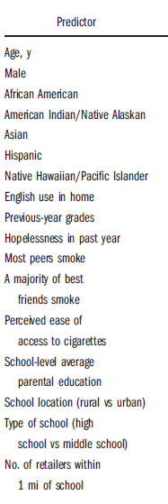
Tobacco retailer density &
Odds Of Youth smoking
Higher tobacco retailer density within 1mi of schools associated with 11% increase in odds of experimentation (OR=1.11*)
After adjustment for 13 individual & 3 school level covariates
McCarthy et al., (2006), AJPH, 2006-2013
Notes:
Proximity mentioned on the previous page but nothing mentioned about it on this one

Slide 17
Student tobacco use & tobacco retailer density near schools
Random sample of 135 high schools in CA
Outcome
Major predictors
Tobacco retailer density within 1/2 mile radius of school (M= 5, SD=7, max=35)
Quantity of POS tobacco marketing within ½ mile radius of school (M=123, SD=173, max=988)
Prevalence of current smoking: Smoked at least 1 day in past 30 days
Notes:
Established
smoking was defined as smoking cigarettes
at least 1 day in the preceding 30 days
and having ever smoked 100 or more cigarettes.
20 Experimental smoking was defined as
smoking cigarettes at least1day in the preceding
30 days and not having smoked at least 100

Slide 18
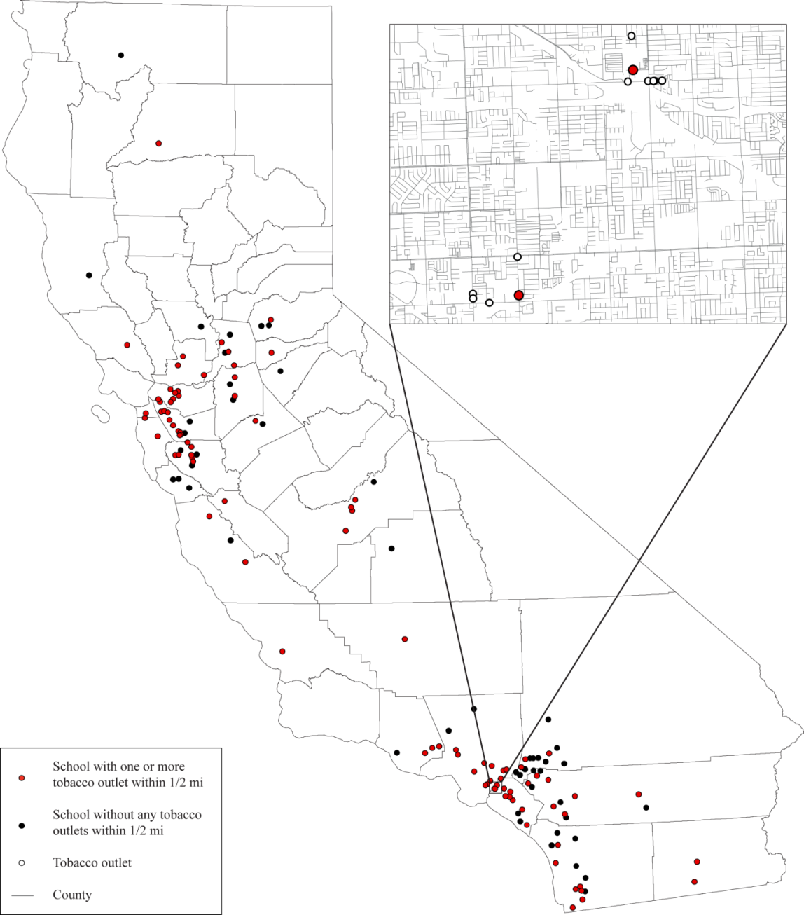
• Visited tobacco retailers (n=384) within walking distance of random sample of California high schools (n=135)
• Counted and categorized tobacco
marketing materials at POS
(School neighborhood mean=123, SD=173, max=988).
• Correlated observations with self-reported smoking from the CA student tobacco survey
Henriksen et al., (2008), Prev Med

Slide 19
Tobacco Retailer/AD density & SCHOOL SMOKING Prevalence
High tobacco retailer density (>5 retailers) within ½ mi of schools and higher quantity of POS tobacco marketing associated with higher prevalence of current smoking.
After adjustment for school-level race, ethnicity, income, and other area demographics
Henriksen et al., (2008), Prev Med

Slide 20
Family Smoking Prevention and Tobacco Control Act Retail Provisions
Ads in tombstone format
(black & white, text only)
No non-tobacco gifts with purchase
Ban on self-service of tobacco
Ban on exterior cigarette/SLT ads near a school or playground
Ban on flavored cigarettes except menthol
Graphic warnings on tobacco packs & ads
*litigation
In effect
In effect
In effect
*litigation, no final rule
*litigation
Notes:
FDA now has authority and plans to implement provisions to regulate the retail environment

Slide 21
Research gaps
Nearly all POS marketing studies are local and/or state samples
No national studies on disparities in amount of advertising
No national estimates of retailer density or disparities
Given newness of FSPTCA, no studies showing compliance
Little known about what state programs are doing at POS
Little research to guide states and communities on reducing exposure to POS marketing and retailer density

Slide 22
Sampling and design
Maximizing State & Local Policies to Restrict Tobacco Marketing at POS

Slide 23
Goals of sampling design
Nationally representative sample of tobacco retailers
Adequate statistical power for multivariate analyses and precise point estimates
Includes retailers from enough states to ensure adequate coverage of state-level POS policy characteristics

Slide 24
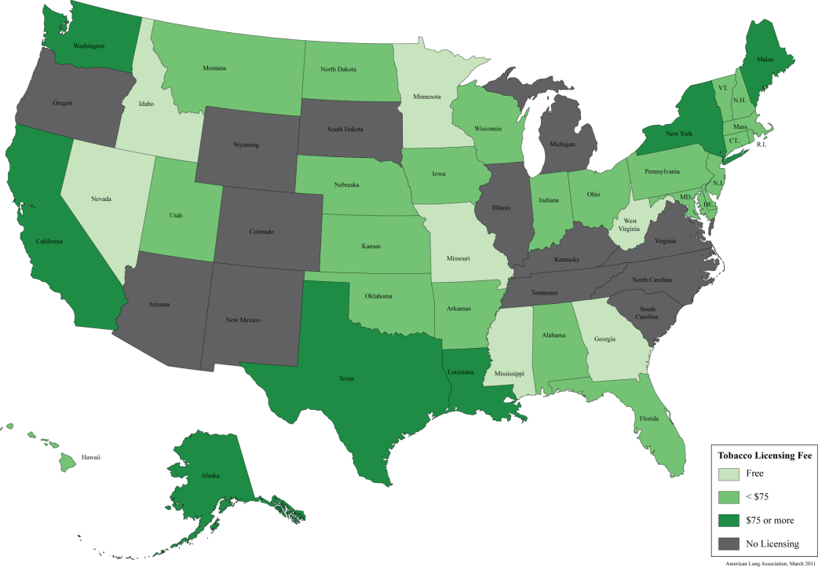
No National RegistrY of Tobacco Retailers
Ideal to identify retailers from state retailer licensing records, but not required in all states
FDA list of 375,000 retailers combines
licensing records and purchased addresses

Slide 25
Proposed DATa source
National Establishment Time Series (NETS) Data
Pull establishment types likely to sell tobacco (convenience stores, gas, supermarket)
Tracks “births” and “deaths” of establishments
Derived from 19 annual snapshots of the Dun & Bradstreet data since 1990

Slide 26
Two-stage probability proportionate to size (PPS) sampling design
Stage 1:
Sample 100 counties mainland US using PPS (large counties)
Explicitly draw separate proportionate samples of counties in 4 U.S. Census Regions (West, Midwest, South, & Northeast)
Stage 2:
Visit 20 outlets per county
Randomly select 30 outlets per county for replacements
Achieves a national sample, lots of states included (about 41), ability to add stores
Notes:
There is no national or comprehensive sampling frame of tobacco retailers because the United States does not have a mandatory licensing system for establishments that sell tobacco products

Slide 27
Overview of aims
Maximizing State & Local Policies to Restrict Tobacco Marketing at Point of Sale

Slide 28
Aim 1: Examine changes in the amount and type of tobacco marketing materials and pack prices
Conduct three waves of store audits (n=2,000) -baseline, 1.5 year follow-up, 3 year follow-up.
Collect tobacco marketing data and purchase cigarettes to track prices (1,000 Marlboro, 1,000 Newport).
Estimate the level of compliance w/FDA advertising & labeling requirements.
Link store audit data to Census neighborhood characteristics to examine racial/ethnic & socioeconomic disparities in POS marketing & price.

Slide 29
Measures of Tobacco Marketing & Merchandising
Category | Construct | Source
Marketing and Promotions | Promotions: price discount (e.g., 50 cents off) or multi-pack offer (e.g., Buy 1 Pack, Get 1 Pack), for Marlboro, Newport, or any other brand (all yes/no) Presence (yes/no) of gift with tobacco product purchase) Tobacco marketing materials, by type (e.g., signs, display, shelving unit, functional item), by location (e.g., outdoors, inside-at counter, inside-away from counter), by tobacco product (e.g., cigarettes, smokeless, other tobacco products), by image characteristics (e.g., color/graphic vs. text-only, black and white) Outdoor tobacco advertising, by brand | Feighery and Ribisl ^{33, 55, 84} Henriksen^{13, 41, 57} Slater⁸⁵
Merchandising | Power wall (yes/no), a prominent display of cigarette cartons or packs | Dewhirst⁸⁶
Products sold | Cigarettes Smokeless tobacco (spitting tobacco, chew, snus) e-cigarettes Cigars Pipes Other | Feighery⁵⁵
Counter-marketing | Visibility of cigarette warning labels mandated by FDA (fully, partially, or not visible) for packs and cartons Presence of signs with graphic, pictorial warnings about tobacco use (e.g., New York City) | Gostin¹ Hammond⁸⁷ Wilson⁸⁸
Price | Single pack price ($) for Marlboro and Newport | Toomey⁴³

Slide 30
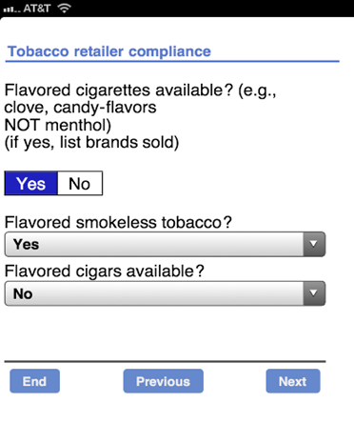
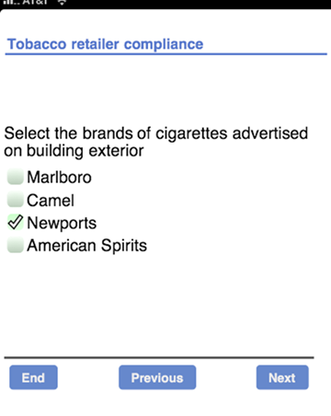
iPhone, ipod touch app
Source: Kurt Ribisl, PhD, UNC-Chapel Hill

Slide 31
Aim 2: Conduct Implementation Research
National Tobacco POS Consortium
National Survey of State Tobacco POS Policies
Case studies
Legal analysis
Notes:
Wash U/CTPR will be taking the lead with Aim 2 activities. The goal of Aim 2 is to conduct implementation research that will guide state and communities seeking to more effectively regulate POS tobacco marketing. It will be build on the first aim, allowing us to understand how changes at the retailer level are influenced by state-level policy activities and implementation capacity. There are four interconnected activities that comprise Aim 2, including: (listed on slide)

Slide 32
National Tobacco POS Consortium
Consortium Inaugural Members from Local, State, and National Tobacco Control Programs
Name | Title
April Roeseler | Chief, Program and Media Operations, California Tobacco Control Program
Brick Lancaster | Senior Advisor, Office of Smoking and Health, CDC
Bronwyn Lucas | Executive Director, Youth Empowered Solutions (YES!), Durham, NC
Eric Lindblom | Director, Office of Policy, Center for Tobacco Products, FDA
Jeffrey G. Willett | Director, Tobacco Control Program, State of New York Department of Health
Karen Girard | Health Promotion Manager, Oregon Department of Human Services
Seema Dixit | Program Manager, Tobacco Control Program, Rhode Island Department of Health
Victoria Fehrman Warren | Program Coordinator, Bureau of Health Promotion, Missouri Department of Health & Senior Services
Notes:
-Given the complexity of the POS, the project will require a close working relationship between the research, practice, and legal community. The POS consortium will created to provide input to the implementation analyses, help guide our selection of case studies, and be a primary dissemination conduit for study findings.
-This table shows our inaugural members. Each person was carefully selected because of their pioneering work related to POS and their strong commitment to reducing tobacco-related disparities in POS.
-The consortium will have quarterly telephone calls and meet in-person annually during all five years.

Slide 33
National Survey of State Tobacco POS Policies
Establish national monitoring system for POS policy activities
Phone Interview with three or more state program stakeholders
Monitor state policy changes across 3 yr period
Wave 1
Wave 2
Wave 3
Year 1
Year 3
Year 4
Q 3/4
Q 1/2
Q 3/4
Notes:
The national phone survey of state tobacco control programs focuses on POS activities, policies and implementation capacity. It is an important component of the overall project for a couple of reasons. First, it establishes a national monitoring system for POS activities. (Currently there is limited information on POS policies at the national level). In addition, the data collected as part of the survey can be linked to the retailer surveillance data that was collected as part of Aim 1. This will allow us to model how state policy and implementation influences retailers POS characteristics.
The survey will be administered in 3 waves that occur at the same time as the retailer surveillance activities. The waves will be equally spaced about one year between each wave. Recruitment for the survey will be facilitated by the Program Services Branch of the CDC’s OSH.

Slide 34
National POS implementation survey
State political environment
General tobacco control efforts
POS policy & program activities
POS implementation capacity
Local POS activities
Notes:
For each wave of the survey, project staff will contact and interview by phone three or more state program stakeholders: 1) the program manager, 2) the program surveillance or evaluation director, and 3) the statewide coalition director or lead state tobacco control advocate. In our experience, people in these three roles are likely to be most aware of state and local POS policy activities. Although the interview may be supported by an online component (using technology such as SurveyMonkey or Snap Survey Software), it is our experience with public health professionals that scheduling and conducting a phone interview helps ensure higher participation rates and more timely data collection. The interview will be designed to be conducted in less than 30 minutes, but may run longer if respondents wish to provide more qualitative supporting details.
The National POS Implementation Survey instrument will be developed during the first six months of the project, and will be based on instruments used in the Assist Evaluation,⁹⁰ our own evaluations of state programs,⁶³ and new instruments developed to assess policy implementation capacity in health organizations.⁵² Given the scope of the study, the survey will be relatively narrowly defined, focusing on five areas: state political environment, general tobacco control program efforts, POS policy and program activities, POS implementation capacity, and local POS activities.

Slide 35
National POS implementation survey
Rate readiness of new policy:
Feasibility
Penetration
Acceptability
Sustainability
Uptake
Costs
Implementation capacity score
Proctor, 2008

Slide 36
National POS implementation survey
Is state program involved in:
Planning
Implementing
Monitoring
Enforcing
Core POS outcomes
Marketing
Merchandising
Products sold
Countermarketing
Price
Retailer Density
NCI, 2006; Mueller, 2006; Mendel, 2008

Slide 37
National Survey: Analysis plan
Environmental context
Changes in retailers over time
State POS policy Implementration scores
Marketing Merchandising
Density
Countermarketing
Price
Notes:
The fundamental analytic goal for Aim 2 (as well as for parts of Aims 1 and 3) is to model how POS retailer characteristics change over time, and how those changes are influenced by the environmental context (i.e., existence of a state POS policy). That is, our research questions are inherently longitudinal and ecological in nature.

Slide 38
National Survey: Analysis plan
Mixed-effects Longitudinal Modeling
Longitudinal changes of POS characteristics
State Policy Main Effects
State policy by capacity interactions
Luke, 2008
Notes:
To build analytic models that are appropriate for this type of research question, we will use mixed-effects longitudinal modeling. These models (sometimes called growth curve models) have a number of important advantages, including the ability to handle unbalanced designs, missing data, and varying time points.⁹¹ This latter characteristic is very important for this study, where data collection for both retailers and state policies and programs will spread across a number of months in each wave

Slide 39
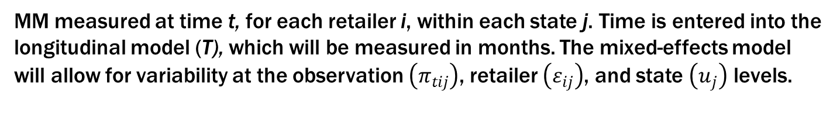
National Survey: Analysis plan
Longitudinal changes of POS characteristics
POS outcome: # marketing materials (MM) observed in each store
MM measured at time t, for each retailer i, within each state j. Time is entered into the longitudinal model (T), which will be measured in months. The mixed-effects model will allow for variability at the observation $\left(π_{tij}\right)$, retailer $\left(ε_{ij}\right)$, and state $\left(u_{j}\right)$ levels.
Luke, 2008
Notes:
To build analytic models that are appropriate for this type of research question, we will use mixed-effects longitudinal modeling. These models (sometimes called growth curve models) have a number of important advantages, including the ability to handle unbalanced designs, missing data, and varying time points.⁹¹ This latter characteristic is very important for this study, where data collection for both retailers and state policies and programs will spread across a number of months in each wave

Slide 40
State and Community Case Studies
Purpose: Provide in-depth information about processes, facilitators, and challenges of the adoption, implementation and/or enforcement of POS policies
Methodology:
  2 case studies per year in years 2-4 (6 total)
  Conduct 18-24 in-person interviews with key tobacco control partners
  County and municipality POS policies obtained and analyzed by legal research team
Notes:
To learn from states and/or communities implementing innovative POS polices and to also learn about tobacco industry responses, we plan to conduct a series of six case studies (2 per year during the project years 2-4). Rich surveillance, quantitative, and qualitative data will be collected from these communities through in-person interviews with key tobacco control partners at each study. Expect to conduct 18-24 interviews, lasting approx 45 minutes in length. Interviews will be transcribed and a theme analysis will be conducted.

Slide 41
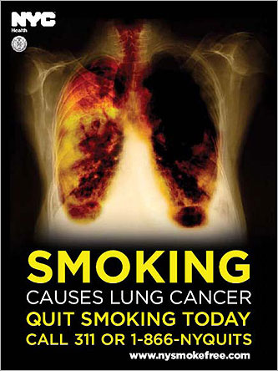
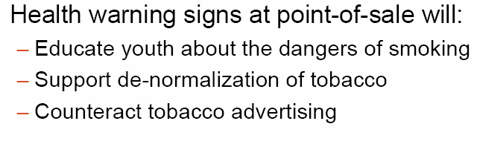
Candidate: NYC POS Health Warning
Source: Anne Pearson PPT 2009

Slide 42
Legal Research and Analysis
Purpose
Conduct legal research to inform policymakers about the following:
First Amendment commercial speech issues
Methodology
Formative research utilizing Westlaw, LEXIS-NEXIS, and HeinOnline
Enacting minimum price regulation
Reducing retailer density
Identify existing policies and case law
Research informed by state survey and case studies
Notes:
Will also plan to conduct legal research about four topics related to POS regulation (bulleted in slide). These analyses will serve as an important resource for communities and policymakers.
Original slide text: Purpose: Conduct legal research to inform policymakers about the following:
First Amendment commercial speech issues related to restricting POS advertising
Reducing retailer density
Enacting minimum price regulation
Final topic determined by POS Consortium
Methodology:
Formative research utilizing Westlaw, LEXIS-NEXIS, and HeinOnline to identify existing policies and case law related to each topic area
Research informed by state survey and case studies

Slide 43
Aim 3: Describe annual change in density and composition of tobacco retailers
Use NETS data to identify retailers, geocode addresses and extract Census 2010 data to compute multiple indicators of tobacco retailer density (per population, area, roadway km).
Assess racial/ethnic and socioeconomic disparities in tobacco retailer density at baseline and in changes over time.
Building on baseline data from store audits (Aim 1), examine associations of price and promotions with tobacco retailer density in store neighborhoods (indicator of localized competition).
Supplement data from state policy surveys (Aim 2) with survey of local licensing policies for randomly sampled communities within the focal counties.

Slide 44
National SURVEY: Analysis plan
Mixed-effects longitudinal modeling
Study change in density and composition of tobacco retailers
State policy main effects
Local policy main effects (e.g., licensing fees)
Notes:
To build analytic models that are appropriate for this type of research question, we will use mixed-effects longitudinal modeling. These models (sometimes called growth curve models) have a number of important advantages, including the ability to handle unbalanced designs, missing data, and varying time points.⁹¹ This latter characteristic is very important for this study, where data collection for both retailers and state policies and programs will spread across a number of months in each wave

Slide 45
Aim 4: Dissemination Products
Product | Audience/Partner
Point of Sale Report to the Nation | Tobacco control programs National partners Policymakers Scientists Advocacy partners
State case study reports | Tobacco control programs Policymakers National partners Scientists Advocacy partners
Policy briefs | Tobacco control programs Policymakers
National retail outlet protocol | Scientists National partners
National retailer data set | Scientists National partners
Notes:
We plan to serve as a national resource for states and communities interested in conducting POS surveillance or implementing policies related to POS marketing or price discounting. The information and analyses developed in Aims 1-3 will be actively disseminated to policymakers & the field of tobacco control via a wide range of forums, including workshops, scientific meetings, the internet and policymaker briefings.
This table presents the many products, audiences and dissemination methods which we plan to implement over the course of our 5-yr study. In addition to the many scientific publications that will result from this project, we are also very excited about the dissemination of diverse products to diverse audiences. The cornerstone of the dissemination activities will the POS Report to the Nation in years 2 and 5. This report will present the current status of retail environment, including POS marketing, tobacco outlet density and the influences of related policies.

Slide 46
Questions?
Maximizing State & Local Policies to Restrict Tobacco Marketing at Point of Sale

