Slide 1

Implementing Patient-Reported Outcome Measures with Diverse Primary Care Patients
UCLA Fielding School of Public Health
Hector P. Rodriguez
Roshan Bastani
Beth Glenn
Dylan Roby
Ritesh Mistry
Michael Ong
CPCRN Meeting, South Carolina, March 22, 2012

Slide 2
Study Setting: 3-4 Federally-qualified health centers (FQHCs) in Southern California
National Partners: a number of additional sites located nationally: VA in Bedford, MA; practice-based research network clinics in Vermont and Virginia
Phase 1
(3/12 - 5/12)
Phase 2
(5/12 - 9/12)
Pre-Implementation Interviews with Staff and Providers (n = 5 per site)
Implementation of Health Update (PROs) with 50 patients per site (1-3 week period)
Post-Implementation interviews with Staff and Providers
(n = 5 per site)
Solicit feedback through brief patient (all) questionnaire
Invite subgroup of patients to participate in a feedback interview

Slide 3
Description of Phase 1
Purpose: gather data that will inform Phase 2 re implementation in each site
Interview: clinic directors, providers, and front office staff involved in PRO data collection ($25 gift card)
Interview focus (captured by Copper Conferencing):
  Experience with collecting PRO data in other areas
  Electronic health record implementation to date/planned
  Where, how, best to administer PROs, to integrate into clinic flow
  Anticipated barriers to implementing the PROs
  Usefulness of data in improving care
  Identify: available resources on-site/in community to address PRO domains; and usual practice to address these issues within the system

Slide 4
Phase 2: Domains for PRO Measure
Domain | Final Measure (Source)
1.Demographics | 9 items: Sex, date of birth, race, ethnicity, English fluency, occupation, household income, marital status, education, address, insurance status, veteran’s status. Multiple sources including: Census Bureau, IOM, and National Health Interview Survey (NHIS)
2. Overall Health Status | 1 item: BRFSS Questionnaire
3. Eating Patterns | 3 items: Modified from Starting the Conversation (STC). (Adapted from Paxton, AE et al. Am J Prev Med, 2011; 40(1):67-71.)
4. Physical Activity | 2 items: The Exercise Vital Sign (Sallis, R. Br J Sports Med 2011; 45(6):473–474)
5. Stress | 1 item: Distress Thermometer (Roth AJ, et al. Cancer 1998; 15(82):1904-1908.)
6. Anxiety and Depression | 4 items: Patient Health Questionnaire - Depression & Anxiety (PHQ-4) (Kroenke K, et al. Psychosomatics 2009; 50(6):613-621.)
7. Sleep | 2 items: a. Adapted from BRFSS b. Neuro-QOL (Item PQSLP04)
8. Smoking/ Tobacco Use | 2 items: Tobacco Use Screener (Adapted from YRBSS Questionnaire)
9. Risky Drinking | 1 item: Alcohol Use Screener (Smith PC, et al. J Gen Intern Med 2009; 24(7):783-788)
10. Substance Use | 1 item: NIDA Quick Screen (Smith PC, et al. Arch Intern Med 2010, 170(13): 1155-1160.)

Slide 5
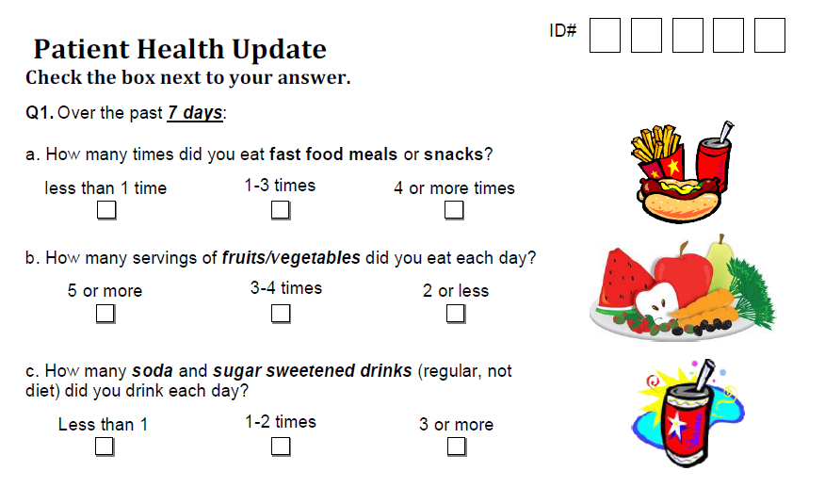
Patient “Health Update” Excerpt

Slide 6
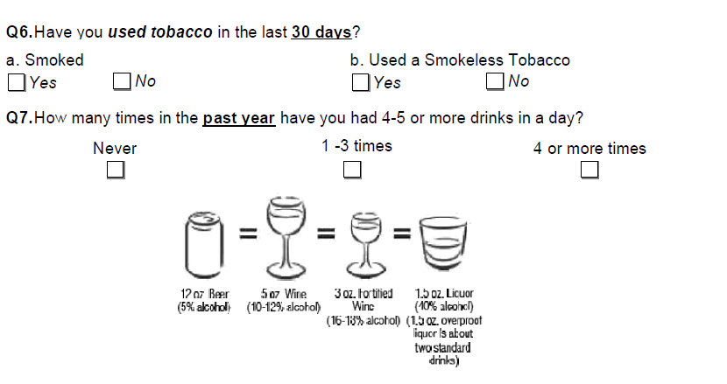
Patient “Health Update” Excerpt

Slide 7

Post- “PRO collection” Patient Questionnaire
9-item, self-administered questionnaire
Office staff hands questionnaire packet to
patients after visit who completed “Health Update”
Packet includes: questionnaire, $5 gift card, self-
addressed stamped envelope for mailing back form
Low literacy patients may need assistance from office staff or family member
  Phase 1 data may shape protocol

Slide 8
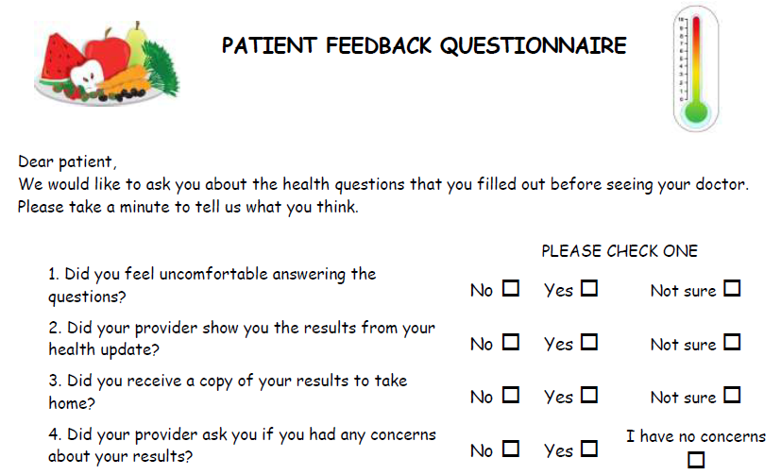
Patient Questionnaire Excerpt

Slide 9
Post - “PRO collection” Patient Interviews
To elicit patient experience with the “PRO” questions and process
Focus on the “who, when, what, where, and how” of completing the Health Update, ease of administration, and acceptability
On-site recruiting of patients after their visits

Slide 10
Patient Interviews, cont.
Recorded and transcribed by Copper Conferencing Service (similar to interview with staff)
Participants receive $25 gift cards (e.g., Target)
Interview data analyzed for key themes, e.g., usefulness of data, challenges, recommendations

Slide 11
Post- “PRO collection” Provider/Staff Interviews
Gather data from staff about implementation, impact, workflow, and ways for improvement ($25)
Solicit guidance for next steps (e.g., large scale implementation practice change)

Slide 12
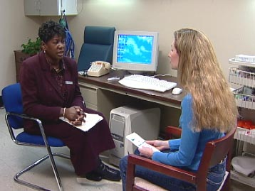
Guidance for Providers
Scoring Template
Annotated clinician version of “PRO measures” indicating out of range values to assist in scoring
Provider Guidance Form
1 page front & back, help to interpret “PRO” results & guide follow-up assessment/treatment
Provider Resource Packet Detailed hard copy/electronic resource to summarize evidence for follow-up/treatment, links to available web resources, inclusion of local resources at site discretion

Slide 13
Data Compilation across Sites
Qualitative Data:
For sites using Copper Conferencing, data will be centrally transcribed by service and compiled for analysis
Quantitative Data:
All clinics asked to mail UCLA a copy of patient forms, stripped of identifying information
UCLA will scan forms for easy data capture
UCLA will share descriptive data with participating
sites

Slide 14
Involvement of other CPCRN Sites
UCLA can provide all IRB approved documents for Phase 1 and 2 (everything we have)
Phase 1 completed by May 15th to be included in initial write-up
Some sites may opt to do Phase 2 only,
but some preliminary information gathering still needed

