Slide 1
Does marketing enhance dissemination?
Results from a system dynamics simulation study
Matthew W. Kreuter, PhD, MPH
Peter S. Hovmand, PhD, MSW
5th Annual NIH Conference on the Science of Dissemination and Implementation
March 19, 2012
Notes:
I’m going to spend the first half of the presentation describing the rationale and vision for a marketing and distribution system to improve dissemination, then Peter will show you how we’ve tested this system and what we found. Let’s start with a question for the audience…

Slide 2
Which do you want?
      ❏ More dissemination knowledge
      ❏ More dissemination
Notes:
We believe that while more dissemination knowledge may help get more dissemination, that alone won’t be nearly enough.

Slide 3
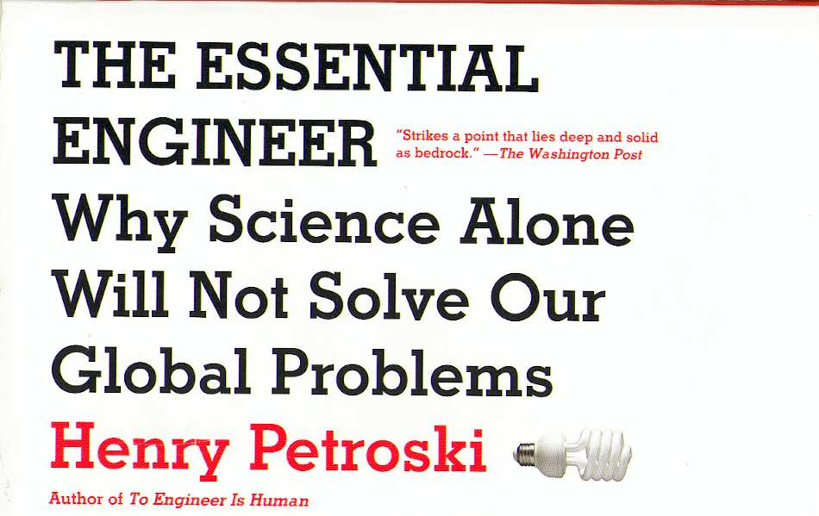
“Science is about knowing; engineering is about doing”
Notes:
Or as Petroski put it, Science is about knowing, but APPLYING that knowledge requires different toolbox
More dissemination knowledge won’t replace the need for systems and infrastructure to support dissemination

Slide 4
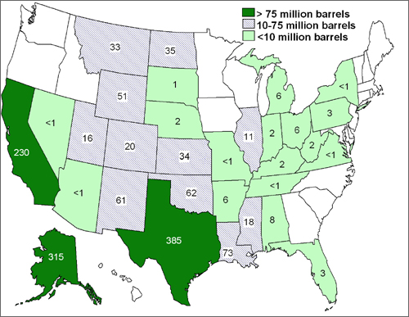
U.S. crude oil production, by state

Slide 5
Notes:
You still have to build one of these… What’s the equivalent of this for our work as researchers?

Slide 6
Reframing the dissemination challenge:
A marketing & distribution perspective
Kreuter, Casey & Bernhardt (2012) In: D&I Research in Health, NY:Oxford
Bernhardt, Mays & Kreuter (2011) J Health Commun
Dearing & Kreuter (2010) Patient Educ Couns
Kreuter & Bernhardt (2009) Am J Public Health
Notes:
Over the last four years, Bernhardt, Casey, Dearing have been thinking and writing about this challenge…

Slide 7
A marketing and distribution system brings
products and services from development to use
Notes:
… and when we looked closely at how other goods and services were marketed and distributed, it was clear that there were processes, systems and infrastructure that we lack for translating research into practice.

Slide 8
Three key attributes
  Demand-driven
  Practice-ready
  Promotion & support
Notes:
Three things stood out to us: (1) dissemination should be more demand-driven; (2) a good system should yield more practice-ready research, and (3) we need specialists – not researchers – to do this work throughout the process, especially promotion & support in working directly with adopters

Slide 9
Three key attributes
  Demand-driven
  Practice-ready
  Promotion & support
Notes:
There is a fairly widespread assumption among researchers, reviewers and funders that all EBIs should be disseminated. You see it at this meeting, we drill it into students, but is it REALISTIC? Is it even FEASIBLE?

Slide 10
Are all EBI’s worth disseminating?
Notes:
Maybe if it was free and easy to disseminate, and if everything we created was in high demand. But it’s not. It’s not free and its definitely not easy. And much of what we develop is NOT in high demand by potential adopters. If you look at consumer products and technology innovations, you see this clearly…

Slide 11
3,000 raw ideas
100 exploratory projects
10 well-developed projects
2 full-fledged product launches
1 successful product
Stevens & Burley (1997) Res Tech Mgmt, 40 (3) 16-27.

Slide 12

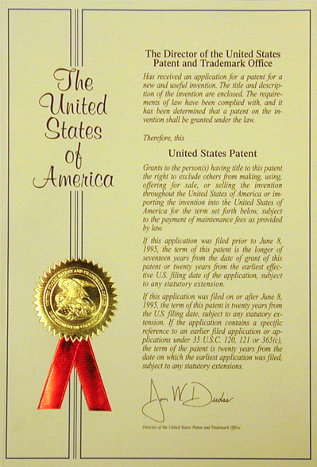
275,000 applications
150,000 approved
7,000 licensed
(2-3%)
Lemley MA (2001) NW Law Rev, 95 (4) 1495-1532.
Notes:
We see it in U.S. patents…
We need to change our expectations. We need to do a better job of dramatically narrowing the pool of EBIs that we invest time and effort to disseminate.

Slide 13
No
Evidence
Strong
Evidence
Notes:
Here’s what we do now… Think of these green dots as research SOLUTIONS, EBIs. We’ve done a good job of using systematic evidence review to distinguish more and less promising solutions

Slide 14
High
Demand
No
Evidence
Strong
Evidence
Low
Demand
Notes:
But we don’t have systematic ways to assess the DEMAND for our solutions…

Slide 15
High
Demand
No
Evidence
Strong
Evidence
Low
Demand
Notes:
Ideally, the relationship between evidence and demand would look like this… But we know it’s not that simple

Slide 16
High
Demand
No
Evidence
Strong
Evidence
Low
Demand
Notes:
So what do you do if the relationship looks like this? Which do you choose? The reality is we can’t even have this discussion right now because WE DON’T KNOW half the equation

Slide 17
Recommendation 1:
User review panels
  Review EBIs
  Rate fit, feasibility, ease of use
  GOAL: effective + in demand

Slide 18
Three key attributes
  Demand-driven
  Practice-ready
  Promotion & support

Slide 19
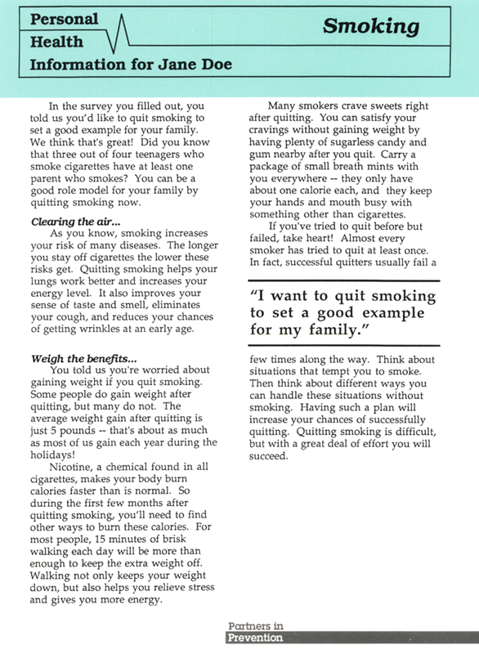
Notes:
This piece of paper is a tailored intervention. Vic Strecher created it, tested it, and it worked. The findings became one of most cited tailoring papers and it appears in EVERY evidence review of tailoring and smoking cessation.

Slide 20

Notes:
This is the website for a tailored smoking cessation program called “Breathe”. Vic Strecher created it, too. It’s based on the tailored piece of paper from the last slide, and other tailoring research. It’s a fully automated web-based system sold to worksites and health care providers around the world.

Slide 21
Notes:
The program on the right is practice-ready. The one on the left is not. Getting from the left side to the right side is no small undertaking. And that’s why we need…

Slide 22
Recommendation 2:
Design & marketing teams
  Market research & segmentation
  Adaptation/reformulation
  Practice-ready solutions

Slide 23
Three key attributes
  Demand-driven
  Practice-ready
  Promotion & support

Slide 24
  Specialized expertise in complex tasks
  Personal contact
  Goal-directed
Notes:
If we had agents for D&I, their goal would be to get EBIs into practice. Do we do that?

Slide 25
Larson et al (2006) Public Health Reports, 121 (3) 228-234.
Notes:
Public health detailing…
Promising results

Slide 26
Recommendation 3:
Dissemination field agents
  Extensive knowledge of EBIs
  Expertise in implementation
  Training/technical assistance

Slide 27
Building a dissemination support system
Three recommendations
  User review panels
  Design & marketing teams
  Dissemination field agents

Slide 28
Building a dissemination support system

Slide 29
Building a dissemination support system

Slide 30
Building a dissemination support system

Slide 31
Building a dissemination support system
Notes:
Collateral benefit…

Slide 32
Building a dissemination support system

Slide 33
Building a dissemination support system

Slide 34
Building a dissemination support system

Slide 35
Testing the process
  Tobacco Quitline in Food Stamps
  MIYO for colorectal cancer screening
  System dynamics modeling

Slide 36
System dynamics modeling approach
System dynamics (SD)
  A method for understanding, designing, and managing complex systems using computer modeling and simulation
  Emphasis placed on understanding dynamics generated by feedback mechanisms and “stocks and flows”
Group model building (GMB)
  Method for developing SD models with HCRL team
  Used an unstructured GMB approach during research team meetings (8 one to two hour group sessions over 12 months, unstructured or “unscripted” approach)
Model purpose:
  To conceptually test and compare different designs of a dissemination support system
Approach:
  Develop different models, one for each design of a dissemination support system, and compare theoretical performance of each to understand implications of each design

Slide 37
Key model assumptions
Average time for adopting and implementing solutions =
    f₁ ( effectiveness,
    demand,
    theoretical min time to adopt,
    delivery teams )
Average time from developing solutions to adopting and implementing solutions =
    f₂ ( average time of expert review reviews,
    average time of user review panels,
    average time for marketing and design teams,
    average time to adopt and implement solutions )
Expert review panels and user panel reviews
  “Best case” scenario
    100% of solutions passed on by panels are evidenced based and in demand
  “Worst case” scenario
    50% of solutions passed on by panels are evidenced based and in demand

Slide 38
Expert review panels
“business as usual”

Slide 39
Expert review panels + user review panels

Slide 40
Expert review panels + user review panels + design and marketing teams

Slide 41
Expert review panels + user review panels + design and marketing teams + dissemination field agents

Slide 42
Delivery system metrics
Average time to adopt and implement solutions
  The average number of years from initial development of an innovation to the adoption of an innovation
  Helps us answer: how long does it take from developing solution to seeing the solution a adopted and implemented?
Ratio of effective solutions adopted and implemented to solutions developed
  This is a measure of how much needs to be invested “upstream” for each effective innovation adopted “downstream”
  Helps us answer: how many R01s need to be funded for every effective solution adopted and implemented?

Slide 43
Simulation results
Model | Average time from developing solution to adoption and implementation (years) “Best case” “Worst case” |  | Ratio of solutions developed for every effective solution implemented “Best case” “Worst case”
“Business as usual” | 21 | 110 | 33 | 132
+ user review panels | 4 | 62 | 145 | 156
+ user review panels + design and marketing teams | 5 | 14 | 16 | 27
+ user review panels + design and marketing teams + dissemination field agents | 5 | 13 | 16 | 25

Slide 44
Conclusions
Business as usual…slow and expensive
User review panels alone…bad idea
User review panels + design and marketing teams…great idea
User panels + design and marketing + dissemination field agents… best solution

Slide 45
Future research
Improving the efficiency of review panels
  What is the “error rate” of review panels?
  How can we reduce the “error rate” of expert review and user review panels?
Understanding design of dissemination field agents
  What is the cost of implementing dissemination field agents? Are there ways to design dissemination field agents and teams that build on existing staffing?
  Under what conditions (e.g., dynamic or “transient” public health priorities, changing environments) do dissemination field agents become essential?
Understanding the business case for designing and empirically testing dissemination support systems
  What is the comparative cost effectiveness of research on dissemination support systems?
  What is the best mix of basic research and dissemination support system research that maximizes overall return on investment?

