Slide 1
CRCCP Workgroup Update:
Grantee Survey Early Findings & Next Steps
CPCRN Steering Committee Meeting
March 22, 2012

Slide 2
CDC's Colorectal Cancer Control Program (CRCCP)
Goal: to increase colorectal (colon) cancer screening rates among men and women aged 50 years and older from about 64% to 80% in the funded states by 2014
Program has two components: screening promotion and screening provision

Slide 3
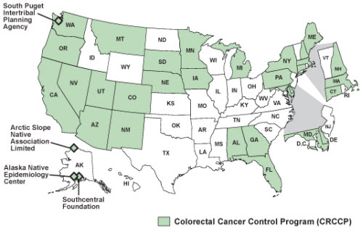
CRCCP Grantees

Slide 4
Overall Workgroup Goals
CRCCP workgroup will implement the Annual Grantee Survey, 2011-2014
CRCCP workgroup will develop and implement additional research projects to assess details of
  Adoption
  Implementation
  Context
  Technical support and resources needed/available
  Organizational characteristics

Slide 5
Annual Grantee Survey Goals
Understand how grantees are implementing CDC’s Colorectal Cancer Control Program (CRCCP),
Establish a baseline to assess how implementation changes each year, and
Collect information related to technical assistance and training needs.

Slide 6
Methods
Survey completed by person responsible for day-to-day management of the CRCCP
Sample: 29 programs (25 states and 4 tribes) across the U.S.
Design: Online survey administered annually

Slide 7
D&I Frameworks Guiding Survey
Conceptual Model
  RE-AIM with focus on Adoption, Implementation and Maintenance of 5 Community Guide strategies
  Interactive Systems Framework for Dissemination and Implementation (ISF)
    Prevention Support System (training and technical assistance)

Slide 8
Survey Administration
& Participation
Survey administered via Web, Nov-Dec 2011
28 of 29 grantees completed the survey
For analyses that follow, denominator = 28 unless noted otherwise

Slide 9
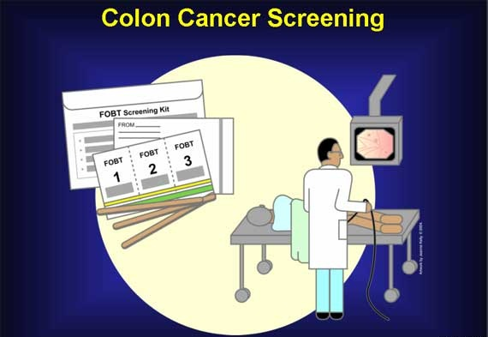
CRCCP Screening provision

Slide 10
Most Offer Colonoscopy or FIT

Slide 11
Patient Navigators Support Screening Provision at Most Programs
86% report that patient navigators (PN) are in place
Average CRCCP supports 5 PN across 5 sites
>90% of those with patient navigators offer:
Patient education about screening modalities
Assessing patient barriers to screening
Tracking patients to complete endoscopy
Assisting patients dx with cancer to get treatment

Slide 12

CRCCP Screening promotion

Slide 13
Most Use > 1 EBI
Note. Mean EBIs used = 3.1 (SD = 1.4)

Slide 14
Reasons for Choosing EBIs
Among those using each EBI, the most commonly given reasons for choosing EBI were:
Evidence-based
Addresses a need we identified
Increases screening more than other activities
CDC supports and promotes this strategy

Slide 15
Implementation Ease Varies with EBI… But Less Than Expected
EBI (N implementing) | Implementation Ease¹ , (M, SD) | Facilitators and Barriers
Small media (27) | 1.9 (1.1) | Facilitators Off the shelf small media materials Established partners, processes, and/or systems Barriers Providers/systems can be challenging to work with Resources required (both cost and time)
Client reminders (21) | 2.2 (0.9)
Reducing structural barriers (14) | 3.1 (1.3)
Provider reminders (9) | 3.1 (1.2)
Provider assessment & feedback (14) | 2.5 (1.1)
¹ Implementation ease scale: 1=Very Easy to 5=Very Difficult

Slide 16
Majority Use PN for Screening Promotion
64% currently use PN
Of these, average grantee supports 6 PN across 5 sites
Grantees most commonly selected same reasons for using PN as for the 5 EBIs:
Evidence-based
Addresses a need we identified
Increases screening more than other activities
CDC supports and promotes this strategy

Slide 17
Majority Use (Or Plan To Use) Other Screening Promotion Strategies
Note. 46% currently use one or more of these interventions; 18% plan to use in next 12 months

Slide 18
Desired ebi training and technical assistance

Slide 19
Desire for Training Depends on EBI

Slide 20
Top 5 Training Topics
Training Topic | M (SD)
Conduct an outcome evaluation of an evidence-based strategy | 2.3 (0.8)
Conduct a process evaluation of an evidence-based strategy | 2.3 (0.8)
Assess the fit of potential strategies or programs with my population | 2.1 (0.7)
Assess the strength of evidence supporting program effectiveness | 2.1 (0.8)
Assess the fit of potential strategies or programs with my organization’s systems, staff, and resources | 2.0 (0.8)
Note. Grantees rated desire for training on each topic 1-3 (3=high desire for training)

Slide 21
Grantees Prefer On-Site or As-Needed Training/TA

Slide 22
CRCCP Workgroup Products To-Date
2011 survey completed
Abstract submitted to 2012 CDC Cancer Conference
Preliminary findings presented to CDC 3/2012

Slide 23
2011-2012 Work Plan Next Steps
Grantee survey
  Complete analyses – March/April 2012
    Report back to grantees & CDC
  Revise survey for 2012 (2nd administration July 2012) & adapt for non-funded states
  Sub working groups identified
  Manuscripts
  Two possible papers led by our workgroup
  Possible participation in additional papers led by CDC

Slide 24
2011-2012 Work Plan Next Steps
Case studies with high and low-implementers
  Identify cases & topics – March 2012
  Design case study methods – March-April 2012
  Conduct case studies/interviews – May-June 2012
  Analyze findings – June-July 2012
  Write paper(s)/abstracts – July-September 2012
Develop work plan/research questions for 2012-2013

Slide 25

Questions
Peggy Hannon Cam Escoffery Annette Maxwell
peggyh@u.washington.edu cescoff@emory.edu amaxwell@ucla.edu

Slide 26
CRCCP Workgroup Members
CPCRN
CDC
Jennifer Allen
Andrea Dwyer
Michelle Carvalho
Cam Escoffery
Peggy Hannon
James Hebert
Jennifer Leeman
Lily Liang
Matt Kreuter
Annette Maxwell
Marlana Kohn
Sandra Morones
Debbie Pfeiffer
Sally Vernon
Thuy Vu
Rebecca Williams
And others!
Amy DeGroff
Vicki Bernard
Kathi Wilson
And others!

