Slide 1
CPCRN FQHC WORKGROUP
Report to the CPCRN Steering Committee
March 22, 2012
Columbia, South Carolina
Emory University
Harvard University
University of California Los Angeles
University of Colorado
University of South Carolina
University of Texas Houston
University of Washington
Washington University

Slide 2
FQHC Workgroup
Year 3 Accomplishments & Plans
  Partnership Committee
  CPCRN FQHC cross-site survey
  Data Subgroup
  Qualitative Inquiry Subgroup

Slide 3
FQHC Workgroup
Partnership Committee
Focus :
  Facilitate opportunities to partner with FQHCs, state, regional & national associations and other stakeholders
Year 3 Objectives
    Engage FQHCs/PCAs
    Strategy
      Increase FQHC/PCA awareness of the CPCRN FQHC Workgroup
      Solicit FQHC/PCA participation in the FQHC Workgroup, Partnership Committee and other Subgroups
      Identify appropriate methods for soliciting periodic feedback on projects from FQHCs/PCAs

Slide 4
FQHC Workgroup
Partnership Committee
  Accomplishments to date
    Developed “Fact Sheet” - workgroup & benefits to participation
    Engaged national stakeholders
        HRSA, NACHC, National CRC Roundtable
        NACHC/NCCR/ACS Summit Planning Committee - MF and SPT
    Convened partnership committee meeting
        Interest expressed by 6 PCAs
        Commitment to participate from 5 PCAs
    Conference call & invited to join FQHC Workgroup calls
    Solicited & received feedback on CPCRN FQHC Survey
  Plans Moving Forward
    Recruitment for CPCRN FQHC survey
    Assist with dissemination of survey results to FQHCs/PCAs

Slide 5
CPCRN FQHC Cross-Center Survey
Update
Survey content
  Literature review
  Thoughtful consideration of CFIR measures
  HRSA – UDS reporting
  NCQA 2011 PCMH standards
  Safety Net Medical Home Initiative (SNMHI) – Chin et al
  SCOPE study – Crabtree et al
  National Demonstration Project – Jaen et al
  Upstate NY PBRN – Fox et al
  Jim Hotz MD– NACHC, NCCR, Georgia PCA
Online survey logistics
Survey protocol (handouts)

Slide 6
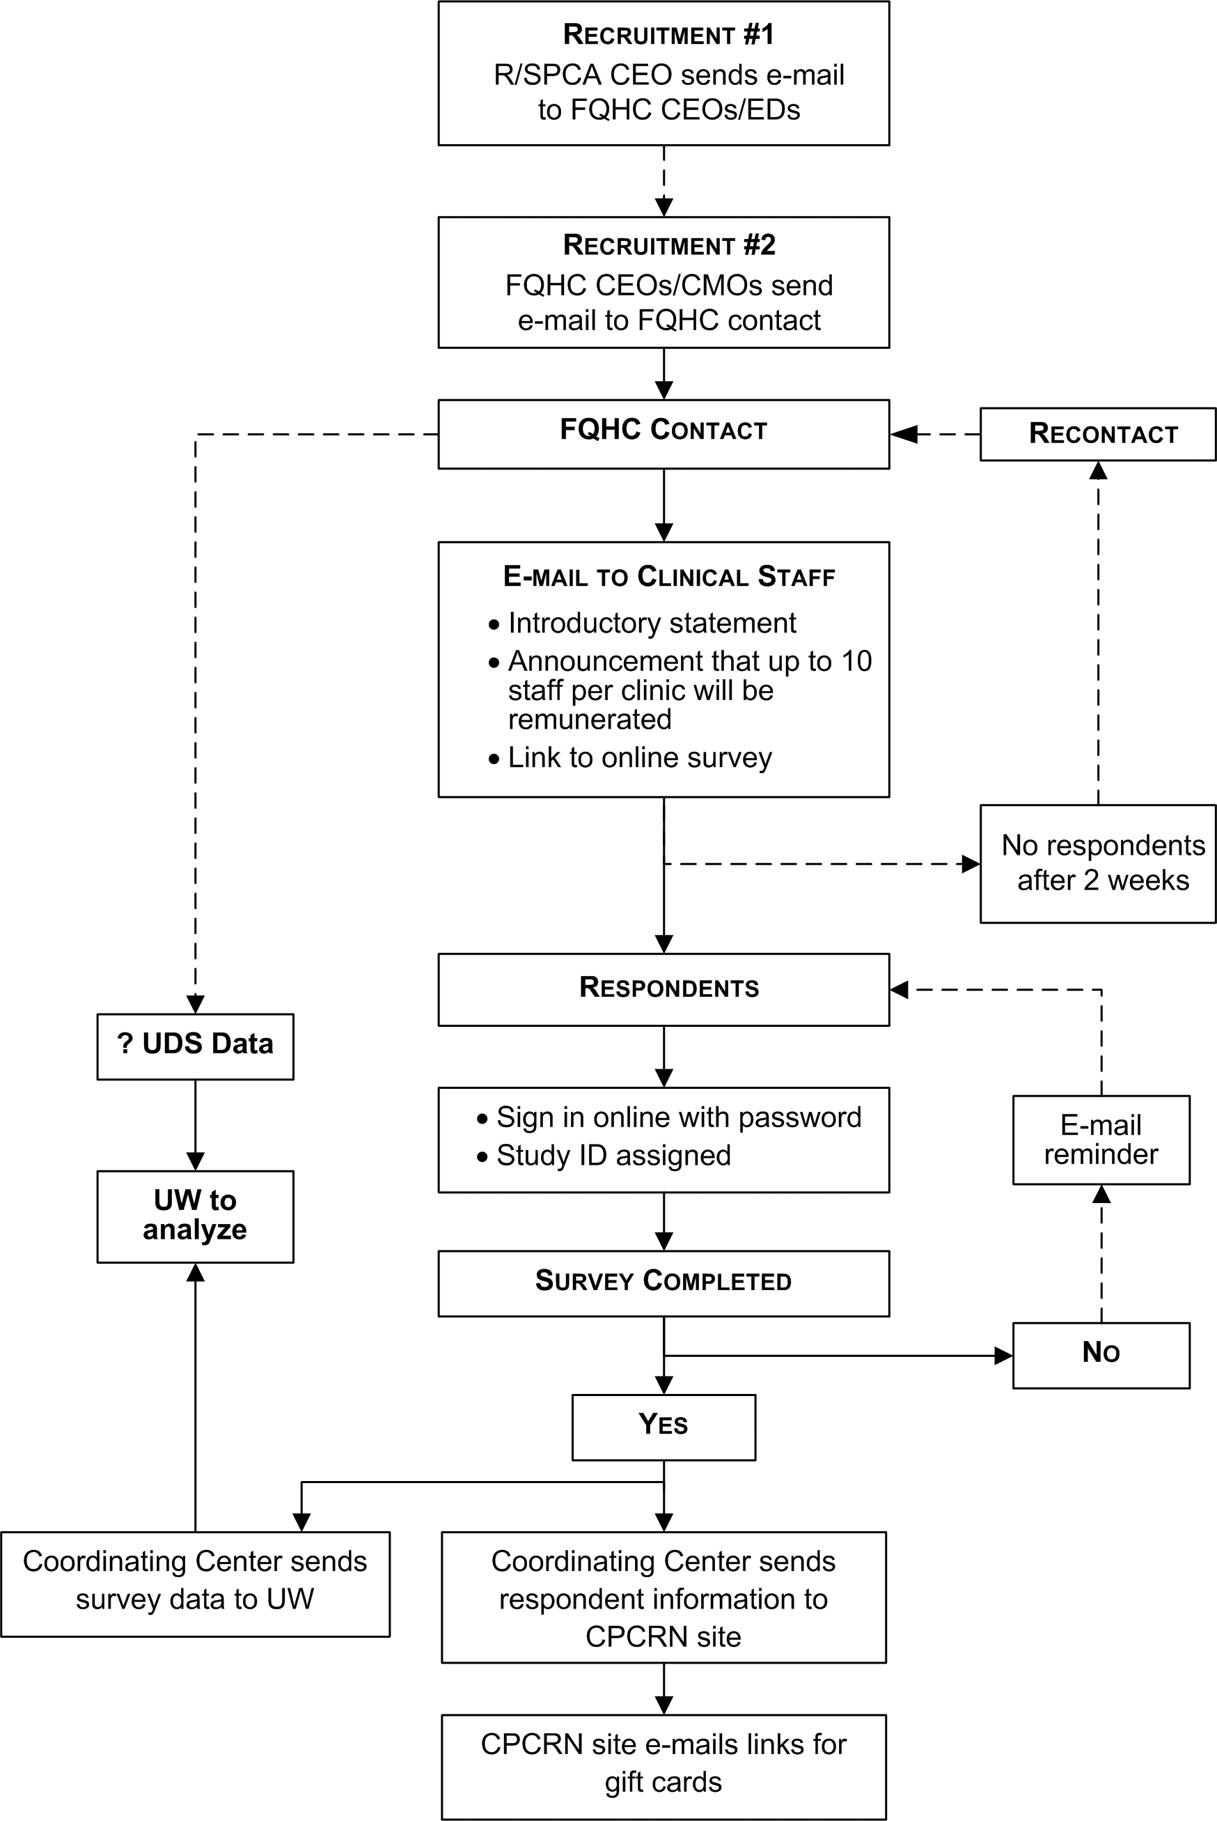
CPCRN FQHC Survey Protocol

Slide 7
CPCRN FQHC Survey
  Survey Content
    Introductory statement/informed consent
    Screening Section – 5 questions (handout)
    Practice Adaptive Reserve (PAR) - 23 items (handout)
    CFIR Measures – 36 items
    Work environment (?SNMHI), workflow (UW-AAPCHO)
    Best Practice(s) Section Draft (handouts)
      Open ended question – Given the history of your clinic how likely do you think your clinic will succeed with the best practice(s)?
      EMR – challenges to Pt care with EMR installation/upgrades/use
    Demographic Section – 7 questions (handout)
    Post Survey
  Clinic characteristics (FQHC contact + UDS data)
      Population/panel based care (SNMHI)
      Has your clinic participated in a HRSA Health Disparities Collaborative project? (SNMHI)
      Staff turnover – clinic’s ability to recruit and retain providers, nurses and MAs – 3 questions (SNMHI)

Slide 8
CFIR constructs(# items)
      Intervention characteristics
        Relative Advantage (2)
        Complexity (4)
      Outer setting
        External Policies & Incentives (TBD)
        Pt needs and resources (1)
      Inner Setting
        Structural Characteristics
          (UDS data vs. Clinic characteristics section)
          Resources (4)
        Networking & Communication
          Overlap w/ Process items

Slide 9
CFIR constructs(# items)
      Inner Setting (cont’d)
        Implementation Climate (7)
          Compatibility (3)
          Tension for change (TBD)
          Relative Priority (included in overall climate questions)
          Organizational rewards & incentives (TBD)
          Goals and Feedback (TBD)
          Learning Climate (PAR)
        Culture (PAR)
            Leadership (PAR)
            Stress (4)
            Effort (5)
        Individual characteristics - Knowledge and Beliefs (4)
      Process
        Engaging champions (3)
        Executing (1)
        Reflecting (PAR; 2)

Slide 10
CPCRN FQHC Survey Timeline
March 2012
  UW - conditional IRB approval, 14 interested clinics
April 2012
  April 1-15: Pre-testing, IRB applications
  April 15-30: Final survey to UNC CC and IRBs
  April 15-May 15: UNC CC develop online survey
May– June 2012 - Implement survey
  May 16-30 : Wave 1 survey
  June 1-15: Wave 2 survey
  June 16-30: Wave 3 survey
July-Aug 2012 – Analysis
National Conferences
  Aug 2012 – CDC National Cancer Conference
  Sept 2012 – NACHC CHI and Expo Sept 7-12, 2012, Orlando FL

Slide 11
FQHC Workgroup
Steering Committee Input
Findings to provide back to FQHCs/clinics
  To inform implementation intervention development
  To inform FQHC QI efforts
CRC screening vs. Tobacco cessation
# Clinic respondents
  FQHC/Clinic level analysis
  Clinic role (providers, nurses, MAs) level analysis
Survey content
  CFIR constructs

Slide 12
CPCRN FQHC Survey
Implementation Outcome
  CRC screening processes and procedures
    HRSA – UDS reporting roll out 2012
    NCQA 2011 PCMH standards
    Complements
      Safety Net Medical Home Initiative
      SCOPE study
      National Demonstration Project
  Tobacco cessation
    HRSA – UDS reporting roll out ~ 10 years ago

Slide 13
The Impact of Federally Qualified Health Centers on Cancer Mortality-to-Incidence Ratios:
An Ecological Analysis
CPCRN FQHC Data Subgroup

Slide 14
Data Information
FQHCs Data - US Department of Health and Human Services Health Resources and Services Administration (HRSA)
  FQHCs identified by county then FQHC concentration was classified into quartiles
Age-adjusted Cancer Incidence and Mortality Data - Surveillance, Epidemiology, and End Results (SEER) Program
  Incidence from 2004-2008; Mortality from 2003-2007
Mortality-to-Incidence ratio (MIRs) = the age-adjusted mortality rate divided by the age-adjusted cancer incidence rate (MIR takes on values ranging from 0 to 1)

Slide 15
Results
Federally Qualified Health Centers

Slide 16
Results

Slide 17
Conclusion
Blacks have higher MIRs for all four cancers (Breast, Cervical, Colon, and Prostate) than Whites.
The overall inverse trend seems evident across race (with MIR decreasing with higher FQHC concentration); but is more pronounced in Blacks.
These formative research results suggest FQHCs may play a role in reducing cancer mortality; and effects may vary by race.

Slide 18



Collaborators
University of South Carolina – Swann Arp Adams, PhD.; James Hébert, MSPH, ScD; Leepao Khang, MPH; Daniella Friedman, PhD; Sudha Xirasagar, PhD
University of Washington – Mei Po Yip, PhD
Harvard University – Reginald Tucker-Seely, MA, ScM, ScD

Slide 19
FQHC Qualitative Inquiry Subgroup (QIS)

Slide 20
QIS Participants
UT Houston:
Maria Fernandez, Lily Liang, Patricia Mullen, Bijal Balasubramanian, William Calo
Emory:
Michelle Kegler, Michelle Carvalho, Gillian Schauer, Yao Shi
University of South Carolina (SC):
Vicki Young, Dayna Campbell
University of Colorado (UC):
Betsy Risendal, Andrea Dwyer, Yvonne Kellar-Guenther
University of Washington (UW):
Shin-Ping Tu, Jane Edelson
National Association of Community Health Centers (NACHC):
Michelle Proser

Slide 21
QIS Goal
To identify and explore factors influencing implementation of evidence-based cancer programs and practices for cancer control in FQHCs.

Slide 22
QIS Activities
(Aug 2011- Mar 2012)
Time | Activities | Location | Participants | Leading Site
Aug 29th, 2011 | A focus group at NACHC Community Health Institute | San Diego, CA | 4 CMO/Medical Directors | UT Houston (Emory, SC)
Nov 10th, 2011 | A focus group (intensive workshop) at Midwest Stream Farmworker Health Forum | Albuquerque, NM | 5 Front-line workers | UT Houston
Mar 8th, 2012 | Two focus groups at Colorado Community Health Network Quarterly Meeting | Denver, CO | 15 Medical Directors; 8 Operation Managers | UC
Mar 21st – 25th, 2012 | Personal Interviews at NACHC Policy and Issues Forum | Washington, D.C | (Approximately) 10 Medical Directors; 6 CEOs | UT Houston (SC, UC)

Slide 23
QIS Planned Activities
(2012-2013)
Time | Activities | Location | Participants | Leading Site
Apr 8th, 2012 | A focus group at the South Carolina Primary Health Care Association Quarterly Meeting | Columbia, SC | Clinical staff including CMOs | SC
Apr 18th-21st, 2012 | Personal interviews at the Georgia Association for Primary Health Care (GAPHC) Patient Centered Medical Home Learning Session | Pine Mountain, GA | CEOs, CMOs and other clinical staff | Emory
May, 2012 | Focus group and interviews at 2 FQHCs in Texas (Legacy & Lone Star Family Health Center) | TX | CEOs, CMOs and providers | UT Houston
2012-2013 | Case study | TBD | Leadership and Clinical Staff | Emory

Slide 24
QIS Timeline (2012 – 2013)
 | Project Year 3 |  |  |  |  |  |  |  |  | Project Year 4
 | Jan | Feb | Mar | Apr | May | Jun | Jul | Aug | Sept | Oct | Nov | Dec | Jan | Feb | Mar | Apr | May | Jun | Jul | Aug | Sept
1.Qualitative Inquiry Paper
Instruments Development
Revised Focus Group Guide
Interview Guide
Data Collection
Focus Groups at CCHN
Interviews at NACHC P&I
Focus Groups in SC
Interviews in GA
Transcription
Analysis
Coding
Consolidate results
Manuscript Preparation
Presentation
CDC Cancer Conference
NACHC CHI, 2012
2. Case Study
Case study plan
Data Collection
Analysis
Manuscript Preparation
Notes:
24

Slide 25
Preliminary Findings
Data fit well with the Consolidated Framework for Implementation Research (CFIR) constructs
Breast, cervical and colorectal cancer screening initiatives were discussed as the primary success areas
The use of EMR is pivotal in CHC’s work and part of the success
Leadership engagement is essential for practice change
CHCs are willing to change but are in need of good tool(s) to implement change(s)
Providing sufficient training and resources for staff to implement change is very important
Programs aligning with the goal of improving quality of care are more likely to be implemented
Notes:
25

Slide 26
QIS Products To-Date
Instruments
  Appreciative Inquiry Guide for Intensive Training (3 hours)
  Revised and shortened Focus Group Guide (1 hour)
  Personal Interview Guide (1 hour)
Presentation
  Presentation on Appreciative Inquiry and evidence-based cancer control practices at Midwest Stream Farmworker Health Forum
Abstracts submitted
  NIH 5th Dissemination and Implementation Conference (not accepted)
  CDC 2012 Cancer Conference

Slide 27
FQHC Workgroup
Abstracts submitted to CDC National Cancer Conference
1. The CPCRN: Partnerships and Processes to Promote Prevention Practices at FQHCs
2. Exploring Factors Influencing Adoption and Implementation of Evidence-based Cancer
Prevention and Control Practices in FQHCs: A Qualitative Study
3. Using GIS Mapping to Inform Cancer Related Primary Care Practice Decisions
MANUSCRIPT FOCUS | LEAD SITE | U Co | Emory | UCLA | USC | UT-H | UW | WU | Harv
Qualitative Inquiry Subgroup
Factors influencing implementation of EBPs for cancer prevention and control | UT-H | X | X |  | X | X | X | X
Multiple case studies of FQHCs implementing EBP | Emory |  | X |  |  | X
Data Subgroup
FQHCs -MIR/EMR Editorial | USC |  |  |  | X |  | X |  | X
GIS Mapping | USC |  |  |  | X |  | X |  | X
Cross-Center Survey
CFIR Measures/ Survey development* | TBD | X | X | X | X | X | X | X
Survey results | UW | X | X | X | X | X | X | X
Practice Adaptive Reserve – NDP / AAPCHO | TBD

