Slide 1
Increasing Reach and Implementation of Evidence Based Programs for Cancer Control
CPCRN Steering Committee
March 22, 2012
Notes:
This project will develop, validate, and evaluate an online, interactive, decision support and program planning tool -
Tailored Aid for Communities adapting Tested Interventions for Cancer Control –TACTICC

Slide 2
History
Submitted by EBA Workgroup as R25 Education Grant in 2008 with UT, Emory, and Wash U leading, and the other CPCRN collaborating centers participating
In 2011, UT led the submission of an R01 D & I Research in Health proposal. Emory is the evaluation subcontractor; and all CPCRN collaborating centers are participating plus Cancer Care Ontario
Notes:
2008 - TACTIC (Technical Assistance for Choosing evidence based cancer control Tools In Communities)
2011 In addition to the participation of the CPCRN, we have Canadian partners, the American Cancer Society, National Center for Farmworker Health, state and other cancer control organizations, and public health training organizations,

Slide 3
CPCRN Partners
UT Health - lead
Pis – Maria Fernandez, Patricia Dolan Mullen;
Co-Is – Kay Bartholomew, Paul Swank
Emory University – Subcontractor for Evaluation
PI - Cam Escoffery, Co-I - Regine Haardoerfer
Notes:
Dr. Fernandez will be responsible for coordinating the process content development and coordinating recruitment for evaluation. She will be the primary liaison for the interface development.
Dr. Mullen will provide overall leadership and coordination for the CPCRN- Cancer Care Ontario consortium, assuring the quality, timeliness, and efficiency of the various tasks and products encompassed in the specific aims. She will coordinate content development, contribute to the evaluation module in years 1-2, and promote message testing during recruitment for the evaluation.
Dr. Bartholomew will contribute to the process content of the decision support tool, particularly to the modules on assessing fit, identifying “active ingredients” of EBAs, and adapting EBAs; and she will lead the promotion planning.
Paul Swank will contribute to the development of the measures and to the evaluation through the use of Item Response Theory.
Cam Escoffery will lead the evaluation team’s effort in refining the primary outcome measures related to evidence-based behaviors. She will direct the evaluation of TACTIC, working closely with colleagues from the Cancer Prevention and Control Research Network through each phase of the evaluation.
Regine Haardoerfer will work on planning the evaluation activities and data analysis.

Slide 4
CPCRN Partners
Program Advisory Committee
UCLA – Roshan Bastani, Beth Glenn
University of Colorado – Betsy Risendal, Angela Sauaia
University of Washington – Vicky Taylor
Texas A & M – Marcia Ory
Wash U – Matt Kreuter, Ross Brownson
UNC Coordinating Center – Rebecca Williams
Massachusetts (Boston U & Harvard) – Deborah Bowen
University of North Carolina – Cathy Melvin, Jennifer Leeman
University of South Carolina – James Hebert, Daniela Friedman
Notes:
will attend the annual Program Advisory Committee meeting held in conjunction with the annual CPCRN face-to-face meetings, participate on quarterly Advisory Committee phone calls, and will advise on the development of content and the evaluation of the interactive tool. Each consultant will provide access to their respective CPCRN network partners, recruit partners for participation in the Beta testing, assist with recruitment for the evaluation and in the promotion of the online tool.

Slide 5
Background - Need
Critical gaps in cancer control practice including capacity among planners to adopt, adapt and implement EBAs
Conceptual gap in dissemination and implementation frameworks regarding practitioners’ perspective and needs
Notes:
Practice needs
Existing resources provide information about effective programs, but offer little instruction to practitioners on how to choose, adapt, and implement these programs in communities.
resources such as the Community Guide suggest strategies rather than fully tested implementable programs. This gap leaves practitioners with the tasks of developing implementation protocols and program materials in order to implement the recommended strategy. These tasks and confusion over exactly what active behavior change “ingredients” are being recommended make it a challenge to apply EBAs in practice.
while efforts to stimulate use of EBAs for cancer control such as training on Cancer Control PLANET and NCI’s “Using What Works” seem to have increased awareness about these resources and the availability of EBAs among some community cancer control planners, they have been less successful than hoped in increasing actual use.
Conceptual needs
A key gap is that dissemination has historically been conceptualized as a linear process – another step along the “discovery to delivery” continuum in which developers must “push” their products out into the community for use. This conceptualization does not substantially acknowledge the need to increase planners’ capacity to find, adapt, and implement programs. Failure to involve community stakeholders, local data and experiences during the development process for EBAs, and the community’s perception that research-tested interventions are frequently not appropriate for their context, are common consequences of such a perspective.

Slide 6
Aims
Aim 1: To develop and validate an online, interactive decision support and program planning tool (TACTICC) to increase use of EBAs in communities.
Aim 2: To evaluate the effectiveness of TACTICC in increasing EBA adoption, adaptation, and implementation.
Notes:
Why Aims are important:
Despite knowledge about what works and availability of EBAs, however, they are often not used in communities.
A central problem with existing resources and models is that they are not tools. They are not responsive to user needs, they make the planner do more work than they reasonably can do, and they do not offer timely, relevant, science-based assistance.
This study will deliver and evaluate a tool that will fill these needs.
The long term goal is to reduce cancer morbidity and mortality by expanding the reach, implementation, and maintenance of effective programs in communities.
The project objective, to increase the capacity of cancer control planners to find, adapt and implement EBAs, is a major step toward this goal.

Slide 7
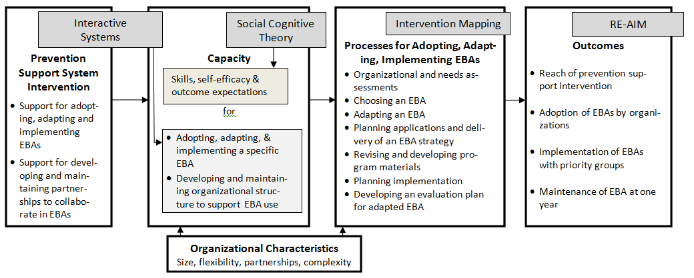
Logic Model
Notes:
This study will be guided by a new conceptual model that integrates four frameworks: a) RE-AIM to identify the longer range outcomes of this study, b) Interactive Systems Framework to guide the focus for enhancing implementation capacity for EBA use, c) Intervention Mapping to provide a systematic process for program adaptation, and d) Social Cognitive Theory to inform identification of determinants and intermediate processes, e.g., self-efficacy, for adoption and implementation behaviors.

Slide 8
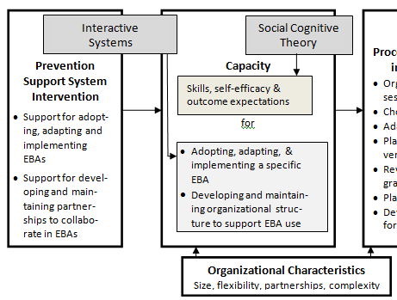
Logic Model – Part 1
Notes:
Four conceptual frameworks have provided guidance for our preliminary studies and our proposed development and evaluation activities:
The Interactive Systems Framework (ISF) is a heuristic for understanding needs across three systems--the synthesis and translation system (work on making the innovation as understandable and easy to implement as possible), prevention support system (building capacity among organizational staff to support implementation), and delivery system (technical assistance to implementers in the field). The ISF suggests the importance of capacity development across these systems and helped us define TACTICC as a tool to enable actors in the prevention support and delivery systems to more effectively find, adapt, and implement EBAs. Furthermore, even though the ISF describes a prevention synthesis and translation system for intervention developers, we believe that this system also applies to the user during the adaptation process. For example we expect that TACTICC will enable users to more readily understand the logic, methods and core elements of the original EBA. The ISF authors define capacity as “skills and motivation” for both innovation implementation and general organizational function. [Wandersman A, Duffy J, Flaspohler P, Noonan R, Lubell K, Stillman L, Blachman M, Dunville R, Saul J. Bridging the gap between prevention research and practice: The interactive systems framework for dissemination and implementation. American Journal of Community Psychology. 2008;41(3):171-181.]
We depend on Social Cognitive Theory to inform our understanding of how to influence the development of these skills and motivation (including self-efficacy and outcome expectations). Social Cognitive Theory (SCT) provides explanations of the psychological mechanisms by which adoption, adaptation, and implementation occur. For a system to adopt and implement a program, the people in the system must be aware of the innovation, hold positive outcome expectations for it, and have sufficient self-efficacy, behavioral capability, and skills for both adoption and implementation. SCT also suggests methods for behavior change including vicarious experiences (modeling—behavior of others that is noted in detail and perceived to be reinforced); enactive mastery experiences with feedback to serve as indicators of capability; verbal persuasion and other social influences that suggest the person or group possesses certain capabilities; and skill training with guided practice; and reinforcement. [Bandura A. Social Foundations of Thought and Action: A Social Cognitive Theory. Englewood Cliffs, NJ: Prentice Hall; 1986.]

Slide 9
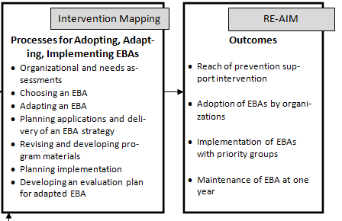
Logic Model Part 2
Organizational Characteristics
Size, flexibility, partnerships, complexity
Notes:
Intervention Mapping²³ provides a systematic process for developing, implementing, and adapting health promotion programs. Developed by Dr. Bartholomew and colleagues, IM has been used to develop many health promotion and dissemination programs (for example, the dissemination of the ALLHAT clinical trial results, asthma management, nutrition, sun protection, adolescent risk taking, violence, HIV prevention, cervical cancer screening, mammography, colorectal cancer screening, leg ulcers, and acute stroke therapy). A recent addition to IM is the explicit application of IM steps to program adaptation. The IM framework also adds an expanded taxonomy of methods and their applications that will help planners identify core methods rather than a tendency to notice only delivery strategies. [Bartholomew LK, Parcel GS, Kok G, Gottlieb NH, Fernandez ME. Planning Health Promotion Programs: An Intervention Mapping Approach. San Francisco: Jossey-Bass; 2011.]
RE-AIM provides the a systematic way to position and evaluate the dissemination and implementation of EBAs for community cancer control (Reach and Implementation). RE-AIM includes five criteria: reach, efficacy, adoption, implementation, and maintenance. Reach refers to the proportion of the target population who receives the intervention and efficacy indicates the proportion of the population receiving the intervention that changes their behavior. Adoption refers to the proportion of public health practitioners who agree to use the intervention. Implementation is the extent to which public health practitioners deliver the intervention, and maintenance reflects the extent to which the delivery of the intervention is sustained over time. The overarching goal of this study is to increase reach of effective programs by enhancing adoption and implementation of EBAs for cancer control. Our primary outcomes will be the level of adoption, adaptation, and implementation of EBA as indicated by behavioral indicators. [Glasgow RE, Vogt TM, Boles SM. Evaluating the public health impact of health promotion interventions: the RE-AIM framework. American Journal of Public Health. 1999;89(9):1322-1327]

Slide 10
Methods – Aim 1
To develop and validate an online, interactive planning tool
Refinement of functional specifications and further validation of the planning tasks
Development of the program wireframe and cancer content
Alpha testing
Program development
Beta testing and final revisions
Preparation for Implementation
Notes:
Methods – Aim 1
To develop and validate an online, interactive planning tool to increase use of EBAs in communities
We will accomplish this aim through a 6-step process. All steps will be carried out by the investigators with LH & A. Step 1 will be conducted primarily by the investigators with the collaboration of LH & A. All other steps will be conducted primarily by LH & A with investigator and Advisory Committee participation in all aspects. During all phases of TACTICC production, the entire project team will meet for monthly progress updating and system planning via teleconference. LH & A will provide database and system well as graphic design expertise. LH & A will also take final responsibility for editing all content, including application-related instructions, and placement onto the application.
programmers as

Slide 11
Methods - Aim 2
To evaluate the effectiveness of TACTICC
Compare TACTICC with usual practice in RCT with 430 planners recruited through CPCRNs, Canadian partners
Use indicators of tasks associated with the module processes for adopting, adapting, and implementing EBAs
Administer measures at baseline and 2 follow-ups
Measure EBA capacity, use of major EBA resources (e.g., Community Guide), and organizational, cancer focus, and planner characteristics as covariates
Evaluate a sample of workplans
Notes:
Methods - Aim 2
To evaluate the effectiveness of TACTICC in increasing EBA adoption, adaptation, and implementation
We will compare the effectiveness of TACTICC to usual dissemination practice (cued direction to Cancer Control PLANET, R-TIPs, The Community Guide, and Canadian Best Practices Portal) in a randomized trial with 430 community level cancer prevention and control planners (one per organizational unit) recruited through the networks of the 10-CPCRN consortium and our other U.S. and Canadian partners. Based on our logic model, our primary outcome is EBA adoption, adaptation, and implementation behavior. We will use indicators of the subtasks associated with the module processes for adopting, adapting, and implementing EBAs. We will use Item-Response Theory and administer measures at baseline and two follow-up points. We will measure EBA capacity, use of major EBA resources (e.g., Community Guide), and organizational, cancer focus, and planner characteristics as covariates. We also will evaluate a sample of workplans.

Slide 12
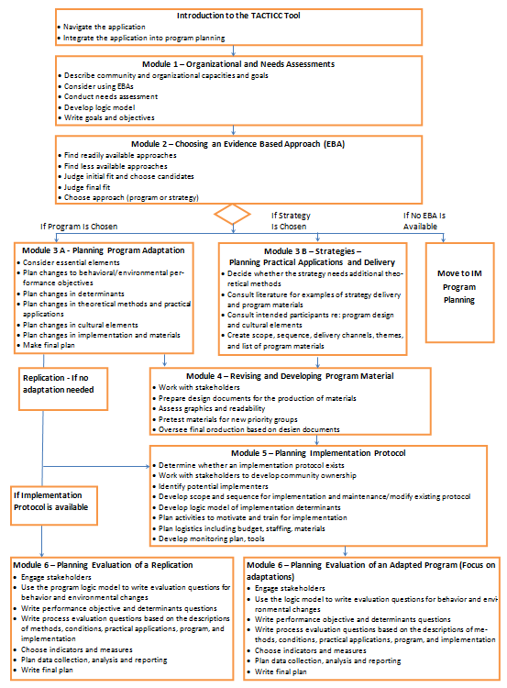
Flow Diagram

Slide 13
Flow Diagram
Module 3A – Adaptation
Consider essential elements
Plan changes to behavioral/ environmental perf objs
Plan changes - determinants
Plan changes - theoretical
methods
Plan changes - cultural elem’ts
Plan changes – implementation
& materials
Make final plan
Notes:
For example, for Plan changes in determinants
Module Objectives include
Compare the targeted change in determinants in the program to be adopted with the determinants thought to effect behavior in the new setting to decide whether overlap in objectives is sufficient
Look at the Logic Model of Change for the new setting and for the program to be used
Decide if new determinants should be added or if some could be modified or deleted to make the candidate program a better fit for the logic model of change
Examples of Support Provided by TACTICC
Interactive worksheets for considering additions, modifications, substitutions, deletions in the determinants of behavioral or environmental targets of change
We expect that while the underlying steps and processes may be more involved than what is typically done, if the user interface and technical support is designed to enhance simplicity and usability, the underlying complexity will be invisible to the user.

Slide 14
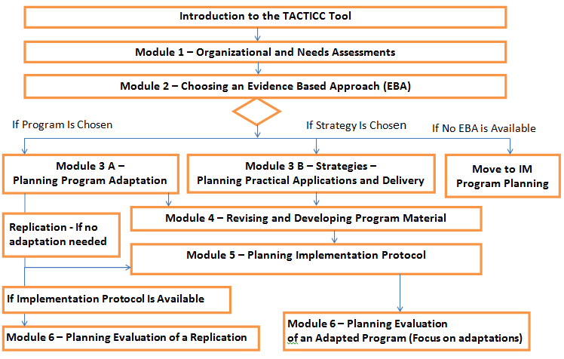
Flow Diagram

Slide 15
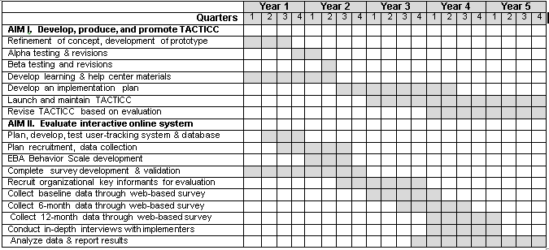
Timeline

