Slide 1
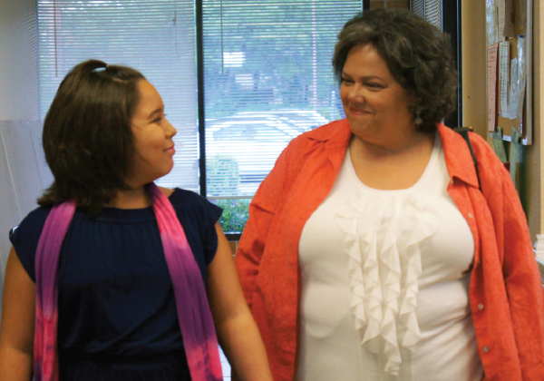


Using Intervention Mapping to Develop a
Tailored HPV Vaccination Intervention
For Low Income Hispanic Parents
Maria E. Fernandez, PhD
CPCRN Fall Meeting Houston, TX 2012

Slide 2
Research Team
UTSPH
Maria E. Fernández, PI
Sally Vernon, Co-I
David Lairson, Co-I
Lara Savas, Co-I
Angelica Roncancio, Co-I
Barbara Kimmel, Project Coordinator
Natalie Fernández-Espada, Project Coordinator
Nancy De la Fuente, Data Collection Coordinator
Chakema Carmack, Data Manager
UT – Medical School Faculty
Laura Benjamins, Co-I
Francisco Orejuela, Co-I
Sean Blackwell, Co-I
Texas Children Hospital/ Prosalud
Margaret Goetz, Co-I

Slide 3

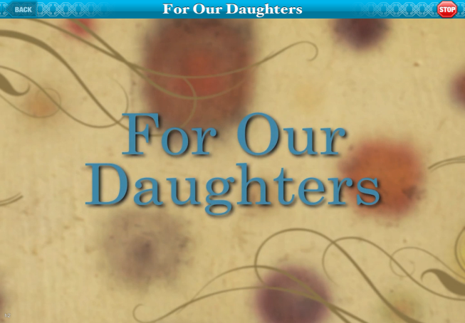
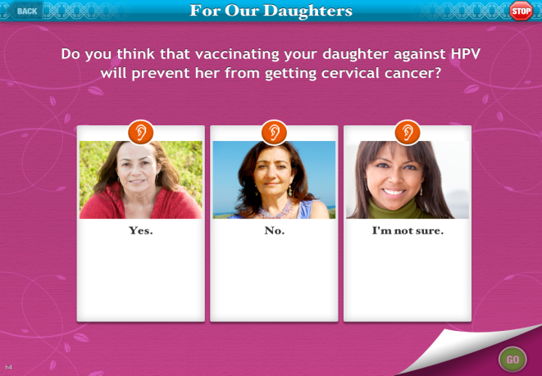
Background
High rates of human papillomavirus (HPV) infection and low rates of screening among Hispanic women contribute to cervical cancer-related health disparities in this population
Low health literacy, language barriers and low income may influence Hispanics’ low uptake rate and failure to complete the HPV vaccine series

Slide 4
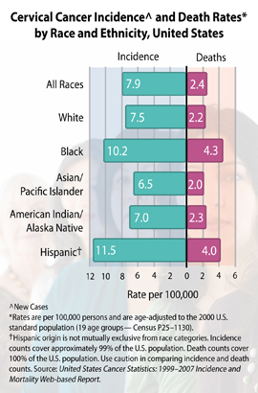
Human Papillomavirus (HPV)
HPV is the most common sexually transmitted infection¹
HPV can be cleared by the body, but in some cases it leads to cervical cancer
Hispanic women have higher cervical cancer incidence and mortality rates compared to non-Hispanic Whites²
1. CDC. (2011, August 17). Sexually Transmitted Diseases (STDs). Retrieved from http://www.cdc.gov/std/hpv/stdfact-hpv.htm
2. American Cancer Society. (2011). Cancer facts and figures 2011. Atlanta: American Cancer Society.
Notes:
HPV is not the same as herpes or HIV (the virus that causes AIDS). These are all viruses that can be passed on during sex, but they cause different symptoms and health problems

Slide 5
Study Population and Timeframe
Target population
  Hispanic parents of daughters (11-17 yrs)
  Daughters not vaccinated against HPV
  Spanish or English speaking
Recruitment Site: Clinics & clinic waiting rooms
  Low-income areas
  Predominately Hispanic areas
  Part of Vaccine for Children’s program
Timeframe
  Goal: Recruit 1,809 parents in 10 months
  6 month follow up after baseline with clinic record validation
Notes:
-High rates of HPV infection and low rates of screening among Hispanic women contribute to high rates of cervical cancer in this population.
-What our study aims to do is reduce the number of cervical cancer cases amongst Hispanics by encouraging them to vaccinate their daughters against HPV.
-The target population for this study are parents/caregivers of girls between the ages of 11 to 17.
We will recruit parents from eligible clinics in the Houston area. Eligible clinics are those that are in low-income areas, Predominately Hispanic areas, and are a part of the Vaccine for Children’s Program.
-We have 1 year to complete the first part of the study, followed by a 6 month follow-up

Slide 6
Study Aims
Identify factors associated with parental decisions concerning HPV vaccination among low-income Hispanic parents
2. Use Intervention Mapping (IM) to develop two culturally appropriate interventions to promote HPV vaccine uptake
  print photonovella (fotonovela)
  self-directed, tailored interactive (TIV) iPad-based program
Evaluate the effectiveness and cost effectiveness of two lay health worker-delivered interventions
Notes:
We built on messages and materials previously developed by an NCI R21-funded project (“Vivir Sin Cancer”)

Slide 7
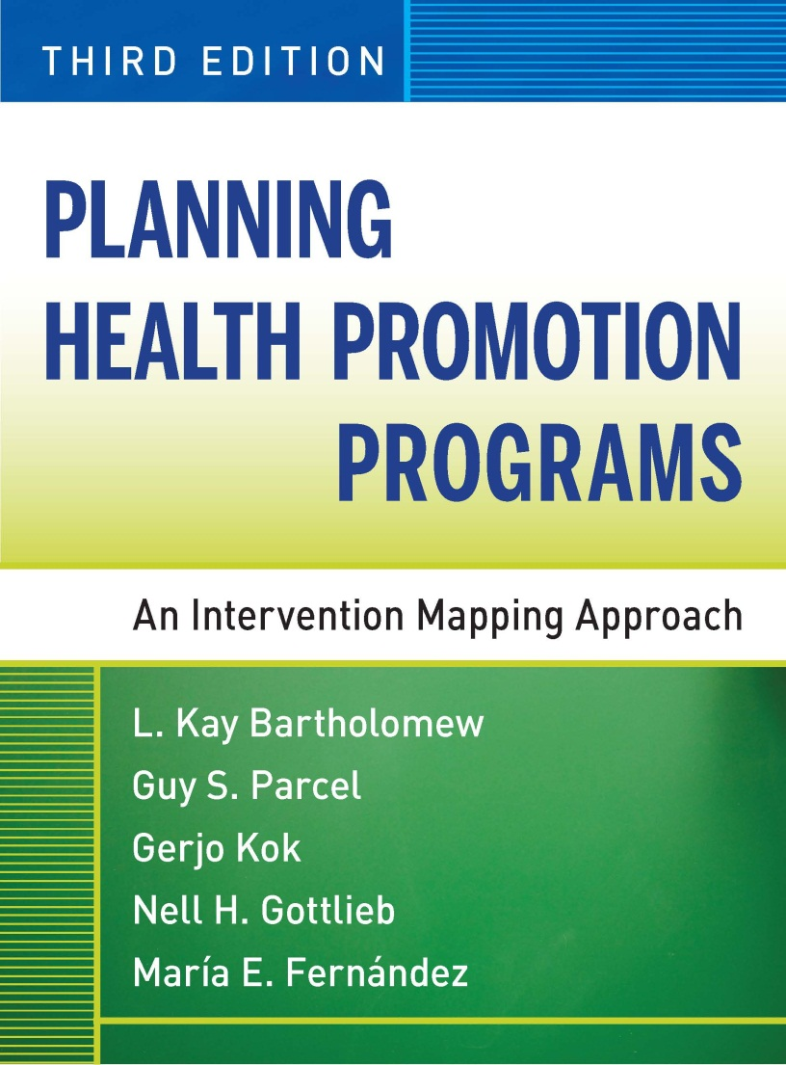
Intervention Mapping
Six Core Steps in IM:
Assess needs
Identify target behaviors, determinants, and change objectives
Identify methods and strategies
Develop program materials
Plan for program adoption and implementation
Evaluation

Slide 8
Needs Assessment
We identified factors/determinants of HPV vaccine uptake through conducting a literature review and qualitative research
  Literature review (45 studies)
Determinants Identified in Literature
Knowledge
Attitude
Perceived Benefits/Barriers
Social Norms
Perceived Susceptibility to HPV
Resources
Notes:
Unchangeable factors:
Older mothers, being Black, high income households ($100,000), associated with daughter being vaccinated
Parental history of sexually transmitted infections
Race, ethnicity, religious group, child’s public school status, Born Again Christian status, education, income, political orientation, & belief vaccine would cause girls to become more sexually active
Mother's history of HPV and pap testing were determinants of giving daughter vaccine
Those who accepted any kind of STI vaccine were more likely to be of lower education and be attending urban clinics
Resources:
The following methods of seeking information on HPV were found as the most popular: pamphlets and brochures (57.1%), gynecologists (55.7%), newspaper (48.6%), general practitioner (48.6%), internet (47.1%), women's health service (42.9%, women's magazine (38.6%), and family planning (34.3%)
Of those who had not actively sought information on the HPV vaccine, 52.4% found out about the vaccine through the media.
Pamphlets containing HPV information were found to increase Maternal knowledge and acceptance of the HPV vaccine.
Parental acceptance of HPV vaccine increased after an HPV-specific intervention.

Slide 9
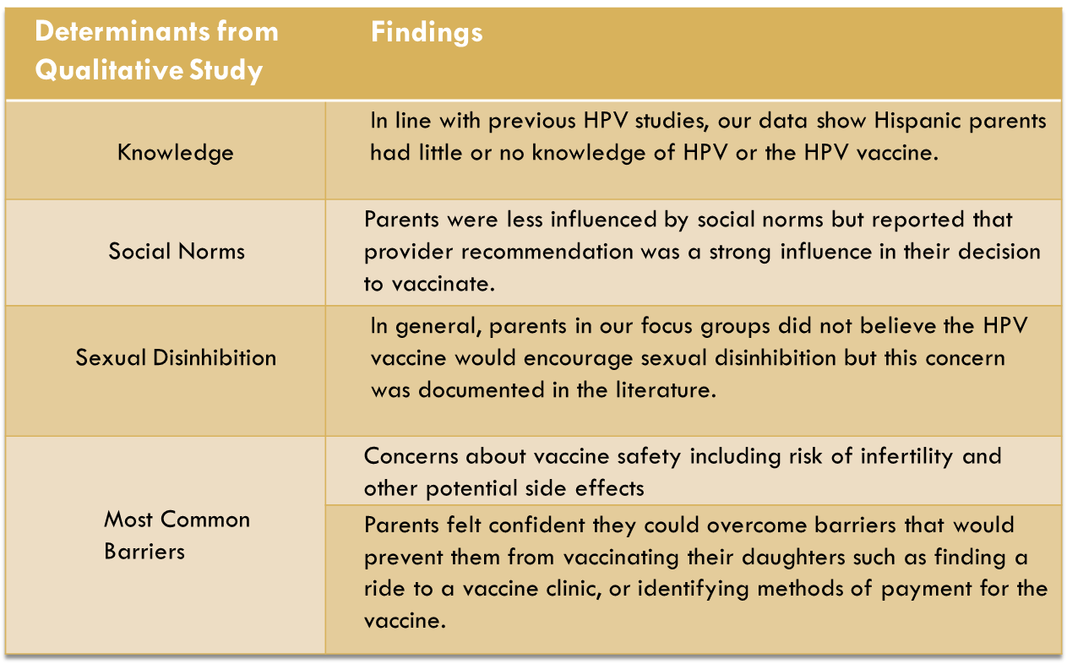
Needs Assessment
  Qualitative Research with Hispanic parents (4 focus groups and 2 in-depth interviews)

Slide 10
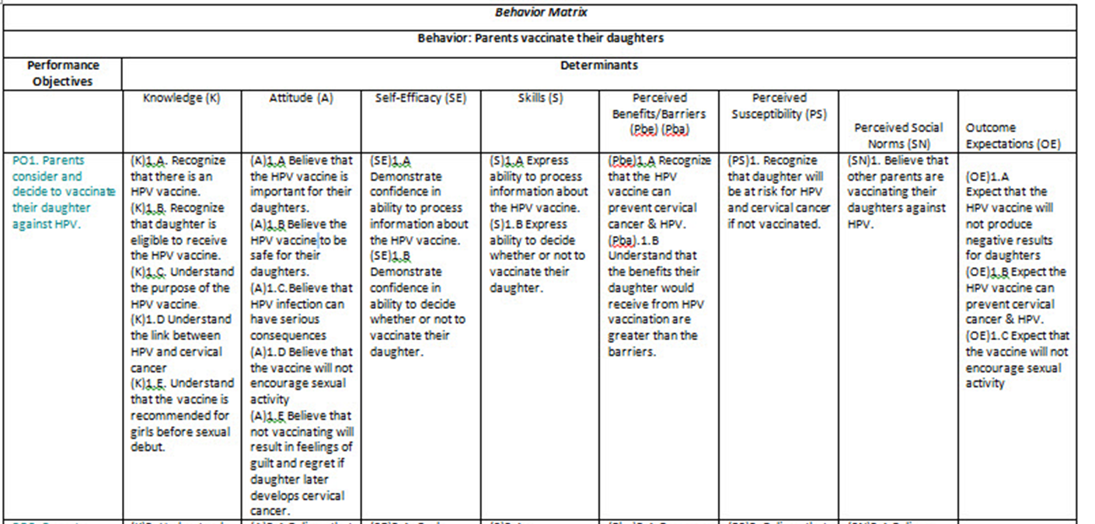
Determinants and Change Objectives
Based on identified determinants we developed matrices of change objectives that drove decisions about intervention content, methods, and strategies
Notes:
Final list of determinants to be addressed in intervention:
Knowledge
Attitude
Self-Efficacy
Skills
Perceived Benefits/Barriers
Perceived Susceptibility
Perceived Social Norms
Outcome Expectations

Slide 11
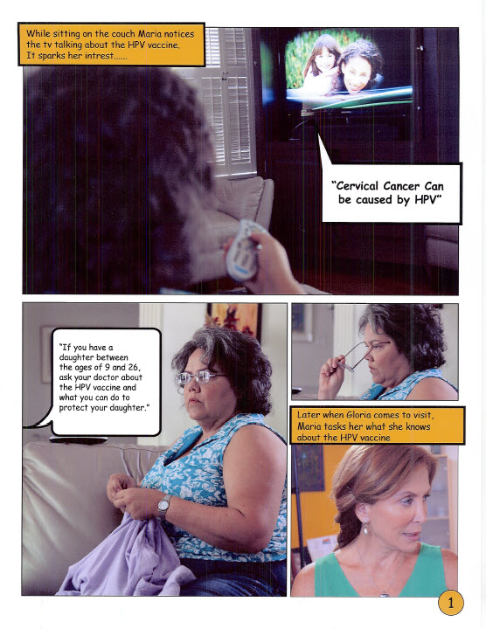
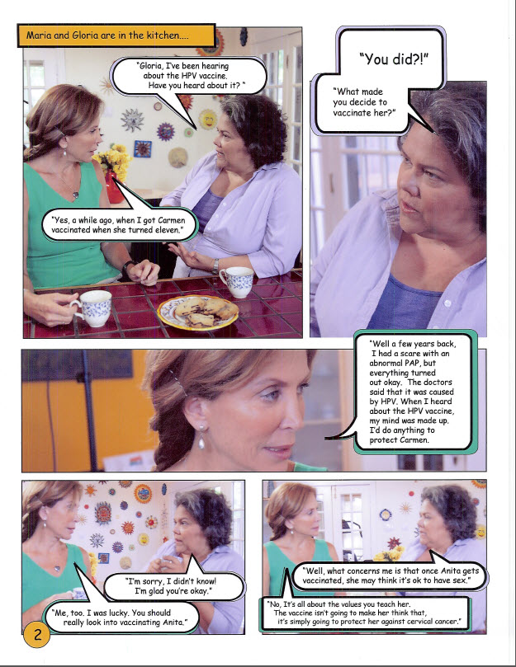
For Our Daughters - Para Nuestras Hijas
The Intervention: Fotonovela
Print fotonovelas are:
  brief stories with pictures & dialog
  popular in Spanish-speaking cultures
  often used to educate Latino audiences about health topics
For Our Daughters fotonovela:
  is brief
  available in English and Spanish
  addresses key behavioral determinants
Notes:
Determinants addressed:
Knowledge
Attitude
Self-efficacy
Skills
Perceived benefits/barriers
Perceived susceptibility
Perceived social norms
Outcome expectations

Slide 12
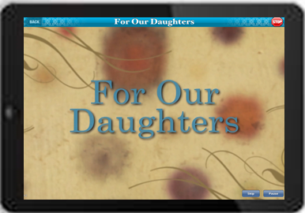
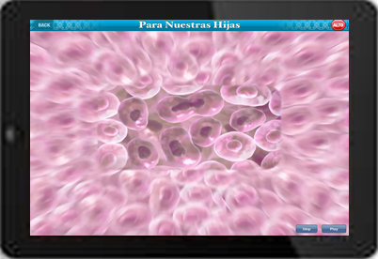
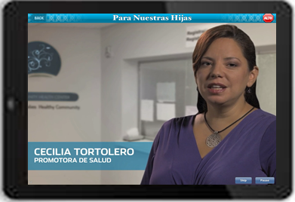
For Our Daughters - Para Nuestras Hijas
The Intervention: Tailored Interactive Program on iPad
Moving video
Stills with audio
Graphics and Animation
Data-based tailoring
Self- Tailoring

Slide 13
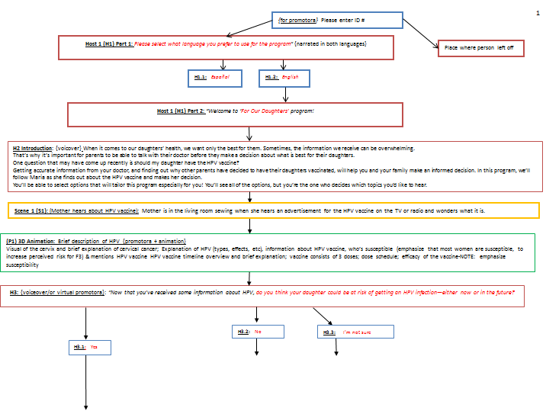
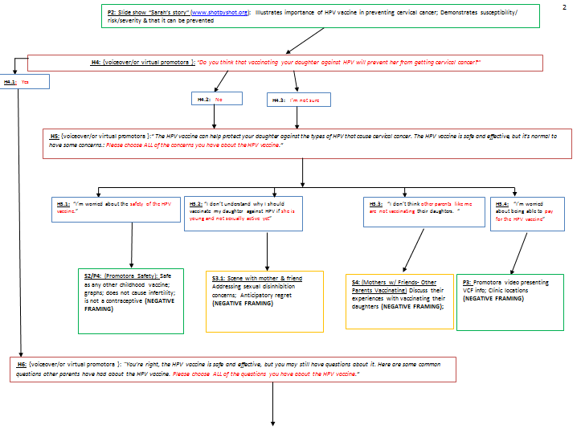
Software Development Flowchart for iPad-tailored For our Daughters Program

Slide 14
Intervention: iPad-Tailored Interactive Program
Tailored Portions | Description of prgram content | Rationale
Language | Parents choose either English or Spanish version | Anticipating majority of parents will only speak Spanish but do not want to exclude English speakers
Perceived Susceptibility | Slideshow illustrating importance of HPV vaccine in preventing cervical cancer; demonstrates susceptibility | Protection Motivation Theory
Perceived Vaccine Efficacy | Virtual promotora explains that the vaccine is effective (reinforced later in the program by the doctor) | Protection Motivation Theory Block & Keller (1995)-increase belief in efficacy of the vaccine
General Concerns/Barriers to Vaccination | Provide set of common concerns addressed with additional information | Increase belief in efficacy of the vaccine Address concerns (Social Cognitive Theory, Theory of Planned Behavior)
Skill-Related Barriers to Vaccine Completion | Present common skill-related barriers to completing vaccine series and ways to overcome them. | Stress importance of completing vaccine series and provide information to do so
Self- Efficacy | Testimonials of mothers who have vaccinated their daughters | Those low in self-efficacy hear from parents who encountered barriers to vaccination but were able to overcome them
Notes:
Tailoring: PERCEIVED SUSCEPTIBILITY
Parents whose risk perception is low will view slide show Sarah’s story and parents whose risk perception is high will continue on to the Perceived Vaccine Efficacy question.
Tailoring: Perceived Vaccine Efficacy
Role of efficacy of the behavior in health communication research comes from Protection Motivation Theory (Rogers, 1975, 1983): Viewing a health communication/education program results in a person assessing: 1. Severity of the event; 2. Probability of the event occurring; 3. Belief in the efficacy of the recommendations
Block & Keller (1995):
Low perceived efficacy for HPV prevention recommendations associated with more in-depth processing of information
Negative framing is more persuasive than positive framing with in-depth processing
High efficacy for HPV prevention recommendations associated with less effortful processing
Positive and negative frames are equally persuasive
Gerend, Shepherd, & Monday (2008):
With low-frequency behaviors such as HPV vaccination, loss-framed messages are associated with greater vaccination intentions
Perceived susceptibility mediates the relation between message frame and vaccination intentions
Abhyankar, O’Connor, & Lawton (2008); MMR vaccination study:
Loss framing is more effective when you believe the behavior is more risky (e.g., loss frame is better for parents who think vaccination is more risky)
Perceived efficacy of the vaccine mediates that relation between framing and intention to vaccinate
Tailoring: General Concerns/Barriers
Low-efficacy parents are provided with a set of common concerns/barriers that reflect their own concerns/barriers and are provided with additional information
Tailoring: Vaccine Series Completion Skill-Related Barriers
We want to stress that it is important to complete the vaccine series and provide parents with the tools/information necessary to do so. In this section we present some common skill-related barriers to completing the vaccine series and allow the parent to choose the relevant barriers and learn more about how to overcome them.
Tailoring: Self-efficacy
In this option we end the program asking parents how sure they are that they can vaccinate their daughter. Those with low self-efficacy will view brief testimonials from parents who encountered barriers to vaccination but were able to overcome them.
NOTE:
We decided to use negative/loss framing throughout (when possible) because it has been found to be most effective for those who perceive the efficacy of the vaccine is low, risky, and with low-frequency behaviors such as vaccination; Block & Keller found that framing does not matter with those who perceive the efficacy of the vaccine to be high, so negative framing throughout is best strategy
Using negative/loss framing allows us to incorporate ANTICIPATORY REGRET throughout.

Slide 15
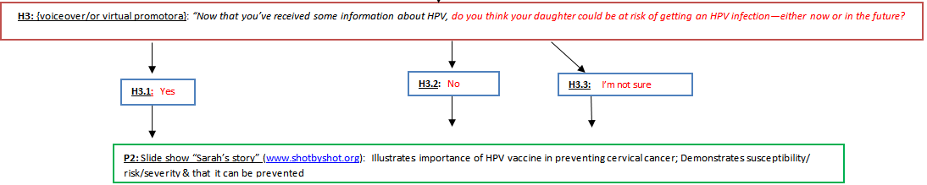
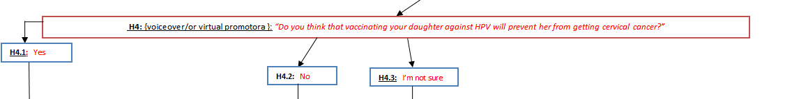
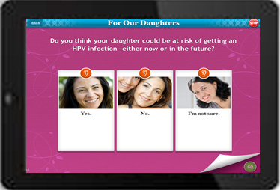

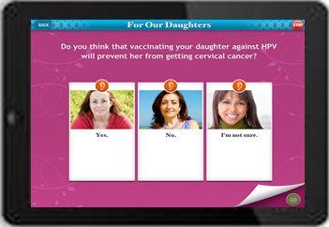
Tailoring: Perceived Susceptibility & Vaccine Efficacy

Slide 16
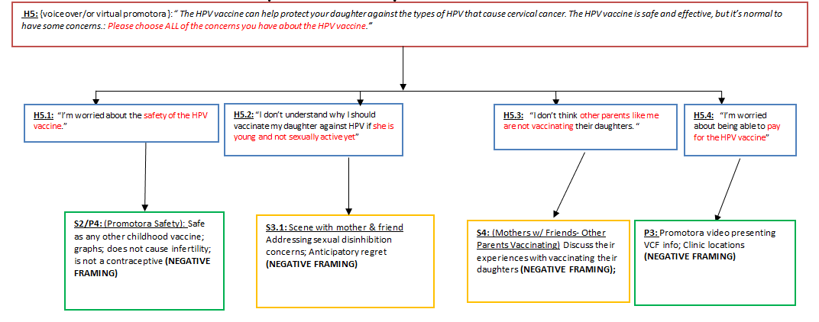
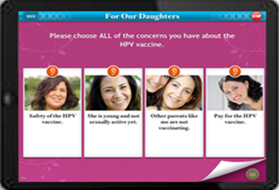
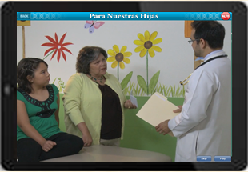
Tailoring: General Concerns & Barriers

Slide 17
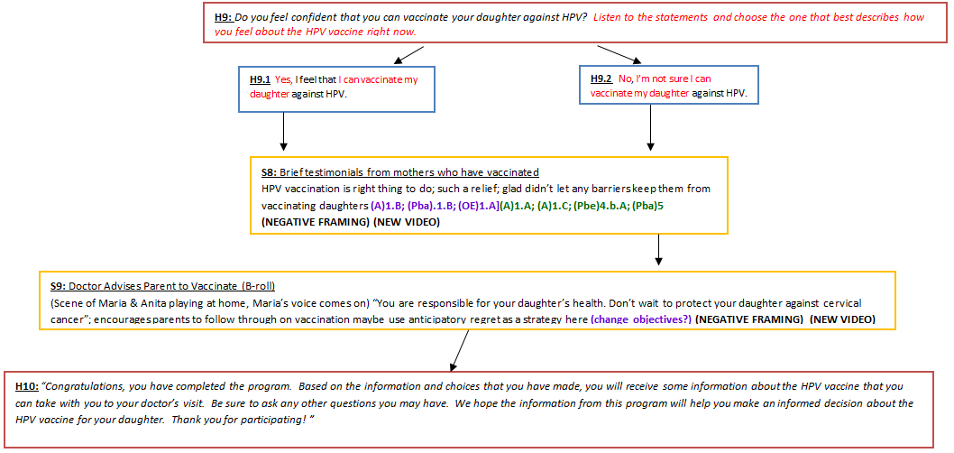
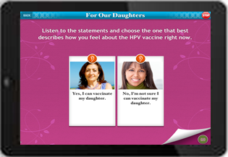
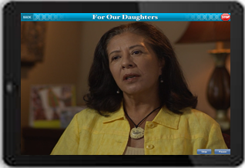
Tailoring: Self-Efficacy

Slide 18

Results of Usability Testing
Hispanic parents indicated
  Program was enjoyable and engaging
  Confidence in ability to use the program
  Information was appropriate and easy to understand

Slide 19
Developed Training Programs
Using Intervention Mapping Methods (Step 5)
LHW 2 ½ Day Training Developed & Implemented
Introduction,
Study Objectives,
Study Protocols,
HPV & Cervical Cancer,
HPV vaccine,
Study Design and LHWs’ Roles,
Overview of Intervention Materials,
Forms
iPad practice
Fotonovela practice
Q &A sessions
Data Collectors (DC) 2 Day* Training Developed & Implemented
Introduction
Study Objectives
Cervical Cancer & Statistics
HPV
HPV vaccine
Study Design
Overview of intervention materials
Protocols
Forms
DCs’ roles & responsibilities’
DC Manual & Forms
Gift Card protocol
Survey
* 4- half day training sessions

Slide 20
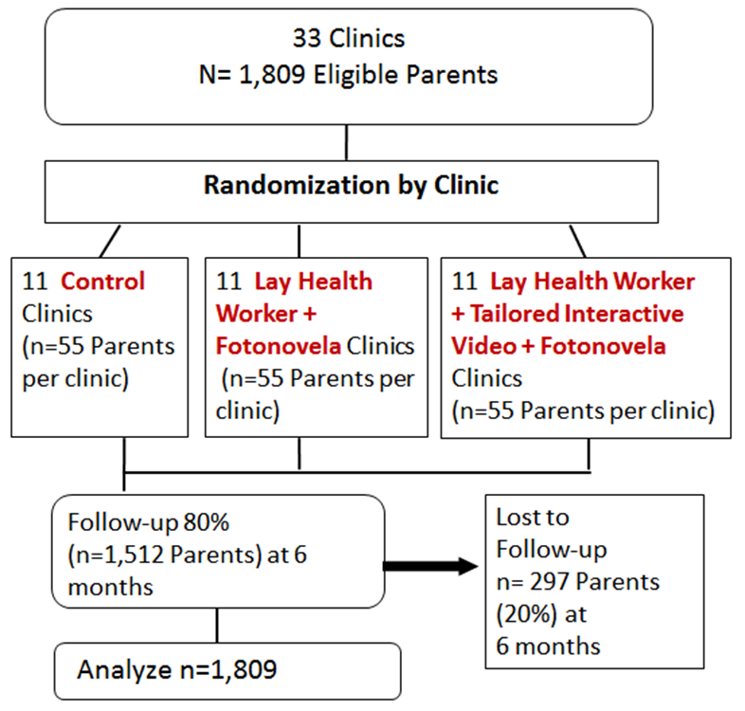
Evaluation Design
Group rendomized Intervention Trial
Baseline: Data collectors
recruit, consent & conduct
face-to-face computer-assisted
interviews with parents
in clinic waiting rooms
2) LHWs deliver intervention in
Intervention clinic sites]
3) Follow-up: Data collectors
conduct 6 month follow-up by
telephone plus clinc record
validation
Notes:
To-date we have recruited 94 parents from clinics in the control arm.

Slide 21
Future directions
To determine the effectiveness of a stepped down intervention using the tailored multimedia intervention in clinics. Assess the effectiveness and cost effectiveness of a clinic only intervention (tailored multimedia program on iPads; no lay health workers) on vaccination initiation among age eligible boys and girls.
Notes:
Aim 3:
Hypothesis 3a: Parents of Hispanic girls (11-17) receiving the iPad-delivered intervention (no lay health worker), will have higher rates of HPV vaccination among their daughters than parents given the photonovella.
Hypothesis 3b: Parents of Hispanic boys (11-17) receiving the iPad-delivered intervention (no lay health worker), will have higher rates of HPV vaccination among their sons than parents given the photonovella.

Slide 22
Future Directions
Assess the effectiveness and cost effectiveness of parental text message reminders on increasing HPV vaccination.
Develop and test parental text messages designed to increase HPV vaccination completion among daughters who have initiated vaccination and to encourage initiation among daughters who have not.
Notes:
The Hypotheses related to Aim 1 are:
Hypothesis 1c1: HPV vaccination rates among daughters of Hispanic parents receiving the photonovella will be higher compared to daughters of parents who receive standard care;
Hypothesis1c2: HPV vaccination rates among daughters of Hispanic parents receiving the tailored interactive video will be higher than rates among daughters of Hispanic parents receiving standard care;
Hypothesis 1c3: HPV vaccination rates among daughters of Hispanic parents receiving the tailored interactive video will be higher than rates among daughters of Hispanic parents who receive the print photonovella.
Aim 2a:
Hypothesis 2a1: Parental message reminders that assign transmission agency to the HPV virus will elicit higher behavioral intentions than reminders that assign agency to daughters.
Hypothesis 2a2: When encouraging completion of an HPV vaccination series, detailed as compared to brief text messages, will achieve the highest response on behavioral intention.
Aim 2b:
Hypothesis 2b: Parental text message reminders will increase vaccination completion rates for participants who have received the initial dose by the time of follow-up for Aim1.
Aim 2c:
Hypothesis 2c: Parental text messages that encourage vaccine uptake will increase the initiation rates for participants who had not initiate the vaccine at follow-up for Aim 1.

Slide 23
Future directions
The proposed study will explore linguistic agency assignment and level of detail
Agency assignments entail different attributions of responsibility that can affect health message persuasiveness.
  Different versions of a pamphlet describing the H1N1 influenza virus that consistently framed viral transmission in terms of human agency (e.g., thousands of people may contract H1N1) or virus agency (H1N1 may infect thousands of people).
  Assignment of agency to the virus significantly increased perceptions of threat severity, personal susceptibility, and vaccination intentions relative to human agency assignment.
Notes:
Although these agency assignments are often treated as interchangeable, they entail different attributions of responsibility that can affect health message persuasiveness. McGlone, Bell, McGlynn, and Zaitchik, (in press) created different versions of a pamphlet describing the H1N1 influenza virus that consistently framed viral transmission in terms of human agency (e.g., thousands of people may contract H1N1) or virus agency (H1N1 may infect thousands of people).¹¹⁶ Assignment of agency to the virus significantly increased perceptions of threat severity, personal susceptibility, and vaccination intentions relative to human agency assignment. These advantages were mediated by participants’ perceptions of the virus as an active predator that the language of virus agency implicitly shapes.

Slide 24
Summary
Effectiveness and cost-effectiveness of the interventions will be evaluated in “real world setting”
Findings will guide future work expanding the intervention to new population groups (e.g., boys, young adults, other ethnic groups) and testing new delivery models (e.g., stand along iPad without LHW facilitation creating a potential for widespread dissemination)

Slide 25
Questions?

