Slide 1
The Cancer Prevention and Control Research Network:
CHC Survey Subgroup
Notes:
1

Slide 2
CPCRN CHC Survey
Engaged national, regional and local stakeholders to ensure our projects
  Align with CHCs’ missions
  Guided by the real world health policy & health care delivery landscapes
7 CPCRN sites partnering with CHCs in their respective states
Cross sectional survey
  Assess factors associated with the implementation of evidence-based approaches (EBAs) and bests practices

Slide 3
Methods
Survey development
Models and Conceptual Frameworks
  Patient Centered Medical Home (PCMH) model
  Consolidated Framework for Implementation Research (CFIR) Damschroder et al. Implementation Science 2009
Practice Adaptive Reserve Miller et al . Ann Fam Med 2010
  Adapted version
  Matched items as closely as possible to CFIR constructs
  Determined gaps in the CFIR constructs
Literature review
  Existing items/scales that filled the gaps or
  Better represented the CFIR constructs

Slide 4
Methods
Survey development
  HRSA – UDS reporting
  NCQA 2011 PCMH standards
  Safety Net Medical Home Initiative (SNMHI)
  SCOPE study – Crabtree et al
  National Demonstration Project – Jaen et al
  Upstate NY PBRN – Fox et al
  Partnership Committee Members

Slide 5
CPCRN CHC Survey
Dependent Variables
Community Guide Evidence Based Approaches
  Provider Reminders
  One-on-one education
  Patient reminders
  Provider assessment and feedback
PCMH Best Practices
  Continuum of CRC screening processes &
  Evaluation of abnormal results

Slide 6
CPCRN CHC Survey
To be completed by CHC/Clinic staff members
  Section A – Clinic Practices Section
    includes Practice Adaptive Reserve Scale
  Section B – Colorectal Cancer Screening Modalities
    includes questions on EMR/EHR
  Section C – 4 Evidence-Based Approaches (EBAs)
    EBA specific CFIR questions
  Section D – PCMH Best Practices
  Section E – Demographics

Slide 7
Clinic Characteristics Survey
To be completed by CHC/Clinic Contact
To provide background information on CHC clinics
  Patient population – uninsured, poverty, limited English proficiency
  Clinic staffing
  Data generation for reports/EMR
  PCMH CRC screening continuum
  7 Community Guide EBAs
  Incentives/feedback
  Participation in Collaboratives

Slide 8
Bridging Research and the Real World
Community Guide EBAs
PCMH Best Practices
Add to current D& I research:
  CFIR & Measures
Associations between EBA implementation and
  CFIR constructs
  Practice Adaptive Reserve
  Clinic characteristics
Applicable to NCQA PCMH standards
Examine clinic roles & CRC screening PCMH Best Practices
Associations between Best Practices implementation and
  Practice Adaptive Reserve
  Clinic characteristics

Slide 9
Online Pretesting
Clinic Characteristics Survey
  Completed
    18 clinics names: South Carolina, Washington
    Skip patterns, required questions, character strings
  Data dump
CHC Survey
  This week!

Slide 10
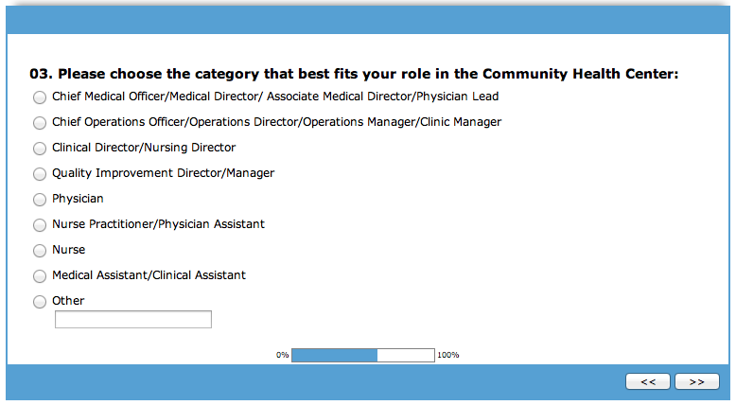
Online CHC Survey

Slide 11
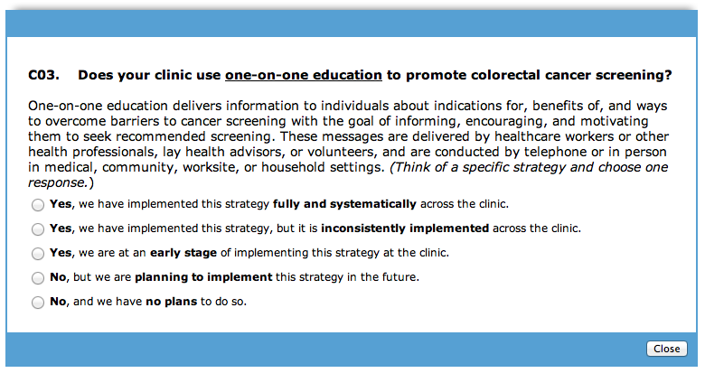
Online CHC Survey

Slide 12
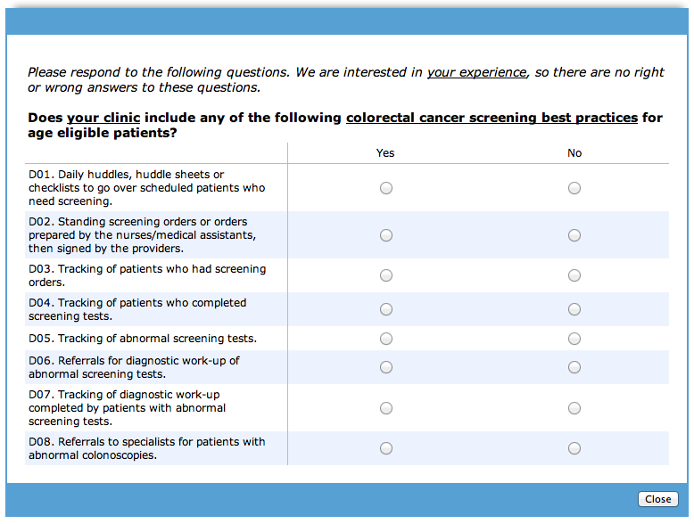
Online CHC Survey

Slide 13
IRB
Institutional Approval
  Coordinating Center
  U South Carolina
  UT Houston
  UW
  Submitted: UCLA, Wash U
CDC Approval
  Coordinating Center
  UW
  UT Houston

Slide 14
CPCRN CHC Survey Timeline
Recruitment projection to date
  Potentially up to 209 CHC clinics
  Up to 10 participants/clinic
Oct 8 – 19: Pretest online survey
Oct 22 – Nov 2: Data dump & revisions
Nov/Dec/Jan: Implement Survey
  Wave 1
  Wave 2
Feb/Mar 2013: Survey Analysis

Slide 15
Proposed Survey Analysis
Univ. of Washington
  CHC Survey Sections A, B, D, and E
  Clinic Characteristic Survey (excluding items 15 and 16 on EBAs)
Univ. Texas Houston
  CHC Survey Sections A **, B**, C, and E**
  Clinic Characteristic Survey (items 15 and 16 on EBAs)
UCD & Emory - Regional data
** program code /processed data to be made available by UW for Sections A. B, D & E.
Notes:
Primary analyses - Division of analysis efforts to facilitate performing in a timely manner. Please note that such a division does not imply ownership of CPCRN data nor study findings.

Slide 16
Proposed Manuscripts
MANUSCRIPT FOCUS | LEAD SITE | U Co | Emory | UCLA | USC | UT-H | UW | WU
CFIR Measures/ Survey development* | TBD | X | X | X | X | X | X | X
Survey results – Practice Adaptive Reserve (PAR)/PCMH Best Practices | UW | X | X | X | X | X | X | X
Survey results – Practice Adaptive Reserve/Clinic characteristics | UW | X | X | X | X | X | X | X
Survey results – CG EBAs/Practice Adaptive Reserve | TBD | X | X | X | X | X | X | X
Survey results – CG EBAs/CFIR measures | TBD | X | X | X | X | X | X | X
Survey results – CG EBAs/Clinic Characteristics | TBD | X | X | X | X | X | X | X

Slide 17
Acknowledgement
All Survey Subgroup Members
  UT Houston - Glenna Dawson, Lily Liang, Bijal Balasubramanian
  Emory – Michelle Kegler and Michelle Carvalho
  U South Carolina – Dayna Campbell, Jamilah Giles, Jesseica Fortune, Minnjuan Flournoy-Floyd, Edith Williams
  UW – Amanda Kimura, Alan Kuniyuki, Jane Edelson, Thuy Vu
Coordinating Center
  Rebecca Williams, Debbie Bush, Katie Byerly
Partnership Committee
  Jim Hotz, MD (NACHC, Georgia PCA)
  Kathleen Clark (WACMHC )
CRCCP Workgroup
  Peggy Hannon
Volunteers for Survey Pretesting
  Texas FQHC volunteers
  Harborview Medical Center Adult Medicine Clinic MAs & Nurses
  Allison Cole; Michael McKee; Xiaoxue Huang

