Slide 1
CRCCP Workgroup Update
CPCRN Annual Meeting
October 15, 2012
Workgroup leaders: Peggy Hannon, Cam Escoffery, Annette Maxwell

Slide 2
Overview
CRCCP & CPCRN workgroup
2011 Grantee Survey: findings & products
Projects in progress
In-depth interviews
2012 survey
2012-13 work-plan

Slide 3
CDC's Colorectal Cancer Control Program (CRCCP)
Established: July 2009
Goal: to increase colorectal cancer screening rates among men and women aged 50+ from 64% to 80% in the funded states by 2014
Program has two components:
  Screening promotion (population-level)
  Screening provision (low-income, uninsured, underinsured)

Slide 4
CRCCP Grantees

Slide 5
Overall Workgroup Goals
CRCCP workgroup will implement the Annual Grantee Survey, 2011-2014
CRCCP workgroup will develop and implement additional research projects to assess details of
  Adoption
  Implementation
  Context
  Technical support and resources needed/available
  Organizational characteristics

Slide 6
Annual Grantee Survey Goals
Understand how grantees are implementing CDC’s Colorectal Cancer Control Program (CRCCP),
Establish a baseline to assess how implementation changes each year, and
Collect information related to technical assistance and training needs.

Slide 7
Methods
Survey completed by person responsible for day-to-day management of the CRCCP
Sample: 29 programs (25 states and 4 tribes) across the U.S.
Design: Online survey administered annually

Slide 8
D&I Frameworks Guiding Survey
Conceptual Model
  RE-AIM with focus on Adoption, Implementation and Maintenance of 5 Community Guide strategies
  Interactive Systems Framework for Dissemination and Implementation (ISF)
    Prevention Support System (training and technical assistance)

Slide 9
2011 Survey Results

Slide 10
Survey Administration
& Participation
Survey administered via Web, Nov-Dec 2011
28 of 29 grantees completed the survey

Slide 11
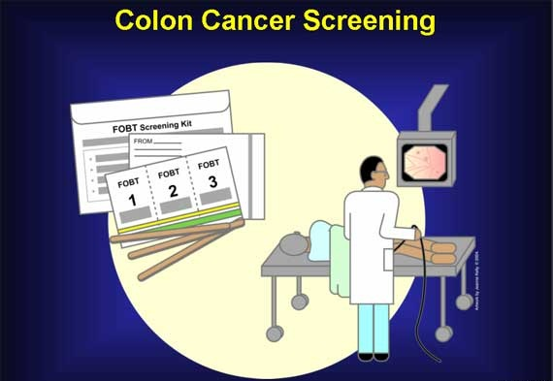
Screening Provision

Slide 12
Primary Screening Tests
Grantee | Primary Test Implemented Through Year 2
Alaska Native Tribal Consortium (ANTHC) | Colonoscopy
Arctic Slope Native Association | Colonoscopy
Colorado | Colonoscopy
Connecticut | Colonoscopy
Delaware | Colonoscopy
Maine | Colonoscopy
Maryland | Colonoscopy
Massachusetts | Colonoscopy
Minnesota | Colonoscopy
New Hampshire | Colonoscopy
Pennsylvania | Colonoscopy
Utah | Colonoscopy
New York | Colonoscopy/FIT
Montana | Colonoscopy/FOBT
Grantee | Primary Test Implemented Through Year 2
Alabama | FIT
Arizona | FIT
California | FIT
Iowa | FIT
New Mexico | FIT
South Dakota | FIT
Florida | FIT/Colonoscopy
Southcentral Foundation | Sigmoidoscopy
Michigan | FOBT
Nebraska | FOBT/Colonoscopy
South Puget Intertribal Planning Agency (SPIPA) | FOBT/FIT
Washington | FOBT/FIT
12
Notes:
An additional primary test is included if it is used for at least 10% of screenings.

Slide 13
Most (24) Use Patient Navigators to Support Screening Provision

Slide 14


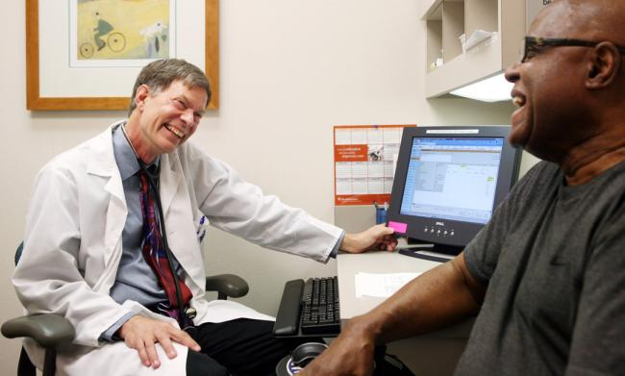
Screening Promotion

Slide 15
Most Use >1 EBI
Notes:
The mean number of EBIs implemented by a grantee was 3.15 (standard deviation = 1.35).

Slide 16
Potential Reach of Small Media Varies
Placement of Small Media | Videos | Flyers or Posters | Brochures, Booklets, FAQ | Newsletter, Insert, or Bookmark | Checklists | Electronic Media
Individual physician’s office | 10 | 17 | 19 | 6 | 7 | 7
Provider group | 5 | 10 | 10 | 5 | 4 | 5
Health care systems | 5 | 15 | 16 | 8 | 5 | 6
Federally Qualified Health Center | 8 | 14 | 16 | 6 | 5 | 6
Medicare office | 0 | 1 | 0 | 0 | 0 | 2
Medicaid office | 1 | 2 | 2 | 2 | 1 | 3
Insurance providers | 3 | 2 | 2 | 3 | 0 | 4
Local health department | 5 | 14 | 13 | 5 | 6 | 7
Workplace | 5 | 13 | 12 | 5 | 2 | 8
Community | 7 | 14 | 11 | 7 | 5 | 10
N/A: We don’t use this to promote screening | 12 | 3 | 3 | 12 | 16 | 9

Slide 17
Paper and Electronic Client Reminders
Organizational Type | Postcards, Letters, or Greeting Cards (21) | Telephone, Texts, or e-mails (12)
My CRCCP | 11 | 3
Health care system | 7 | 2
Individual physician’s office | 6 | 5
Provider group | 6 | 4
Other | 6 | 2
Indian Health Service or tribal group | 4 | 4
Federally Qualified Health Center | 4 | 2
Health insurer | 3 | 2
Medicare Quality Improvement Organization office | 2 | 0
State Medicaid office | 1 | 0
(Source: Grantee Survey, 2011.)

Slide 18
Approaches to Reducing Structural Barriers
Strategy | n (14)
Eliminating or simplifying administrative procedures and other obstacles | 10
Reducing time or distance between service delivery settings and target populations | 5
Offering services in alternative or nonclinical settings | 3
Modifying hours of service to meet client needs | 2

Slide 19
Provider Reminders Least Used
Organizational Type | Patient Chart Reminders (7) | Reminders in EMR (9)
Individual physician’s office | 5 | 5
IHS or tribal clinic | 3 | 4
Provider group | 4 | 3
FQHCs | 4 | 5
Health care system | 1 | 2
My CRCCP | 2 | 2
Other | 0 | 2

Slide 20
Provider Assessment & Feedback
Organizational Type | Assessment (14) | Feedback (14)
Individual physician’s office | 7 | 7
IHS or tribal clinic | 3 | 3
Provider group | 8 | 7
FQHCs | 7 | 7
Health care system | 1 | 2
My CRCCP | 3 | 3
Other | 1 | 1

Slide 21
Partnerships for Implementing Community Guide CRC Screening Promotion Strategies
(Source: Grantee Survey, 2011.)

Slide 22
Similar Patient Navigation Activities for Screening Promotion and Screening Provision
Navigator Activities for Screening Promotion | n (18)
Patient education about screening modalities | 17
Assessment of patient barriers to screening | 17
Patient recruitment for screening | 16
Scheduling screening appointments | 15
Making reminder calls for colonoscopy appointments | 15
Assisting patients to access to bowel preparation materials | 15
Tracking patients to be sure they complete colonoscopy | 13
Assisting patients diagnosed with cancer get into treatment | 13
Arranging transportation to/from screening appointments | 13
Arranging and providing translation services | 13
Tracking patients to be sure they return FOBT/FIT kits | 9
Meeting patients at endoscopic appointment | 5

Slide 23
Many Grantees Implementing Additional Strategies for Screening Promotion
Other Strategies | N (13)
Mass media | 13
Provider education/professional development | 11
Quality assurance/quality improvement | 10
Patient or group education | 4
Other | 7
(Source: Grantee Survey, 2011.)
Analyses include all grantees (n = 28).

Slide 24
Desire for Training Depends on EBI

Slide 25
Grantees Prefer On-Site or As-Needed Training/TA

Slide 26
Evaluation & Adaptation Are Top Training Topics
Training Topic | M (SD)
Conduct an outcome evaluation of an evidence-based strategy | 2.3 (0.8)
Conduct a process evaluation of an evidence-based strategy | 2.3 (0.8)
Assess the fit of potential strategies or programs with my population | 2.1 (0.7)
Assess the strength of evidence supporting program effectiveness | 2.1 (0.8)
Assess the fit of potential strategies or programs with my organization’s systems, staff, and resources | 2.0 (0.8)
Note. Grantees rated desire for training on each topic 1-3 (3=high desire for training)

Slide 27
Current CRCCP Projects

Slide 28
In-depth Interviews
Purpose
Describe the CRCCP grantees’ screening promotion goals Describe the grantee’s implementation of EBIs (e.g., EBI used, implementation strategy, barriers and facilitators to implementation). Special attention to systems-level strategies Describe grantees’ experience transitioning from primarily providing screening services (like in B/C) to integrating population-level promotion activities Explore engagement of partners to promote CRC cancer screening Describe efforts to leverage organizational-level policy change Identify technical assistance needs for use of EBIs and screening promotion

Slide 29
CRCCP Qualitative Guide Topics
CRC screening promotion goals
Selection of EBIs
Use of EBIs (in depth case studies)
Partnership engaged
Evaluation of EBIs
Organizational policies or systems change initiatives

Slide 30
Interview Instrument
Topic | Sample Questions
Use of EBIs | Prioritize probing about systems and organizational level/policy EBIs first (in this order): reducing structural barriers, provider assessment and feedback, provider reminders, patient reminders, group/1 on 1 education, small media, patient navigation] Key Components What are the key components of the intervention? Or what does it include? Describe how you are implementing [each EBI]? Who have been the main people/groups implementing the activity? Where are you implementing the activity?

Slide 31
Interview Instrument
Topic | Sample Questions
Facilitators | What factors facilitated using this [EBI]? (e.g., previous experience, partner expertise, a training they attended on the EBI) What technical assistance or other resources did you use, to assist you with implementing [EBI]? Is there additional assistance or other resources that would have helped you plan and implement [EBI]? What are those?
Partnerships | If any, what new partnerships have you formed since the beginning of the CRCCP program to promote population-based screening? How would you characterize the effectiveness of these partnerships? What partnerships have you tried to foster but have been unsuccessful?

Slide 32
Interview Instrument
Topic | Sample Questions
Policy Change | Think about the policy that you view to be the most successful, or that has the potential for most impact. What was the organization that implemented the policy? What was the new or revised policy? Why was this policy adopted? Who were the players involved in creating or revising the policy? What process did you undertake to create or revise this policy? What facilitated the process? What were some barriers that arose, if any? How did you overcome that/those barrier(s)? Do you have plans to evaluate the impact of that policy? If so, how? Do you think this policy will be maintained, why or why not?

Slide 33
Methods
Sample: Interview at least half of grantees who adopt many EBIs and those who have organizational/systems changes
Semi structured guide (~ 1 hr)
Analysis
  Codebook
  Thematic analysis in Nvivo
  Case stories of successful EBI implementation or partnerships/policy changes
Current status
  CDC CRCCP leadership and staff gave input
  IRB will be submitted in October
  Interviews to be conducted Nov/Dec 2012

Slide 34
Qualitative Study Timeline
Date | Deliverables
Mid-June | Draft of priority questions for Interview Guide
July | Feedback from CDC CRCCP Staff
End of July | Submission to Emory IRB (Escoffery) with CITI certifications from other CPCRN university staff
August | Draft Emory IRB approval; CDC IRB deferral
August 21-22 | Promotion of qualitative interviews/study with grantees at CDC Cancer Conference
October | Emory IRB approval; CDC IRB deferral
November | Data collection
November – December | Codebook development Data analysis
January – February 2013 | 1st summary reports (topline)

Slide 35
2012 Survey: Grantees & Unfunded States
2012 survey launched 9/28/12
29 grantees
34 unfunded states & tribes (25 states + 8 tribes + DC)
Still in the field
37 have started or completed the survey

Slide 36
2012-13 Work-plan Objectives

Slide 37
Projects
Complete in-depth interview project
Complete & analyze 2012 survey
Compare grantee 2011 and 2012 data
For 2012, compare grantees’ and unfunded sites’ EBI implementation
Collaborate with CDC and others on emerging project and/or training opportunities

Slide 38
Next Steps
Develop papers and conference presentations
2012 survey data
In-depth interview projects
Collaborate with CDC on CRCCP evaluation papers/ conference presentations

Slide 39
Products To-Date/In Progress
Measures
Survey to measure EBI implementation
Interview guide to assess use of CRC EBIs in depth, and steps in making organizational/systems change to increase population health
2011 Grantee survey papers
EBI use by grantees
Patient navigation for screening promotion and provision
2011 Grantee survey presentations
CDC Cancer Conference
National Colorectal Cancer Roundtable
Webinars with CDC and CRCCP grantees (Grantee Highlights Report)
High CPCRN visibility in national CDC’s CRCCP

Slide 40

Questions
Peggy Hannon Cam Escoffery Annette Maxwell
peggyh@u.washington.edu cescoff@emory.edu amaxwell@ucla.edu

