Slide 1

Survivorship Workgroup:
2012 Annual Meeting –Houston, TX
The presentation was supported by Cooperative Agreement _{1-U48-DP-001938} from the Center for Disease Control and Prevention. The findings and conclusions in this presentation are those of the author(s) and do not necessarily represent the official position of the Centers for Disease Control and Prevention.

Slide 2
Agenda
Survivorship Survey Results: 20 min
Case Study from Survey – Texas
Scoping Study: 10 min
Cancer Thriving and Surviving: 10 min
Survey and Scoping Study Comments-All: 5 min
Next Steps-All: 5 min

Slide 3
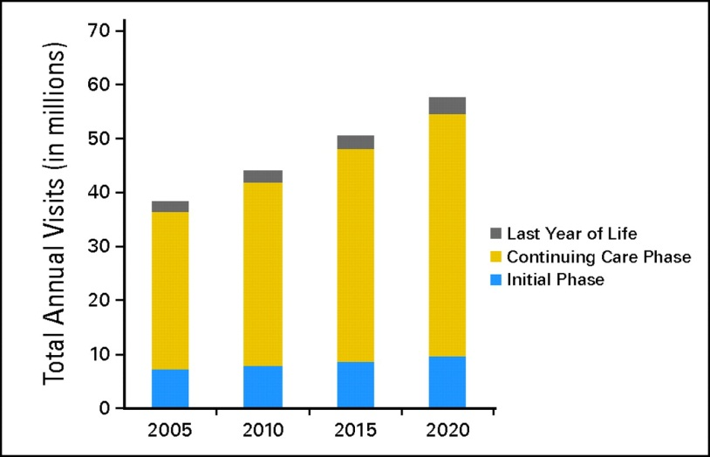
The Need….
A. Total annual oncology visits by phase of care, 2005 to 2020.
B. Co-morbidities in Cancer Survivors (NHIS Data)
# of Co-morbid Conditions | Cancer Survivors | Non-Cancer Controls
None | 42.4% | 54.7%
1 | 36.0% | 30.8%
2 | 13.3% | 9.3%
3 | 8.4% | 5.1%
Warren J L et al., 2008
p>0.001; Yabroff et al., 2004

Slide 4
Background
Reducing morbidity and mortality in the growing population of cancer survivors is an important public health concern.
However, little is known about the state of implementation of health promotion programs for cancer survivors:
- Where are programs located (or NOT located)?
  - Where are they delivered, and by whom?
  What groups are served?
  Are programs being evaluated, and if so, how?

Slide 5
Purpose and Framework
Purpose: Conduct an environmental scan of health promotion activities for cancer survivors of use to program planners, funders, researchers, and survivors.
Framework: Inquiry guided by RE-AIM to inform how research is being translated into practice in real-world settings

Slide 6
Methods: Instrument
Five sections:
Institutional information (setting, respondent position description, additional contact specifics)
Characteristics of target population
Type of program offered (Nutrition, Psychosocial, Weight management, Physical Activity)
Evaluation activities (time points and type of data collected)
Interest in follow-up/additional contacts

Slide 7
Methods/Recruitment
On-line, cross-sectional survey (Survey Monkey)
Survey respondents identified using 3 methods: internet-based keyword search, state cancer coalition networks, and snowball method.
Unified key word strategy: cancer survivorship, cancer rehabilitation, cancer exercise programs, cancer health promotion, cancer physical activity cancer programs for patients, wellness for cancer survivors, aerobic programs and cancer and cancer chronic fatigue.

Slide 8
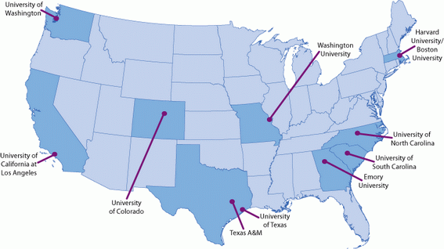
CPCRN Network Center Map

Slide 9
Overview of Findings
All states demonstrated a concentration of services available in urban, metropolitan regions.
Few programs in each state offer all types of services, but several offer more than one type.
In each state, hospital-based programs represent the setting where the majority of programs are offered.
There are settings that are not represented in a some participating states.
Evaluation of these programs appears to be a nascent field.

Slide 10
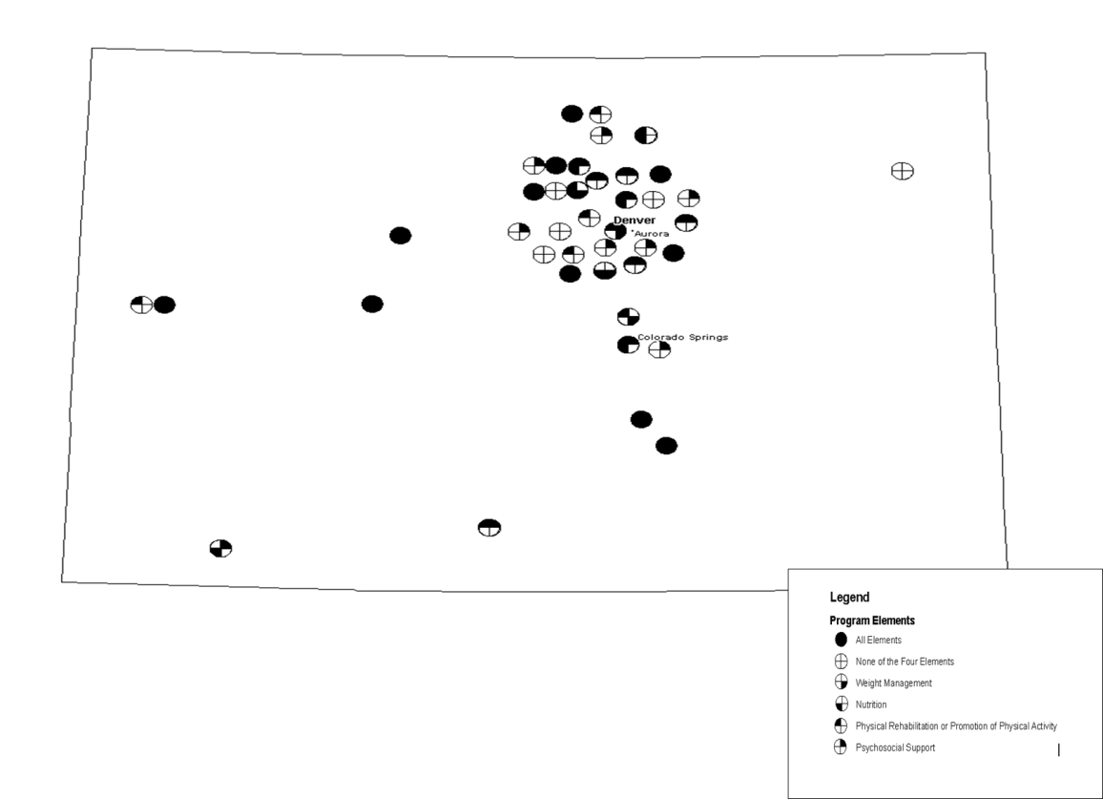
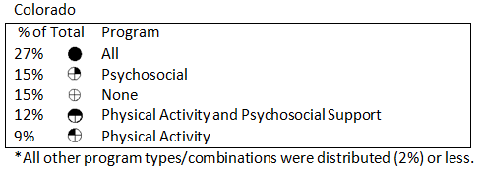
Colorado N=58

Slide 11
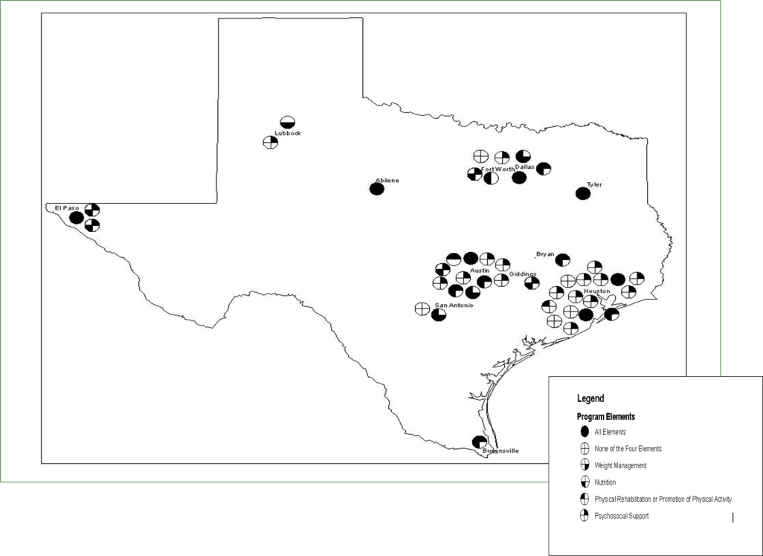
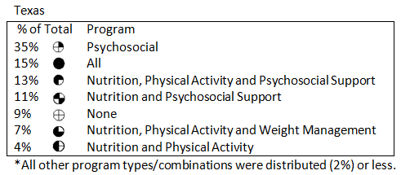
Texas = 59

Slide 12
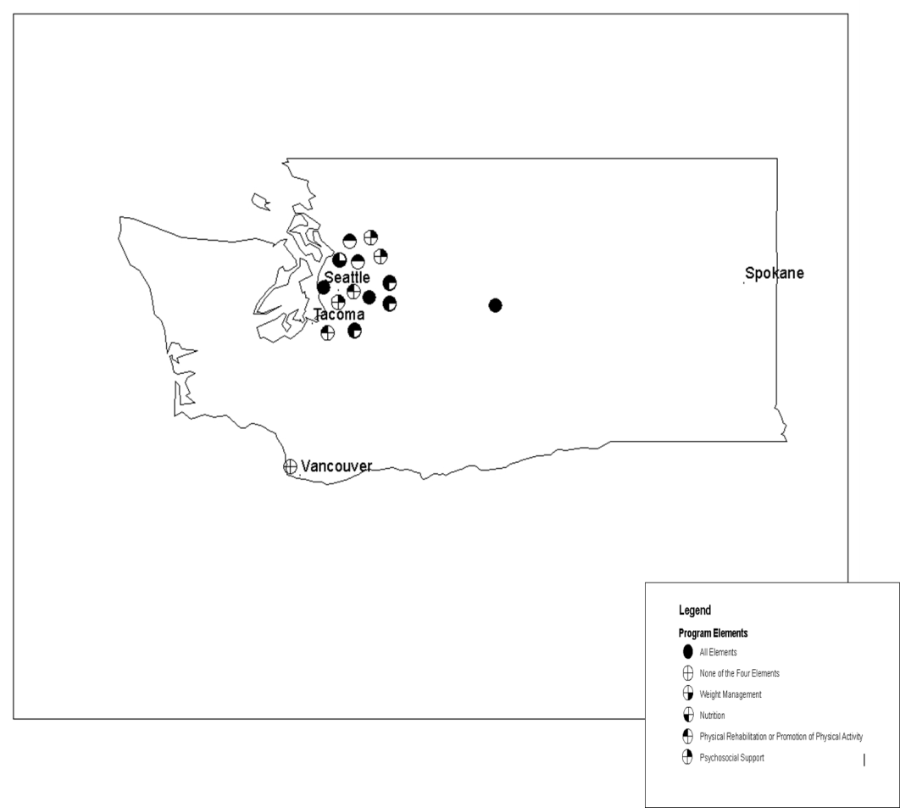
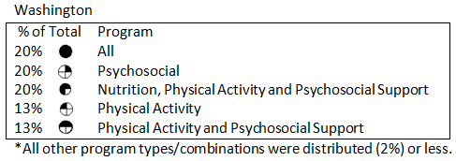
Washington=21

Slide 13
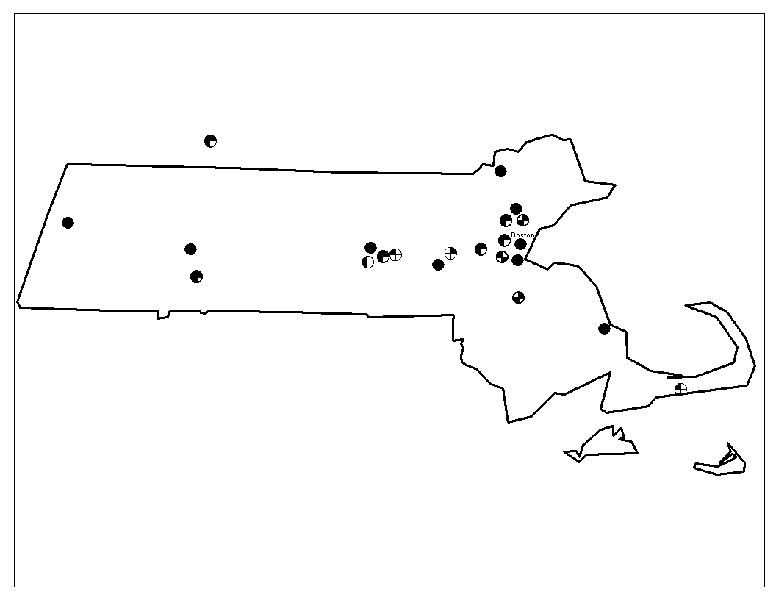
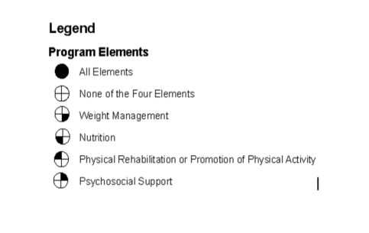
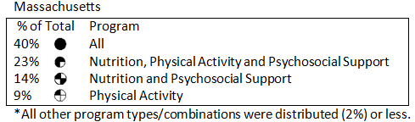

*Massachusetts = 21

Slide 14
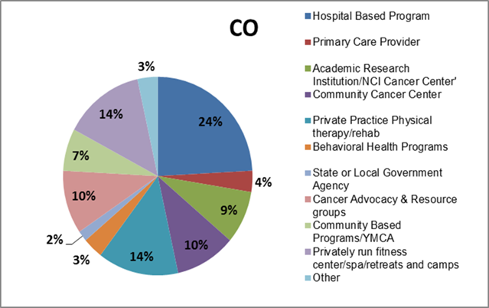
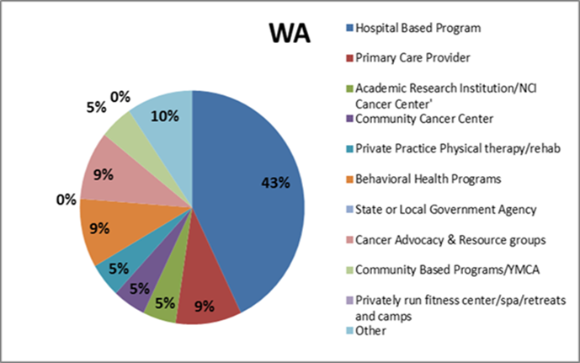
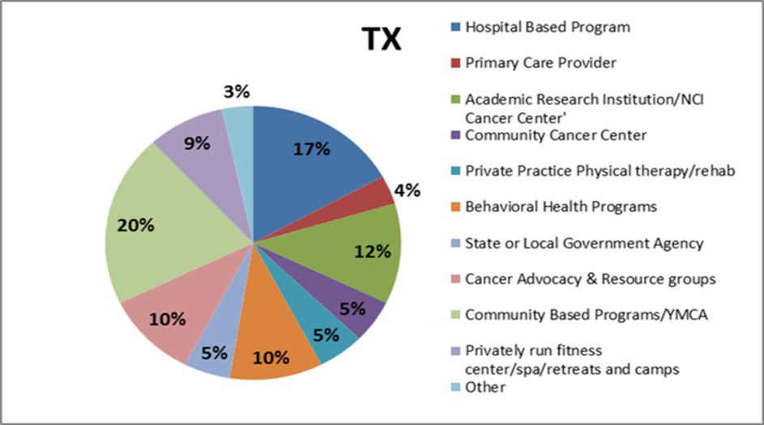
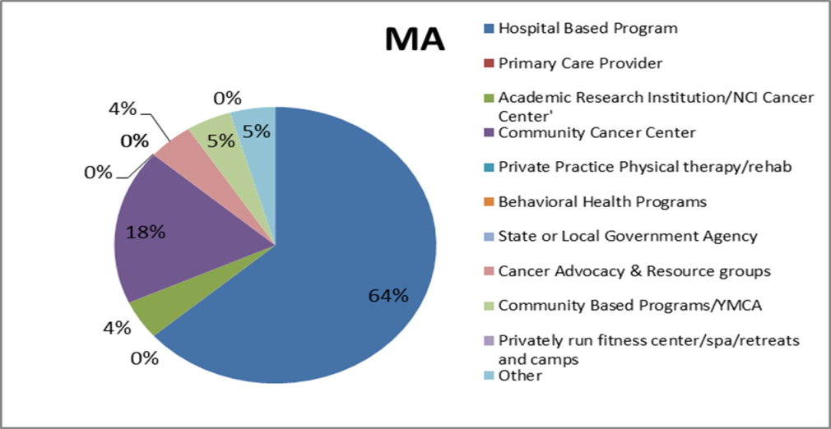
Program Setting

Slide 15
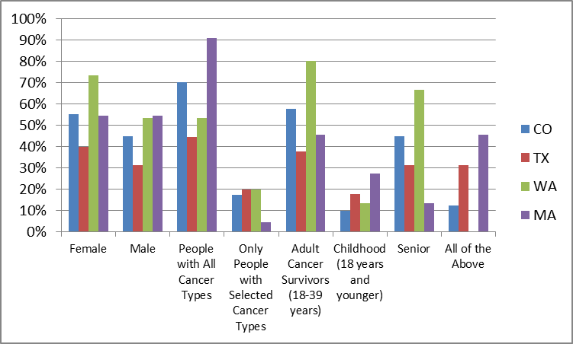

Demographic Served by Programs
Respondents: CO=58, TX=59, WA=21 *MA=21

Slide 16
Demographic Summary
Majority of respondents noted serving about equal numbers of males and females within their respective states.
In all states, limited number of services for childhood cancer survivors.

Slide 17
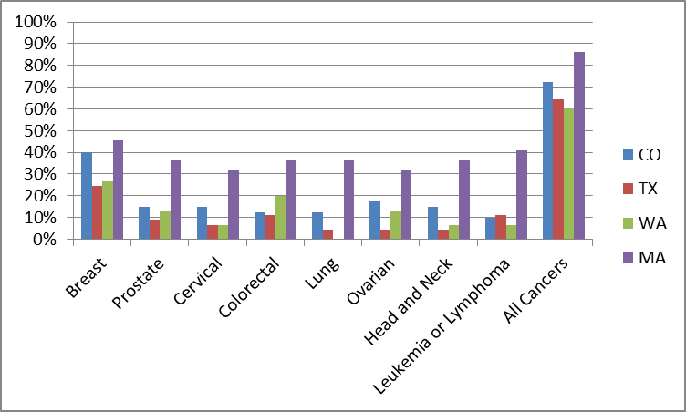
Cancer Type Served By Program
Respondents: CO=58, TX=59, WA=21 *MA=21
*MA Survey Still in Process

Slide 18
Cancer Type Summary
Majority of the programs in all states served all cancer types.
The most common cancer-specific programs were targeted to breast cancer survivors

Slide 19
EVALUATION ACTIVITIES
Evaluation (Y/N), by Program Type
(not mutually exclusive)
Type of Program | Number | %
Nutrition (n=67) | 49 | 73.3
Psychosocial (n=91) | 57 | 62.6
Physical activity/rehab (n=76) | 58 | 76.3
Weight Man. (n=40) | 30 | 75.0

Slide 20
Evaluation Activities (%)
Type of Program | Baseline | Post-program
Nutrition (n=49) | 83.7 | 38.8
Psychosocial (n=57) | 75.4 | 53.2
Physical activity (n=58) | 93.1 | 62.1
Weight man. (n=30) | 96.7 | 63.3

Slide 21
Evaluation Activities (%)
Type of Program | Satisfaction | Long-term Follow-up
Nutrition (n=49) | 44.9 | 28.5
Psychosocial (n=57) | 57.9 | 31.6
Physical activity (n=58) | 62.1 | 27.6
Weight man. (n=30) | 53.3 | 43.3

Slide 22
Utility
Results of this survey can be used by state-wide partners, program planners, funders, and public health professionals to target resources and guide survivorship activities.
Respondents can be re-contacted to monitor the implementation of survivorship programs from RTIPs or the Community Guide, as they become available.
Results can be used as a “snapshot” to monitor trends.
The information will also be available to cancer survivors as a resource ( Case Study – Texas).

Slide 23
Conclusions - Does the research link to what is happening in the real world?
Strong evidence of the importance of weight management reducing risk of morbidity and mortality after cancer, yet few programs available
Programs of all types are available in a variety of settings, yet there are few available evidence-based strategies to guide implementation
Survivors likely need interventions to address multiple conditions, yet most programs are not comprehensive in nature

Slide 24
Implications
Programs are most commonly offered in hospital settings: Several viable adopters are likely underutilized (physical therapy providers, community cancer centers?)
Less than half of all programs offer comprehensive services: Bolstering expertise in existing programs may be an effective strategy to increase reach
Few programs are available for rural survivors: Utilize other potential adopters/routes for delivery (community-based, online?)

Slide 25
Limitations
Snow ball and convenience sample method limit interpretation of findings.
Every attempt was made to identify and reach members through a mixed methods approach.
Overall, the high number of respondents suggests that our survey represents a timely “scan” of the type of program, setting, and cancer survivor populations served.

Slide 26




Collaborators
CPCRN Cancer Survivorship Workgroup
University of Colorado:
Dr. Betsy Risendal, Principle Investigator
Andrea Dwyer, Program Director
Co-Investigators and Survey Developers:
Drs. Catherine Jankowski, William Thorland, Kristin Kilbourn
Texas A&M Health Science Center and UT Houston Health Science Center:
Dr. Marcia Ory, Principle Investigator
Richard Wood and Meghan Wernicke, Program Director
Co-Investigators: Drs. Maria Fernandez and Karen Basen-Enquist
University of Washington:
Dr. Rachel Ceballos, Principal Investigator
Jocelyn Talbot, Program Director
Harvard University and University of MA Medical School, Boston University and Massachusetts
Department of Public Health
Stephanie Lemon, PhD, University of Massachusetts Medical School-Primary Lead
Co-Investigators: Dr Marianne Prout CPCRN co-I, Gail E. Merriam, MSW, MPH, Susan Moll and Kathryn Swaim

Slide 27
Implementation in Two Texas CPCRNs:
Texas A&M and UT - Houston
Step 1 - Google key word search provided by Colorado resulted in 109 Texas entities
Step 2 - Entities were organized in a list by geographic region
Step 3—This list was shared members of the Survivorship WorkGroup of Cancer Alliance of Texas (CAT) who were composing their own resource guide
Step 4 – CAT and other secondary respondents (MD Anderson) suggested 262 additional entities for a total of 371

Slide 28
Implementation in Two Texas CPCRNs:
Texas A&M and UT - Houston
In sorting through the list and contacting organizations, 33 of the 371 were found to be duplicate entries; an additional 33 reported not having survivorship services (new total 305)
Of the 305, we obtained valid emails for only 214 - an initial email and two reminder emails were sent to these
71 responded, 59 had survivorship services

Slide 29
Texas Recruitment Conclusions
It takes a variety of channels to generate potential delivery sites
There are misclassifications – data is sometimes out of date
Some delivery sites are difficult to reach – even using multiple contact strategies

Slide 30
Dissemination in Texas
Survey results were shared at the Cancer Prevention Research Institute of Texas (CPRIT) 2011 conference
Interactive maps were created using Google and linked via our CTxCARES.com website starting May 14, 2012
-Program Type – page views range from 14 (weight management) to 25 (all programs)
-Metropolitan Region – page views range from 16 (San Antonio) to 45 (Houston)

Slide 31
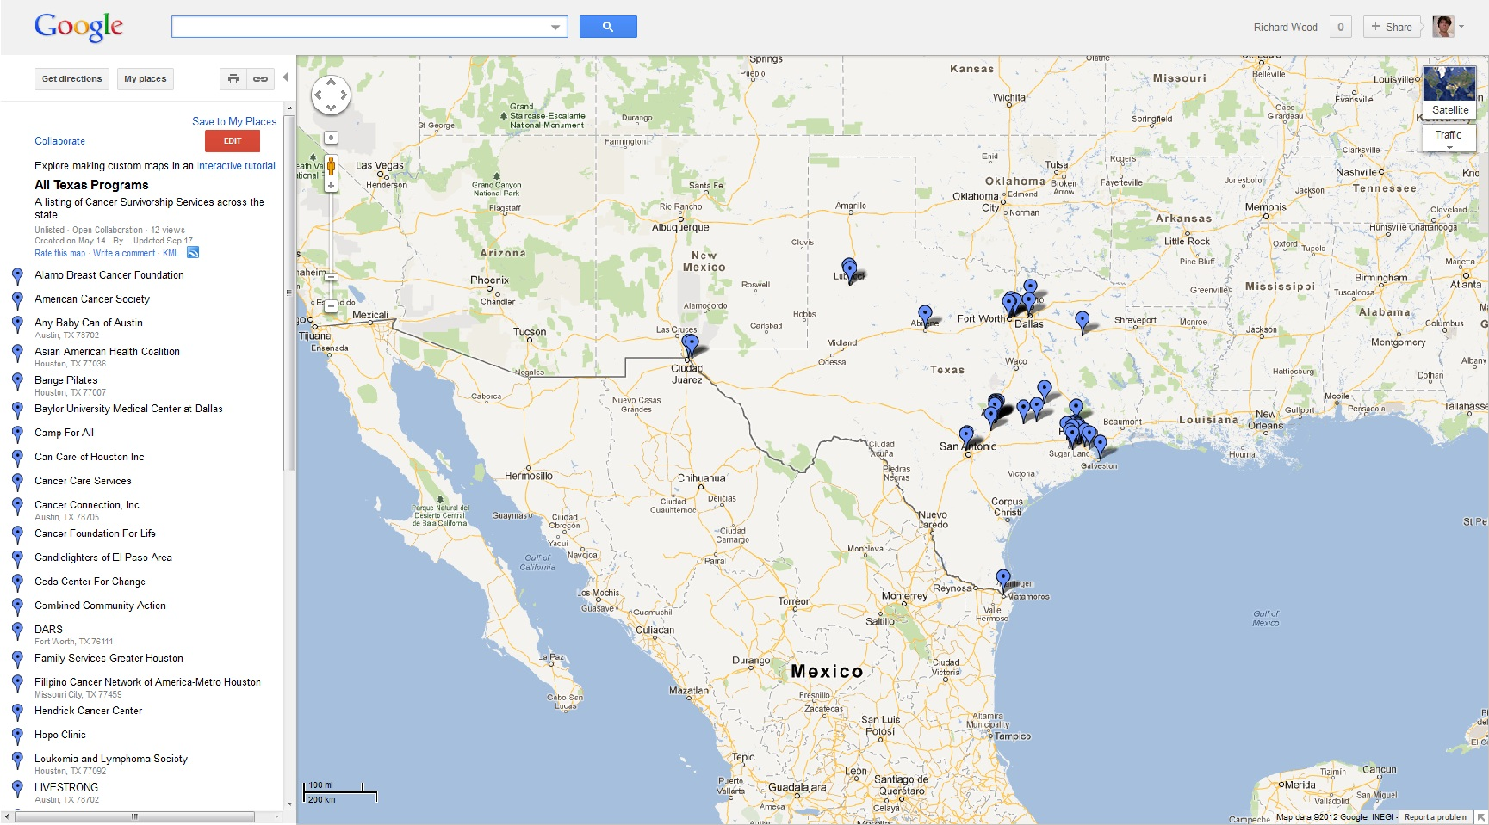
Dissemination in Texas
All Programs

Slide 32
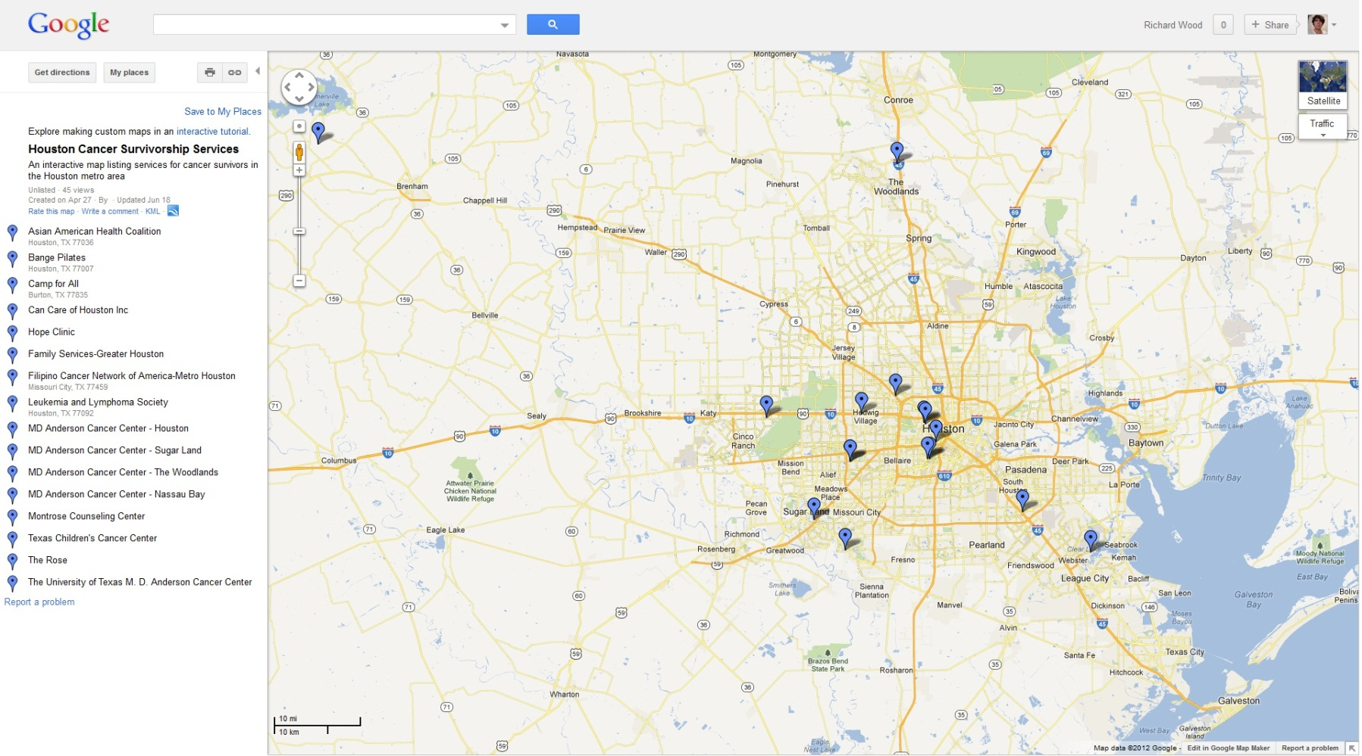
Dissemination in Texas
Programs in Houston

Slide 33
Dissemination in Texas
Ongoing - We listed the maps as an entry in the 2012 Cancer Alliance of Texas Survivorship Resource Guide
Ongoing - Additional organizations have contacted us about being included – the maps are updated to include more than the original set of respondents
Ideal - Cancer.org (ACS) has a searchable database for finding local programs; the closest category to health promotion is support groups and support services

Slide 34
Cancer Survivorship & Exercise Scoping Study
The quantity of hypothesis-driven, randomized controlled trials (RCTs) of exercise interventions among cancer survivors has greatly increased in recent years.
White et al (2009) proposed that the weak external validity of RCTs hinders the translation of clinical exercise research into practice settings, their recommendations may take years to impact implementation of ongoing programs.
One approach to closing the translation gap in the near term is to evaluate a broad scope of literature through a scoping study

Slide 35
Cancer Survivorship & Exercise Scoping Study
Overview of the proposed scoping study

Slide 36
Scoping Study Methods
Databases were searched using the key words, “cancer survivor” with “exercise”, “exercise implementation”, “evidence-based exercise”, “exercise translation”, “exercise health promotion”, and “exercise rehabilitation”
Searches were performed in PubMed, CINAHL, Library of Congress, and Sport Discus for 2009-2011.
Database searches resulted in 349 citations that were then screened using abstracts and minimal criteria
Notes:
Sport Discus includes titles from journals that are related to the fitness industry, physical education, and the grey literature.
36

Slide 37
Scoping Study Methods
Abstracts required a description of the population studied and at least 2 of the 3 following elements:
  Nature and/or setting of the intervention (e.g., individual/group-based, aerobic, therapeutic)
  Duration of the intervention (e.g., days, weeks, months)
  Intensity of exercise (e.g., mild, moderate, high) or frequency of exercise (e.g., daily, X days per week
Investigators at UCD and Texas A&M independently reviewed all abstracts and then compared results
Notes:
37

Slide 38
Scoping Study Methods
Abstract screening results (May 2012):
Source |  | PubMed | UCD Library | SportDiscus
Adjudication
Total | 356
Met | 84 | 64 | 5 | 15
Equivocal | 109 | 88 | 10 | 11
Not Met | 163 | 78 | 23 | 61
Notes:
38

Slide 39
Scoping Study Methods
In May 2012, the Survivorship Workgroup held a call to discuss the collection and next steps
Most agreed that the collection was too large to devote our resources toward
It was suggested that we re-focus the inquiry to facilitate the development of new knowledge and understanding of the role of ‘maintenance’ in cancer exercise program translation and dissemination
Notes:
39

Slide 40
Scoping Study Methods
The criteria was expanded through May 2012, resulting in 20 additional records; in June/July 2012 “met” was narrowed to publications that met all prior criteria as well as:
  described plans for follow-up assessments or,
  reported the results of follow-up assessments at the individual or system level
The final maintenance collection now has 30 citations, 23 of them meeting the “foundational (met)” criteria and 7 falling in a “context” subgroup.
Notes:
40

Slide 41
Scoping Study Flow Chart
RCTs by types of cancer:
-Breast Cancer (n= 8)
-Combination of cancers (n= 7)
-Prostate cancer (n=3)
-Lymphoma (n=1)
-Lung (n=1)
-Uterine (n=1)
-Adult survivors of childhood cancer (n=1)
Records identified through database searching (n= 376)
Abstracts assessed for eligibility (n=211)
99 met initial inclusion (RCTs)
112 contextual
Articles meeting maintenance criteria
(n= 29)
22 RCTs
7 contextual
Contextual Articles by Types of Cancer
-Breast Cancer (n= 4)
-Combination of cancers (n= 2)
-Colorectal (n=1)
articles excluded (n= 165)
articles excluded (n= 182)
Types of Contextual Articles
-Qualitative, phenomenological (n= 2)
-Program evaluation (n= 1)
-Longitudinal observational (n=1)
-Prospective survey (n=1)
-secondary reports from RCTs (n=2)
Notes:
41

Slide 42
Scoping Study Methods
Six investigators from the Survivorship Workgroup representing four CPCRN sites have coded the final collection of 30 articles
We are currently synthesizing information for analysis
Our goal is to have a manuscript draft by the end of the month
Notes:
42

Slide 43
The Need: Self-Management & Survivorship
Chronic Care Model applied to survivorship in the landmark Institute of Medicine report “Lost in Transition”, 2005.
Recently published evaluation of the LAF Centers of Excellence (COEs) in Survivorship found…:”self-management support was largely limited to health promotion in clinics, with few COEs providing patients with self-management tools and interventions.” Campbell MK, J Cancer Surv 2011; 5(3): 271-82
However:
There are no evidence-based programs to meet this need.

Slide 44
Objectives
Describe the adaptations made to the CDSMP for the Cancer Thriving and Surviving Program, and evaluate the perceived satisfaction and utility of these adaptations among survivors.
Through a Wait-List Randomized Control Trial (RCT) demonstrate the feasibility/ acceptability of the delivery and evaluation of the Cancer Thriving and Surviving Program

Slide 45
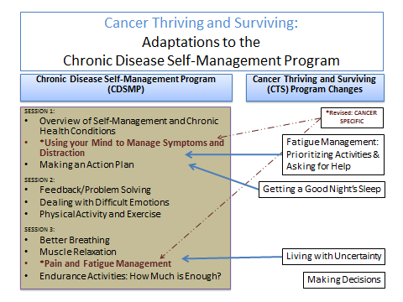

Slide 46
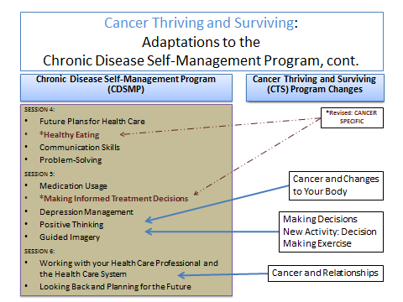

Slide 47
Demographics: Survivors=252 Caregivers=54 Total= 306
Intervention vs. Control (September 1, 2012)
Survivors=252 Table of age by group
age | Group (randomization)
 | Early Intervention | Late Intervention | Total
 | (Intervention | (Control Group)
 | Group)
<50 |  |  | 50
 | 20% | 20%
50-64 |  |  | 121
 | 49% | 47%
65+ |  |  | 81
 | 31% | 33%
Total | 167 | 85 | 252

Slide 48
Demographics: Survivors=252 Caregivers=54 Total= 306
Intervention vs. Control (September 1, 2012)
Survivors= 252 Table of sex by group
 | group(Randomization)
Sex | Early Intervention | Late Intervention | Total
 | (Intervention | (Control Group)
 | Group)
Male |  |  | 42
 | 21% | 8%
Female |  |  | 210
 | 79% | 92%
Total | 167 | 85 | 252

Slide 49
Demographics: Survivors=252 Caregivers=54 Total= 306
Intervention vs. Control (September 1, 2012)
Survivors= 252 Table of sex by group
 | Group(Randomization)
Race/Ethnicity (Check All That Apply) | Early Intervention | Late Intervention
 | (Intervention Group) | (Control Group)
White Non Hispanic | 85% | 84%
Black/African American | 8% | 6%
Hispanic | 8% | 6%
Other | 10% | 14%

Slide 50
Additional General Characteristics:
Survivors of 13 different cancer types are represented.
Nearly 40% indicated their health was very good at program start; 16% indicated it was fair/poor.
About 20% are caregivers (family members or close friends)

Slide 51
How satisfied are you with the overall CONTENT? (n=101)

Slide 52
Did you think the content in the new modules was…. (n=101)

Slide 53
Would you recommend Cancer Thriving and Surviving to Friends and Family? (n=100)

Slide 54
Feasibility and Acceptability of Delivering and Evaluating Cancer Thriving and Surviving?
Can Cancer Survivors be recruited and trained as CTS leaders? Experienced CDSMP peer lay leaders (Colorado = 28; Texas = 4) were recruited the first-ever CTS leader training sessions held in Denver, CO in January, 2011 and May, 2012.
Where has the program been delivered
(n= 15 classes)?

Slide 55
Conclusions
Adaptations made to the Chronic Disease Self-Management Program are acceptable to cancer survivors. However, survivors may desire more resources in the area of CAM and possibly coping.
2.Recruitment of survivors to the program as trainers and participants to a wait-list randomized controlled trial is feasible.
3. The program can be delivered in a variety of settings.
4. Special interest to comparison of intervention and control demographics and response to final measures.

Slide 56
CPCRN Connection and Opportunity
Texas A&M: Dr Marcia Ory longstanding relationship with Dr Kate Lorig and national experience evaluating the CDSMP Program
Colorado: Dr Betsy Risendal connections with cancer community and observing opportunity to study CDSMP adaptation
Colorado: Community Partner in Colorado-
Consortium for Older Adult Wellness (COAW)
activated and over 300 CDSMP leaders to implement study

Slide 57
Acknowledgements
Stanford Patient Education and Resource Center, Dr Kate Lorig
Consortium For Older Adult Wellness (Colorado)
CDC Prevention Research Centers

Slide 58
Survivorship - Next Steps as a Workgroup
Generation of Next Steps:
The workgroup has solicited ideas for next steps both in person and on our conference calls
Criteria for selection:
  What addresses important D&I research questions?
  What follows from our current work?
  What can be accomplished in remaining funding cycle?

Slide 59
Survivorship - Next Steps as a Workgroup
Environmental Scan of Programs for Cancer Survivors:
Research
  Compare with current listings from other key sources (e.g, ACS)
  Examine best strategies for dissemination of findings
  Analyze key informant interviews from all of the states
Practice
  Work with partners to disseminate findings
  Provide technical assistance to delivery sites regarding evaluation methods

Slide 60
Survivorship - Next Steps as a Workgroup
Scoping Study:
Analysis
  Reflect on findings
  Further explore areas of maintenance in the literature (at both individual & organizational levels)
  Assess & advise on comparability / homogeneity of process and outcome measures
  Examine relationship between intervention components and outcomes
  Consider a formal meta-analysis

Slide 61
Survivorship - Next Steps as a Workgroup
Organizational Readiness: To what extent are comprehensive cancer centers ready to implement survivorship care plans?
  Questions
    What frameworks are they choosing?
    What infrastructure is needed?
    What implementation barriers exist when balancing recognition of essential elements?
  Methods
    Scope & geographic parameters
    Guiding frameworks
    Data collection - survey and/or interview

Slide 62
Survivorship - Next Steps as a Workgroup
NCI proposal for Survivorship Care Planning:
Several CPCRN investigators intend to submit a proposal
Can resources of the CPCRN network be effectively leveraged for a cross-site proposal?
    What ways can we best work together to add synergy?
    What other network advantages exist?

