Slide 1
Implementing Patient-Reported Outcome Measures among Diverse Primary
Care Patients
UCLA Fielding School of Public Health
Hector P. Rodriguez
Beth Glenn
Roshan Bastani
Dylan Roby
Ritesh Mistry
National Cancer Institute
Russ Glasgow
Suzanne Heurtin-Roberts
Additional Partners
Alex Krist, VCU/Virginia Ambulatory Care Outcomes Research Network,
Stephanie Shimada, Bedford, Massachusetts Veteran’s Administration Hospital
Rodger Kessler, University of Vermont, Fletcher Allen Health Care
HRSA

Slide 2
Study Setting: 4 Federally-qualified health centers (FQHCs) in Southern California
National Partners: Facilitating data collection in a number of additional sites located nationally: VA in Bedford, MA; practice-based research network clinics in Vermont and VA
Phase 1
(3/12-6/12)
Phase 2
(6/12-9/12)
Pre-Implementation Interviews with Staff and Providers (n = 5 per site)
Implementation of PRO Questionnaire with 50 patients per site (over 1-2 wks)
Post-Implementation interviews with Staff and Providers
(n = 5 per site)
Solicit feedback through use of brief questionnaire from all patients
Invite subgroup of patients to participate in an feedback interview

Slide 3
Behavioral Health Domains
Domain | Final Measure (Source)
1.Demographics | 9 items: Sex, date of birth, race, ethnicity, English fluency, occupation, household income, marital status, education, address, insurance status, veteran’s status. Multiple sources including: Census Bureau, IOM, and National Health Interview Survey (NHIS)
2. Overall Health Status | 1 item: BRFSS Questionnaire
3. Eating Patterns | 3 items: Modified from Starting the Conversation (STC). (Adapted from Paxton, AE et al. Am J Prev Med, 2011; 40(1):67-71.)
4. Physical Activity | 2 items: The Exercise Vital Sign (Sallis, R. Br J Sports Med 2011; 45(6):473–474)
5. Stress | 1 item: Distress Thermometer (Roth AJ, et al. Cancer 1998; 15(82):1904-1908.)
6. Anxiety and Depression | 4 items: Patient Health Questionnaire - Depression & Anxiety (PHQ-4) (Kroenke K, et al. Psychosomatics 2009; 50(6):613-621.)
7. Sleep | 2 items: a. Adapted from BRFSS b. Neuro-QOL (Item PQSLP04)
8. Smoking/ Tobacco Use | 2 items: Tobacco Use Screener (Adapted from YRBSS Questionnaire)
9. Risky Drinking | 1 item: Alcohol Use Screener (Smith PC, et al. J Gen Intern Med 2009; 24(7):783-788)
10. Substance Use | 1 item: NIDA Quick Screen (Smith PC, et al. Arch Intern Med 2010, 170(13): 1155-1160.)

Slide 4

Provider Guidance
Scoring Template
Annotated clinician version of PRO questionnaire indicating out of range values to assist in scoring
Provider Guidance Form
1 page front & back, help to interpret PRO questionnaire results & guide follow-up assessment/treatment
Provider Resource Packet Detailed hard copy/electronic resource to summarize evidence for follow-up/treatment, links to available web resources, inclusion of local resources at site discretion

Slide 6
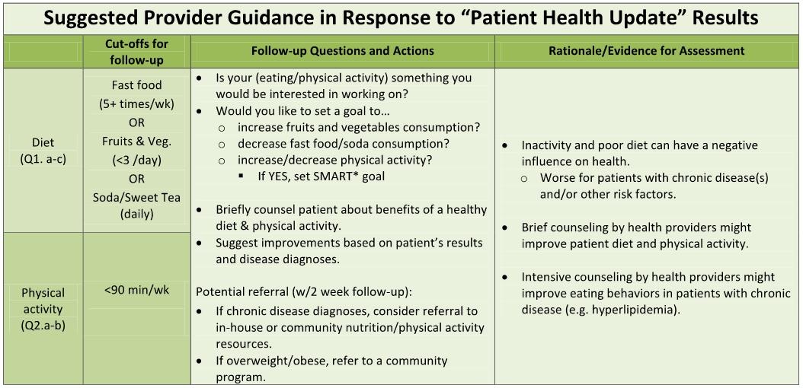

Slide 7
Preliminary Results: Phase 1
Interview Participants (n = 18; Southern California sites only)
Clinic level
Most clinics are assessing at least some of the behavioral domains (inconsistent assessment, use of unvalidated measures common)
  Tobacco among most frequently assessed PRO
  Anxiety/depression: PHQ 4 or 9, often in select patients(diabetics)
  Level of resources available within domains varied widely
Provider/Staff level
Providers generally interested and invested in behavioral health issues (particularly family physicians)
Some concern about “added work” but most staff providers supportive of implementation
No major concerns raised about questionnaire itself

Slide 8
Phase 2: Characteristics of Phase 2 Patient Sample
(n = 284; California sites only)
Age | Gender
< 39 - 14% | 30% Male
40-59 - 57% | 70% Female
60+ - 29%
Race/Ethnicity | Language of Survey
54% Latino | 29% English
20% Chinese | 51% Spanish
10% Filipino | 20% Chinese
6% White
2% African American | English fluency
7% Other | 31% Well/Very well
 | 66% Not well/Not at all

Slide 11
Patient Feedback Questionnaire Results
(n = 259; 92% of PRO sample)
Felt uncomfortable answering questions | 8%
Provider asked if you had concerns about your results | 44%
Provider asked which concern you want to work on | 46%
Provider helped you identify steps to address concerns | 60%
Patient plans to follow-up with provider about concerns | 74%

Slide 12
Post-Implementation Staff/Provider Interviews
(n = 7; additional interviews pending)
No major concerns about PRO questions
Some concerns about duplication of data capture, given various ongoing required assessments for health plans/payers.
Use of PRO questionnaire results during visit was highly variable
Low use of Provider Guidance Materials
High interest in integrating the instrument into EHR

Slide 13

The Road Ahead: Phase 3

Slide 14
Pragmatic Implementation Trial
(Fall 2012 - Summer 2013)
18 paired primary care clinics: half FQHC community health centers, half other PBRN clinics
  Each clinic recruits minimum of 150-200 patients
  Randomized pragmatic study—delayed intervention control—assess both conditions at 0, 4 and 8 months (discuss timing)
  Clinics selected to be diverse and at different stages of EHR implementation
  Key outcomes include implementation; creation of action plans; patient behavior change is secondary
  Final protocol designed collaboratively with you and customized to your clinics
Notes:
10/15/12
National Cancer Institute
14

Slide 15
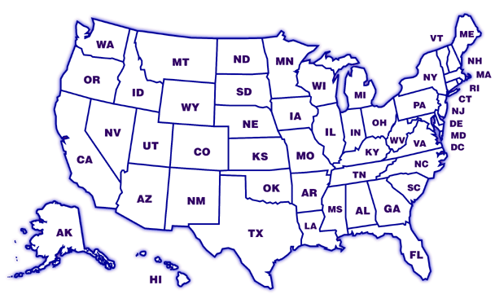
Key Points of Collaborative Implementation Trial
Designing for flexibility and adoption—e.g., varying levels of clinic integration of EHRs, different levels and modalities of decision aids
WHAT is delivered—e.g., survey, feedback, goal setting, follow-up is STANDARD;
HOW this is delivered is customized to setting
Study goal = routine use of survey items, feedback, action planning/goal setting tools and follow-up support
OR
MN
CA
VA
NC
TX
Notes:
10/15/12
National Cancer Institute
15

Slide 16
Intervention Component
Estimated n/Clinic?
How Data Collected
Patient Identified as Eligible and Invited
500
Non-urgent Visit List from Clinic (Denominator for Reach)
Patient Completes Automated Survey (Patient Health Update)—at Home or in Waiting Room
Automated Transfer to UCLA (Numerator for Reach)
350
Patient Receives Feedback and Identifies Priorities
325
Automated Transfer to UCLA
Primary Care Staff Receives Feedback on Patient Needs and Priorities (from VCU via EHR import, e-mail, fax, etc.)
Automated information to UCLA
Local Process to Make This Actionable in Clinic-Patient Flow
300
Patient and Staff Have Collaborative Goal Setting/Action Planning Discussion
Documented in EHR
Patient Experience Survey
225
Follow-up Contact on Action Plan Progress within 1 Month
150
Documented in EHR
Patient Experience Survey

Slide 17
Patient Health Update Web Tool
Web site for
Patient input of survey data
Tailored Patient Printout
  Summary of data entered
  Recommendations for positive findings (ordered by importance)
Tailored Physician Printout
  Summary of positive findings with recommendations from the Physician Guidance sheet
Printout of blank action plan to be filled out during the clinical visit

Slide 19
Phase 3:Pragmatic Trial
Early Implementation Sites (4 FQHC, 5 PBRN)
Multi-Component Intervention
Baseline (n = 150)
Follow-up 1
Follow-up 2
Delayed Implementation Sites (4 FQHC, 5 PBRN)
Multi-Component Intervention
Baseline (n = 150)
Follow-up 1
Follow-up 2
Months
0 1 2 3 4 5 6 7 8 9 10 11 12

Slide 20
Moving Forward with
Patient-Reported Data to Enhance Consistency of Primary Care Attention to Health Behavior and Psychosocial Issues
Background for Collaborative Pragmatic Implementation Trial Sponsored by Supplements from
NCI, OBSSR and AHRQ
http://cancercontrol.cancer.gov/is/
Notes:
20
10/15/12
National Cancer Institute

Slide 21
Patient Report EHR Measures for Primary Care
In the billions of dollars spent on EHRs in last several years, one thing is missing: Patient-Reported Measures
Advent of patient-centered medical home and “meaningful use” of EHRs
Impossible to provide patient-centered care if no patient measures, goals, preferences, concerns collected
With recent advances in measurement, meaningful use incentives, time is right
Notes:
21

Slide 22
Focus of the Implementation Study
It’s not about the items/measures
It IS about enhancing consistent delivery of evidence-based interventions on health behaviors and psychosocial issues
The items—and support/decision aids—are a strategy to overcome key implementation barriers
Timing and Context are everything—(e.g., PCMH, meaningful use, annual wellness exams, EHR adoption incentives)
Notes:
10/15/12
National Cancer Institute
22

Slide 23

Evidence Integration Triangle (EIT) - A Patient-Centered Care Example
Intervention Program/Policy
Evidence-based decision aids to provide feedback to both patients and health care teams for action planning and health behavior counseling
Evidence:
US Preventive Services Task Force Recommendations for health behavior change counseling; evidence on goal setting & shared decision making
Feedback
Feedback
Stakeholders:
Primary care (PC) staff, patients and consumer groups; PC associations; groups involved in meaningful use of EHRs, EHR vendors
Participatory Implementation Process
Iterative, wiki activities to engage stakeholder community, measurement experts and diverse perspective. Clinics help to design interventions
Practical Progress Measures
Brief, standard patient reported data items on health behaviors & psychosocial issues -- actionable and administered longitudinally to assess progress
Feedback

Slide 24
BIG PICTURE
Identify Common Data Elements (CDEs)
Align with Related Efforts
Cognitive Testing/Focus Groups
Field Test Set of CDEs
Promote Software Development
Feasibility Tests and Pragmatic Trial
Encourage Implementation (CHCs,PBRNs,
HMOs, VA, IHS, CMS)
Publications
Widespread Use of CDEs in
Primary Care

Slide 25
Timeline
Oct.-Dec. 2012: Collaboratively finalize protocol and measures, sites finalize and prepare clinic pairs, secure IRB approvals and assess context.
For discussion: Possible 1-2 week pilot; PDSA period to get procedures working smoothly prior to official data collection
Jan.-April 2013: Phase I—Complete Baseline in both sites and Implementation in one clinic, each site
May-August: Phase II—Complete 4-month assessments; conduct intervention in delayed clinics, maintenance/sustainability period for initial intervention clinics.
For discussion: Timing of delayed intervention—this
design vs. longer initial intervention and just give intervention to delayed sites toward end of the project
September: Collect final assessments (sustainability in initial sites) and post-interview, final reports
Notes:
10/15/12
National Cancer Institute
25

Slide 26
Notes:
10/15/12
National Cancer Institute
26

