Slide 1

Preliminary Results: MOHR Reach
María Férnandez, PhD
My Own Health Report (MOHR) Project Panel
CPCRN Fall Meeting
October 3, 2013
This presentation was supported by Cooperative Agreement Number CDC/NCI U48DP001934/SIP09-022 from the Centers for Disease Control and Prevention. Additional funding provided by NCI R01Supplement to CA154549. The findings and conclusions in this presentation are those of the author(s) and do not necessarily represent the official position of the funders.
Notes:
I am pleased to share with you some preliminary data from the MOHR assessment tool related to patient-reported health behaviors and psychological status

Slide 2
Number of new users per week
Notes:
Talk about how differences over time will be explained through contextual analysis – factors changing over time include level of provider buy-in, staffing changes, use of locums when physicians are on vacation or out of the office, changes in eligibility criteria – UTH started with all chronic disease patients then changed to only annual checkups because clinic was overwhelmed but then we weren’t reaching enough people so had to increase the eligible patients to all new patients and established patients in addition to annual checkups

Slide 3
MOHR Reach by Fielding Strategy
Notes:
Most successful strategy was fielding in the lobby, exam room or by phone, but may not be feasible in the larger practices → mailing the MOHR may have reached a larger number of patients overall even the reach proportions may be lower.

Slide 4
Sample
Results based on MOHR assessments
completed as of ≈ September 1, 2013:
1,381 patients
  40% from FQHC clinics (n = 548)
  60% from PBRN clinics (n = 833)
Notes:
Although data are still trickling in, I am going to present results of MOHR assessments completed as of Sept 1st---which includes 1,381 patients—40% from FQHC clinics and 60% from PBRN clinics

Slide 5
Demographics
 | FQHC | PBRN | Total
Gender | % | % | %
Female | 71 | 60 | 64
Age
18-34 | 21 | 16 | 17
35-50 | 34 | 25 | 29
51-64 | 37 | 34 | 35
> 65 | 8 | 25 | 18
Marital Status
Married/Living as married | 51 | 55 | 53
Divorced/Separated | 21 | 22 | 21
Widowed | 6 | 7 | 7
Single | 23 | 17 | 19
Notes:
My first several slides display demographic data stratified by clinic type—FQHC vs. PBRN. Please keep in mind this is our first peek at the data stratified by clinic type. So, these results are quite preliminary, although exploring what looks like differences, we did not conduct any significance tests at this point.
We can see that more than half of patients from all sites were female with women representing a higher proportion of FQHC patients compared to PBRN patients
Regarding age, we have a fairly good distribution across categories with patients ranging in age from 18 to over 65, one difference—PBRN patients appear to be somewhat older than FQHC patients—25% of PBRN patients > 65 vs. only 8.4% of FQHC patients
Marital status-around 53% married-in line with expectations for adult clinic sample

Slide 6
Demographics (cont)
 | FQHC | PBRN | Total
Education | % | % | %
Less than high school | 28 | 19 | 22
High school | 38 | 26 | 31
Some college/associate | 25 | 26 | 26
College degree or higher | 10 | 29 | 22
Employment
Full time | 37 | 31 | 33
Part time | 14 | 10 | 11
Unemployed | 15 | 11 | 12
Homemaker/Student | 12 | 7 | 9
Disabled | 13 | 19 | 17
Retired | 8 | 20 | 15
Notes:
These are data for education and employment—see differences between FQHC and PBRN patients as we would expect with PBRN patients having higher levels of education 29% college degree or higher vs. 10% of FQHC patients
Employment—did not assess type of employment but see relatively few differences with exception of % retired---reflects age differences we found

Slide 7
Race/Ethnicity
 | FQHC | PBRN | Total
Ethnicity | % | % | %
% Hispanic/Latino | 35 | 4 | 17
Race
White | 58 | 78 | 70
African American | 39 | 17 | 26
Asian/Pacific Islander | 2 | 3 | 2
American Indian/AN | 2 | 2 | 2
English fluency
Well/Very well | 81 | 99.6 | 92
Notes:
As we expected, there are substantial differences regarding racial and ethnic diversity of FQHC vs. PBRN patient samples with FQHC samples having higher proportions of Hispanic and African American patients and lower proportion of white patients compared to PBRN. English fluencey similarly differed with >99% of PBRN patients reporting high English fluency vs. 81% of FQHC patients

Slide 8
Data from MOHR Assessment Tool:
Patient-Reported Health Behaviors and Psychological Status
Beth Glenn, PhD
My Own Health Report (MOHR) Project Panel
CPCRN Fall Meeting
October 3, 2013
This presentation was supported by Cooperative Agreement Number CDC/NCI U48DP001934/SIP09-022 from the Centers for Disease Control and Prevention. Additional funding provided by NCI R01Supplement to CA154549. The findings and conclusions in this presentation are those of the author(s) and do not necessarily represent the official position of the funders.
Notes:
I am pleased to share with you some preliminary data from the MOHR assessment tool related to patient-reported health behaviors and psychological status

Slide 9
Unhealthy Behaviors:
% Positive Screens
 | FQHC | PBRN | Total
Diet, Physical Activity, BMI | % | % | %
Poor fruit/vegetable consumption (<5 svgs/day) | 86 | 81 | 83
Excess fast food intake (> 1 time/week) | 61 | 50 | 55
Excess soda/sugary beverage intake (> 1/day) | 50 | 34 | 46
Insufficient physical activity (<150 mins/week) | 98 | 97 | 98
Elevated Body Mass Index (>25 kg/m²) | 84 | 70 | 76
Alcohol/Tobacco/Other Substance Use
Excess alcohol intake (> 1 binge/year) | 27 | 22 | 24
Current smoker or smokeless tobacco user (any) | 24 | 25 | 25
Illegal drug/inappropriate prescription use | 3 | 4 | 4
Sleep Problems
Sleepy often or always/snoring | 83 | 84 | 84
Notes:
The next two slides display the % of patients who completed the MOHR who “screened positive” for the health domain. Again, we were able to stratify the data by clinic type.
Overall, we see that insufficient physical activity (<150 mins per week) by far the most common domain that patients tested positive for---nearly 98% of all patients
Fruit & vegetable consumption was also poor with 83% of patients “screening positive for this domain”
Not suprisingly, about ¾ of patients also “screened positive” for elevated BMI
Related to differences, for the domains where most screened positive we see no major differences
FQHC patients have higher “screen positive rate” for fast food, sugar sweetened beverage, and high BMI
Related to alcohol/tobacco/substance: binge drinking fairly common 24%---25% current smokers
Sleep disturbance extremely common
No differences by clinic type for these issues

Slide 10
Mental Health & Perceived Health
% Positive Screens
 | FQHC | PBRN | Total
 | % | % | %
High Stress (>5 on 10 pt scale) | 58 | 58 | 58
Anxiety/worry (score >4) | 12 | 20 | 17
Depression (score >4) | 6 | 11 | 10
Self-reported health (fair/poor) | 50 | 38 | 43
Notes:
Related to mental health overall, over half of patients screened positive for “high stress” over 5 on 10 point scale. Fewer patients endorsed significant anxiety and depression-43% had fair or poor health---Related to differences, the screen positive rate was twice as high for anxiety among PBRN vs. FQHC patients…poor self-reported health also was more common among FQHC vs. PBRN patients

Slide 11
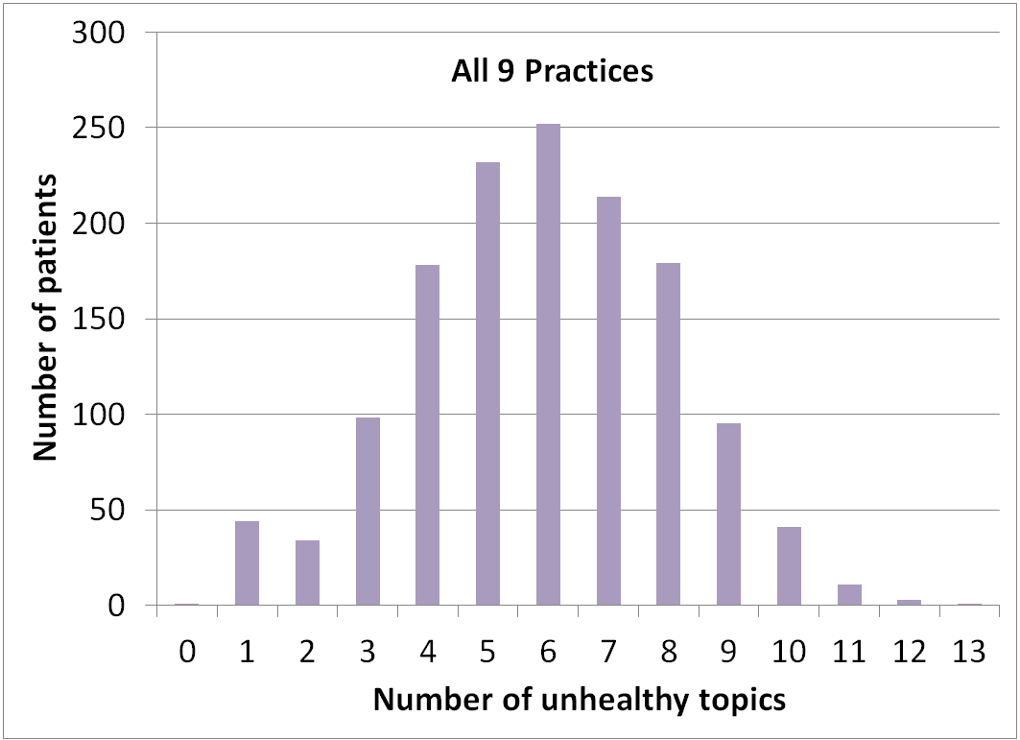
Distribution of Patients
by Number of Positive Screens
Mean positive screens = 6.09 Overall
FQHC Patients = 6.2
PBRN Patients = 6.0
Notes:
This figure shows the distribution of all patients in the sample by number of positive screens. We can see that we have a fairly normal distribution with patients screening positive for 6 health domains on average. And despite any differences within domains by clinic type, the mean number of positive screens is equivalent for fQHC and PBRn patients

Slide 12



Patient Readiness to Change &
Discuss Health Topic with Provider
 | # Screened Positive | Ready to Change (%) | Want to Discuss (%)
Insufficient physical activity | 1029 | 15 | 9
Fruit & vegetable intake | 992 | 23 | 10
Daytime sleepiness/Snoring | 984 | 6 | 7
High BMI | 910 | 28 | 20
Stress level | 691 | 21 | 24
Fast food intake | 659 | 19 | 9
Overall health | 506 | 20 | 15
Soda/SSB intake | 488 | 13 | 7
Tobacco | 291 | 19 | 17
Excessive alcohol intake | 281 | 16 | 11
Anxiety/Worry | 194 | 22 | 39
Depression | 105 | 31 | 49
Illegal drug/Inappropriate prescription use | 42 | 21 | 21
98% of screened
83%
3
2
1
Notes:
One of the most innovative and most patient-centered aspects of the MOHR tool is that when patients screen positive for a particular health domain, they are asked if they are ready to make a change in that area and if they would like to speak about the issue with their physicians. In this slide I have ranked the domains from the highest to lowest # of positive screens. The columns to the right display the % of patients who scored positive who are either “ready to change” or “want to discuss” I have combined data from all patients for this slides.
Obviously, there are a lot of numbers on this slides. I just want to point out a few things. As we know from prior slides, insufficient physical activity is the most common domain to screen positive with 98% of patients screening positive. However, few patients are interested in making a change and even fewer want to discuss the issues with a provider
We see a similar issue for fruit and vegetable intake and even sleep disturbance…
The domains that patients appear more likely to be interested in making changes now include depression, followed by high BMI, followed by fruit and vegetable intake—overall low rates of being interested in making changes despite high rates of screening positive . BMI finding is interesting in quite a few patients are interested in making changes in BMI—however fewer of these same patients want to make changes in physical activity and nutrition—major drivers of BMI???

Slide 13
Top Patient Priority
 | FQHC (%) | PBRN (%) | Total (%)
High BMI | 36 | 34 | 35
Insufficient physical activity | 13 | 17 | 15
Overall health | 18 | 10 | 13
Stress level | 11 | 12 | 11
Fruit & vegetable intake | 8 | 9 | 9
Tobacco | 4 | 17 | 5
Anxiety/Worry | 3 | 4 | 4
Daytime sleepiness/snoring | 1 | 3 | 2
Fast food intake | 2 | 2 | 2
Depression | 2 | 2 | 2
Soda/SSB intake | 1 | .8 | 1
Excessive alcohol intake | 2 | .4 | 1
Illegal drug/inappropriate prescription use | 0 | 1 | .5
3
1
3
2
2
Notes:
Finally, we asked patients among the areas they are willing to make a change. What is their top priority. These data are again stratified by clinic type and these % add up to 100 given all patients chose 1 priority. Here the picture has shifted a bit. We see that high BMI is the top priority for close to third of patients with no difference by clinic type. However, beyond that some divergence between FQHC and PBRN patients. The second most common priority for FQHB patients was overall health and the third insufficient physical activity. For PBRN patients the second most common priority was tobacco folllowed by stress.

Slide 14
Summary
Patients screen positive for many domains
Few motivated to make changes at this time
Despite FQHC and PBRN sample differences, same level of need
Some interesting differences between FQHC and PBRN patients
  Anxiety more commonly reported in PBRN pts
  Fewer FQHC patients want tobacco cessation
Results highlight need for prioritization and involvement of care team vs. reliance on provider

