Slide 1

CPCRN Presentation Template
Accelerating the Adoption of Evidence-Based Cancer Prevention and Control In Communities-Accomplishments
September 24, 2013

Slide 2
CPCRN Grant Applications (cumulative)
Grant Applications
Funded Grants

Slide 3
CPCRN Multi-Center* Collaborations 2004-2012
*More than two centers

Slide 4
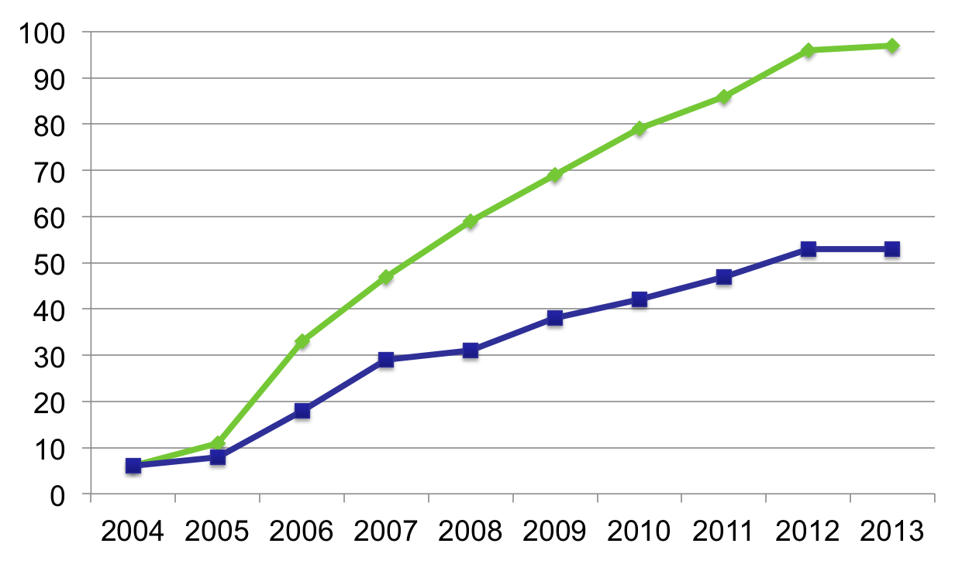
Multi-center Grants (cumulative)
Multi-center Grant Applications
Multi-center Funded Grants

Slide 5
Network Diagram: Evolution of CPCRN
CPCRN1: 2002-2004
Harvard
Rounds of CPCRN Funding
Centers in CPCRN1 – 2002-2004
Centers in CPCRN2 – 2004-2009
Centers in CPCRN3 – 2009-2014
U.Texas
U.Wash

Slide 6
Network Diagram: Evolution of CPCRN
UNC
CPCRN2: 2004-2009
Harvard
Rounds of CPCRN Funding
Centers in CPCRN1 – 2002-2004
Centers in CPCRN2 – 2004-2009
Emory
Centers in CPCRN3 – 2009-2014
U.Texas
Morehouse
UCLA
U.Wash
Wash.U

Slide 7
Network Diagram: Evolution of CPCRN
Texas A&M
UNC
CPCRN3: 2009-2014
USC
Harvard
Rounds of CPCRN Funding
Centers in CPCRN1 – 2002-2004
U.Colorado
Centers in CPCRN2 – 2004-2009
Emory
Centers in CPCRN3 – 2009-2014
U.Texas
Morehouse
UCLA
U.Wash
Wash.U

Slide 8
Network Diagram: Multi-center Connections Grants and Publications Legend
Texas A&M
UNC
Rounds of CPCRN Funding
Centers in CPCRN1 – 2002-2004
USC
Centers in CPCRN2 – 2004-2009
Harvard
Centers in CPCRN3 – 2009-2014
Connections between centers
Number of
Connections
CPCRN2 CPCRN3
U.Colorado
1
Emory
2
3
4
5
U.Texas
6
Morehouse
7
8
9
10+
UCLA
U.Wash
Wash.U

Slide 9
Network Diagram:
Multi-center Grants, 2004
Texas A&M
UNC
USC
Harvard
U.Colorado
Emory
U.Texas
Morehouse
UCLA
U.Wash
Wash.U

Slide 10
Network Diagram:
Multi-center Grants, 2005
Texas A&M
UNC
USC
Harvard
U.Colorado
Emory
U.Texas
Morehouse
UCLA
U.Wash
Wash.U

Slide 11
Network Diagram:
Multi-center Grants, 2006
Texas A&M
UNC
USC
Harvard
U.Colorado
Emory
U.Texas
Morehouse
UCLA
U.Wash
Wash.U

Slide 12
Network Diagram:
Multi-center Grants, 2007
Texas A&M
UNC
USC
Harvard
U.Colorado
Emory
U.Texas
Morehouse
UCLA
U.Wash
Wash.U

Slide 13
Network Diagram:
Multi-center Grants, 2008
Texas A&M
UNC
USC
Harvard
U.Colorado
Emory
U.Texas
Morehouse
UCLA
U.Wash
Wash.U

Slide 14
Network Diagram:
Multi-center Grants, 2009
Texas A&M
UNC
USC
Harvard
U.Colorado
Emory
U.Texas
Morehouse
UCLA
U.Wash
Wash.U

Slide 15
Network Diagram:
Multi-center Grants, 2010
Texas A&M
UNC
USC
Harvard
U.Colorado
Emory
U.Texas
Morehouse
UCLA
U.Wash
Wash.U

Slide 16
Network Diagram:
Multi-center Grants, 2011
Texas A&M
UNC
USC
Harvard
U.Colorado
Emory
U.Texas
Morehouse
UCLA
U.Wash
Wash.U

Slide 17
Network Diagram:
Multi-center Grants, 2012
Texas A&M
UNC
USC
Harvard
U.Colorado
Emory
U.Texas
Morehouse
UCLA
U.Wash
Wash.U

Slide 18
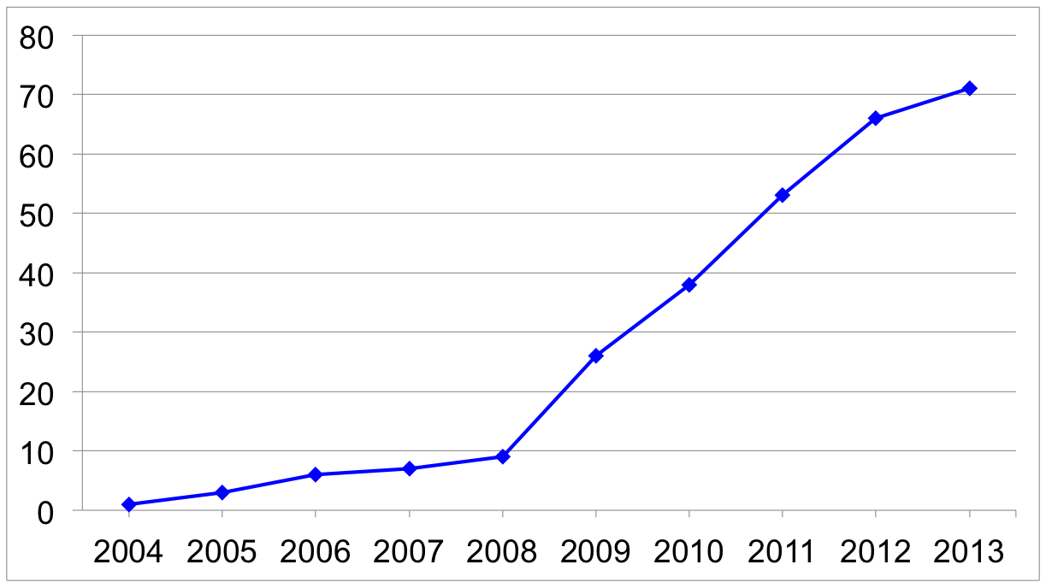
Multi-center Publications (cumulative)

Slide 19
Network Diagram:
Multi-center Publications, 2004
Texas A&M
UNC
USC
Harvard
U.Colorado
Emory
U.Texas
Morehouse
UCLA
U.Wash
Wash.U

Slide 20
Network Diagram:
Multi-center Publications, 2005
Texas A&M
UNC
USC
Harvard
U.Colorado
Emory
U.Texas
Morehouse
UCLA
U.Wash
Wash.U

Slide 21
Network Diagram:
Multi-center Publications, 2006
Texas A&M
UNC
USC
Harvard
U.Colorado
Emory
U.Texas
Morehouse
UCLA
U.Wash
Wash.U

Slide 22
Network Diagram:
Multi-center Publications, 2007
Texas A&M
UNC
USC
Harvard
U.Colorado
Emory
U.Texas
Morehouse
UCLA
U.Wash
Wash.U

Slide 23
Network Diagram:
Multi-center Publications, 2008
Texas A&M
UNC
USC
Harvard
U.Colorado
Emory
U.Texas
Morehouse
UCLA
U.Wash
Wash.U

Slide 24
Network Diagram:
Multi-center Publications, 2009
Texas A&M
UNC
USC
Harvard
U.Colorado
Emory
U.Texas
Morehouse
UCLA
U.Wash
Wash.U

Slide 25
Network Diagram:
Multi-center Publications, 2010
Texas A&M
UNC
USC
Harvard
U.Colorado
Emory
U.Texas
Morehouse
UCLA
U.Wash
Wash.U

Slide 26
Network Diagram:
Multi-center Publications, 2011
Texas A&M
UNC
USC
Harvard
U.Colorado
Emory
U.Texas
Morehouse
UCLA
U.Wash
Wash.U

Slide 27
Network Diagram:
Multi-center Publications, 2012
Texas A&M
UNC
USC
Harvard
U.Colorado
Emory
U.Texas
Morehouse
UCLA
U.Wash
Wash.U

Slide 28
Successes: CPCRN Funding (9/30/2009-3/29/13)
The CPCRN Network
Applications $518,965,412
Funded Grants $154,518,735
Multi-Center CPCRN
Applications $60,680,675
Funded Grants $31,161,560

