Slide 1
Cancer Prevention and Control Research Network Coordinating Center
CPCRN:
A national network of academic, public health, and community partners who work together to reduce the burden of cancer, especially among those disproportionately affected.
PI: Bryan Weiner

Slide 2
CPCRN Network Center Map
University of
Washington
University
of Iowa
University
of Kentucky
Oregon Health &
Science University
Case Western
Reserve University
University of
Pennsylvania
University of
North Carolina
University of
South Carolina

Slide 3
CPCRN Collaborating Centers
Member Name | Principal Investigator | Research Focus
University of North Carolina at Chapel Hill | Jennifer Leeman, Dr.P.H. | Tobacco prevention, cancer screening (colorectal and HPV), corner store initiatives, implementation support
University of South Carolina at Columbia | Daniela Friedman, Ph.D. | Physical activity, diet, disease mapping, colonoscopy, tobacco control, informed decision making, psychosocial/mental health
University of Washington | Margaret A. Hannon, Ph.D. | Improve cancer screening in community health clinics, health departments, and workplaces
Oregon Health Science University | Thomas M. Becker, Ph.D. | Cultural adaptation of EBIs, survivorship, diet and physical activity, AI/AN and rural populations
Case Western University | Susan A. Flocke, Ph.D. | Tobacco cessation, community health clinics, e-referral, community-clinical linkages, urban
University of Pennsylvania | Karen Glanz, Ph.D. | Improve cancer screening in community health clinics, disadvantaged/minority populations, evidence academies and community engaged scholarship
University of Iowa | Susan J. Curry, Ph.D. | HPV vaccination, Latino and AA populations, rural and micropolitan areas
University of Kentucky | Robin Vanderpool, Ph.D. | Improve cancer screening, multilevel interventions, office systems changes, rural Appalachian region
Coordinating Center – University of North Carolina at Chapel Hill | Bryan J. Weiner, Ph.D. | Health systems change, community-clinical linkages, multilevel intervention

Slide 4
CPCRN Multi-Center Projects
HPV Vaccination Signature Project
FQHC Signature Project
Tobacco/Lung Cancer Screening Workgroup
Community Implementation Workgroup
Cervical Cancer Screening Workgroup
CDC Screening Programs Workgroup
EBI Modeling Workgroup

Slide 5
HPV Vaccination Signature Project
Purpose:
Contribute to the science and evidence-base supporting innovative community-clinical linkages to increase HPV vaccination initiation and completion among adolescents and young adults
Work in Progress:
Identify existing and potential community-clinical linkages for HPV vaccination via environmental scan
Assess core components, processes, relationships, and outcomes of community-clinical linkages via case studies

Slide 6
FQHC Signature Project
Purpose:
Collaborate with FQHCs—and the state and national associations that represent them—to evaluate and strengthen colorectal cancer (CRC) screening initiatives at the patient, clinic, and community level
Work in Progress:
Identify the evidence-based interventions, evidence-informed implementation strategies, and implementation supports that FQHCs currently use to increase CRC screening rates
Assess FQHC readiness to implement multi-level interventions to increase CRC screening rates

Slide 7
Tobacco and Lung Cancer Screening Workgroup
Purpose:
Identify barriers and facilitators faced by FQHCs related to implementing: 1) tobacco assessment and cessation assistance/referral; and 2) low dose computed tomographic (LDCT) scan for lung cancer screening
Work in Progress:
Review literature on smoking cessation and LDCT practices in FQHCs, identify barriers and facilitators of lung cancer screening
Survey FHQCs to determine current practices, interest, and capacity to screen and refer for tobacco lung cancer

Slide 8
Community Implementation Workgroup
Purpose:
Develop, test, and refine training and technical assistance strategies with the goal of building community-based organizations’ capacity to select, adapt, and implement evidence-based interventions.
Work in Progress:
Support, evaluate, and refine the Putting Public Health Evidence in Action curriculum with a focus on scalable approaches to delivery.
Develop implementation support that supplements existing training curriculum

Slide 9
Cervical Cancer Screening Workgroup
Purpose:
Identify and evaluate methods to increase implementation of new guidelines for cervical cancer screening – at the patient, provider, organizational, and policy levels
Work in Progress:
Conduct literature review to identify the drivers of, and strategies for, de-escalation of low-value care

Slide 10
CDC Cancer Screening Programs Workgroup
Purpose:
Evaluate and support CRCCP and NBCCEDP efforts to increase implementation of evidence-based interventions (EBIs) to increase breast, cervical, and colorectal cancer screening.
Work in Progress:
Analyze 2010-2015 CRCCP grantee survey data to identify trends in EBI adoption, implementation, and maintenance
Participate in CDC CRCCP evaluation meetings to assist evaluation planning for CRCCP-2.
Meet with CDC NBCCEDP evaluation team to identify collaboration opportunities.

Slide 11
EBI Modeling Workgroup
Purpose:
Inform cancer screening intervention planning at practice, health system, and policy level by integrating best available evidence into decision support models and using these models to conduct virtual comparative effectiveness research
Work in Progress:
Adapt UNC’s microsimulation model to determine best EBIs for improving CRC screening for Oregon’s counties and regional Coordinated Care Organizations
Estimate statewide effect of health insurance coverage on costs and benefits of CRC screening in vulnerable populations in NC

Slide 12
Strengths and Challenges
Strengths:
Strong community partnerships
Focus on under-served populations
Broad geographic reach
Challenges:
New network means new centers, new people, new projects
Multicenter projects need leadership, staffing, and resources
Staying focused versus pursuing emergent opportunities
Collaboration takes (lots of) time

Slide 13
Accomplishments Past and Present
Past (2004 - 2014):
Scientific: 249 multi-center articles, 42 multi-center grants
Scientific: advanced state of measurement in D&I science
Practice: 600 public health practitioners trained in putting public health evidence into practice
Practice: Delivered Smoke-Free Homes intervention to thousands of callers of 2-1-1 information and referral service
Present (2014 - 2016):
ACS grant to pilot-test HPV Immunization Neighborhood
Upcoming ACS train-the-trainer collaboration

Slide 14
Success Story: Can We Do It Again?

Slide 15
Lessons Learned:
Fostering Multi-Center Collaboration
Build expectation of multi-center collaboration into the RFA
Reinforce expectation through active Funder involvement
Develop processes and resources to support multi-center collaboration via Coordinating Center:
  Logistics (e.g., collaboration tools)
  Facilitation (e.g., research services)
  Monitoring (e.g., online progress reporting)
  Accountability (e.g., policies and procedures)

Slide 16

Comprehensive Cancer Control Collaborative of North Carolina
PI: Jennifer Leeman

Slide 17




4CNC Team
Jennifer Leeman - School of Nursing
Noel Brewer - Health Education Health Behavior, Gillings School of Global Public Health
Catherine Rohweder - Consortium for Implementation
Science, Gillings School of Global Public Health
Stephanie Wheeler - Health Policy & Management,
Gillings School of Public Health

Slide 18
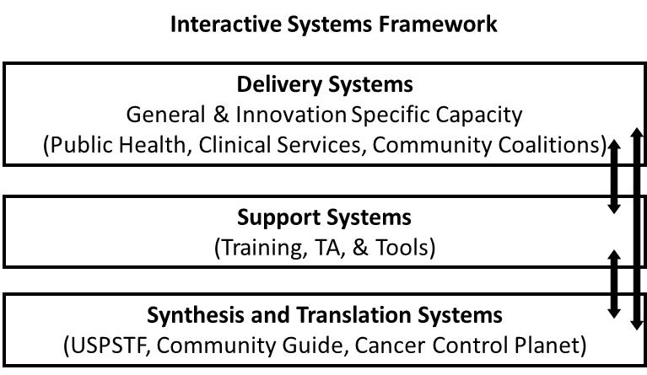
4CNC’s Research Model for Implementation and Dissemination
(Wandersman et al., 2008; 2012)

Slide 19
4CNC’s Research Questions
How do we build the evidence base for implementation support systems?
What strategies do implementation support systems use?
How do these strategies vary (dose, medium, focus)?
How might we tailor these strategies to optimize effectiveness across different contexts and evidence-based strategies?
How do different strategies affect general capacity? Intervention-specific capacity?

Slide 20
4CNC’s Core Project
Develop and test the effectiveness of implementation support strategies that combine
Training
+
  Technical Assistance (TA)
  +
  Tools

Slide 21
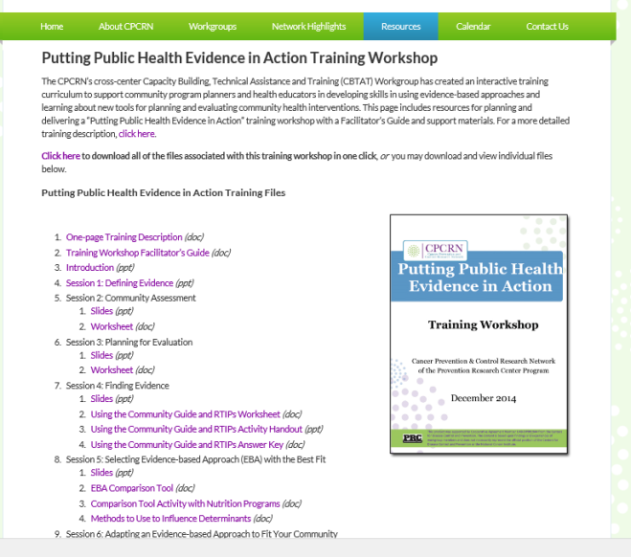

CPCRN Training Curriculum (developed 2009-2014)
Putting Public Health Evidence in Action

Slide 22
Steps in the Intervention
Planning Process
Establishing Goals & Objectives;
Planning for Evaluation
Assessing Your Community
Finding Evidence
Selecting Best Fitting Evidence- Based Strategies
Putting Public Health Evidence in Action
Adapting
Implementing & Evaluating

Slide 23
Curriculum Development and Dissemination Activities
Created two new modules
  Using QI Strategies to Implement an Intervention
  Creating a Communication Plan
Delivered curriculum modules
  George Washington Cancer Institute (Sept 2015)
  National Association of Chronic Disease Directors (Jan 2016)
Disseminated curriculum
  NCI Research-to-Reality Webinar (Feb 2015)
  APHA Train-the-Trainer Learning Institute (Oct 2015)
  American Cancer Society collaboration (planned for 2016)

Slide 24








4CNC’s Training Partners in
North Carolina

Slide 25
Trainings Delivered on Evidence-Based Public Health
Since 2013, we have delivered 6 trainings in North Carolina
2 – 3 days in length, 30+ participants at each training
Training locations:
  Greenville
  Raleigh
  Asheville
  Morrisville
  Winston-Salem
  Greensboro

Slide 26
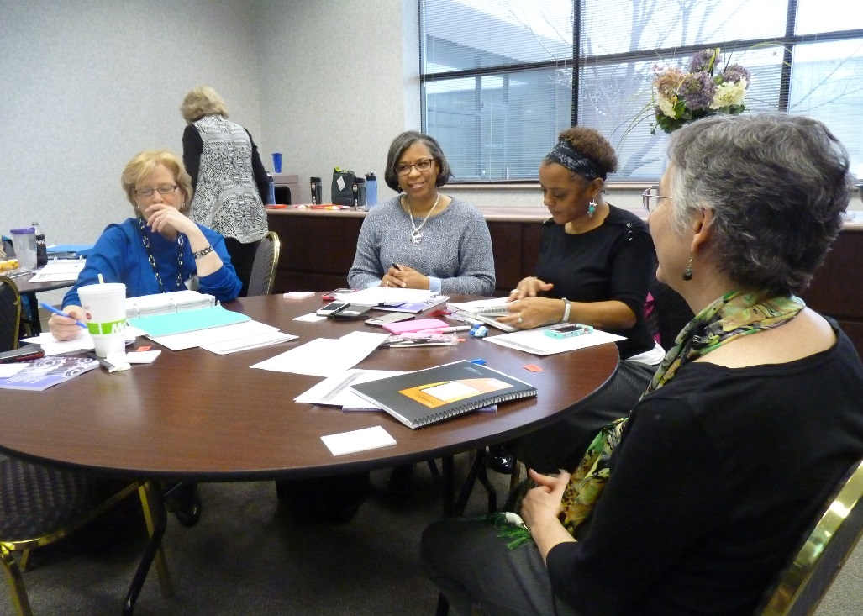
Training: Necessary but Not Sufficient
Training builds general capacity - practitioners also need to build intervention-specific capacity
Practitioners need ongoing support for implementation
Practitioners need assistance in overcoming barriers

Slide 27
Implementation Support Includes:
Training
+
  Technical Assistance (TA)
  +
  Tools

Slide 28
Technical Assistance: Piloting a
Webinar-Based Approach
Pilot Protocol
Training followed by technical assistance
Delivered via three interactive webinars
Pilot 1 focused on a single intervention
“Healthy Foods in Corner Stores” (Feb – April 2016)
Pilot 2 focused on a category of interventions
“Obesity Prevention”* (March – May, 2016)
* Funding provided by the NC Area Health Education Center (PI: Avia Maynor)

Slide 29
Technical Assistance
Walk teams/coalitions through a staged implementation process
Engage cross-sector partners
Assess local environments
Collectively formulate an evidence-informed solution
Develop and execute an advocacy/implementation plan
Evaluate processes and outcomes
Notes:
4 contacts over time to assist practitioners as they navigate the complexities involved in changing community environments.

Slide 30
Tools
Provide tools that practitioners can use at each step in the process
Engage stakeholders
Collect local data
Raise awareness of problems and solutions
Develop and implement action plans
Evaluate processes and outcomes

Slide 31

Developing Measures of Implementation Support Effectiveness
Two organizations are working with us to develop measures:
Counter Tobacco (funded by CDC and directed by Kurt Ribisl)
Counter Tools (non-profit in Chapel Hill, NC and directed by Allison Meyers)
Leeman J, Myers AE, Ribisl KM, Ammerman AS. Disseminating
policy and environmental change interventions: insights from obesity
prevention and tobacco control. Int J Behav Med. 2015 Jun;22(3):301-11

Slide 32
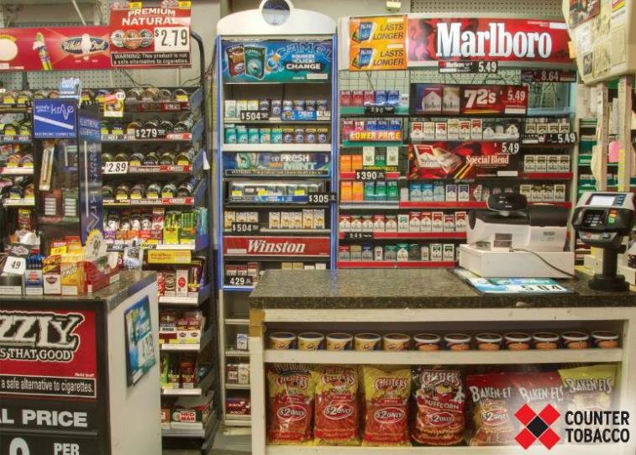
Implementation Support to Counter Point of Sale (POS) Tobacco Marketing

Slide 33
Pilot Study to Measure Implementation Support Effectiveness
Pilot involves 30 tobacco control coalitions
NC Department of Health and Human Services provided funding for coalitions to work on POS tobacco marketing
NC DHHS contracted with Counter Tools to provide implementation support
Outcomes include:
  Changes in individual capacity (survey)
  Coalition completion of integration components (interviews)

Slide 34
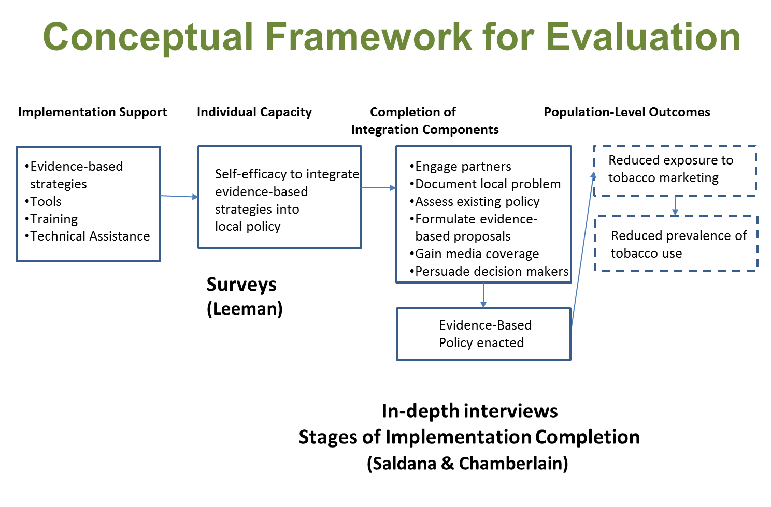

Slide 35
4CNC Contributions to Cross Center Workgroups
FQHC Signature Project
Dr. Rohweder co-leads, Dr. Leeman member
Community Implementation Workgroup (focus on implementation support)
Dr. Leeman co-leads, Dr. Rohweder member
EBI Modeling Workgroup
Dr. Wheeler leads
Cervical Cancer Screening Workgroup
Dr. Brewer member

Slide 36
Plans for Year 3
Add two new co-investigators (Dr. Daniel Reuland and Dr. Alison Brenner)
Integrate work from Rohweder (CRC screening in FQHCs), Leeman (implementation support), and Wheeler (decision support for CRC screening)
Adapt CPRCN Curriculum for CRC screening in FQHCs in partnership with American Cancer Society
Develop and pilot technical assistance and tools to support implementation of multi-level CRC screening interventions

Slide 37
4CNC Publications
Twelve peer-review publications in Years 1 and 2, nine of which have 4CNC investigators as lead authors
Journals include Implementation Science, Tobacco Control, Public Health Reports, Gynecologic Oncology, Health Communication, and Preventing Chronic Disease: Public Health Research, Practice, and Policy
Refer to 4CNC bibliography for full citations

Slide 38

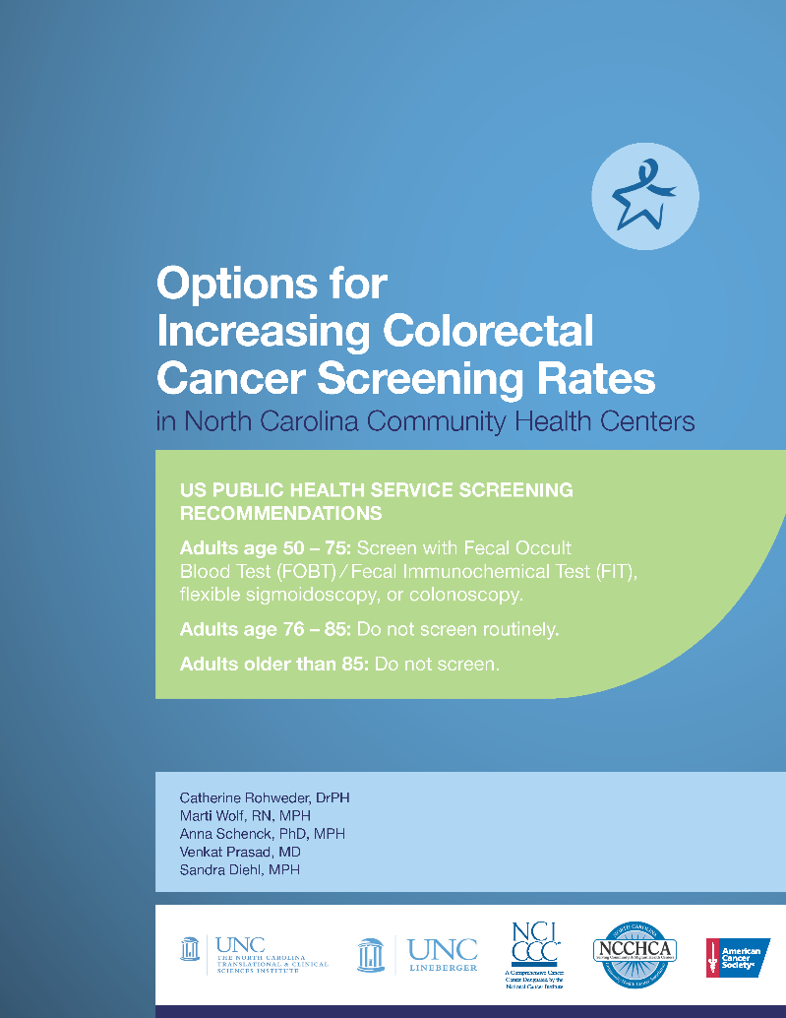
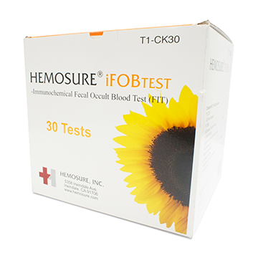
FQHC Signature Project:
A Co-Chair’s Perspective
Co-I: Catherine Rohweder

Slide 39
Study Aims
Aim 1. Identify the evidence-based interventions FQHCs are currently using to increase CRC screening rates
Aim 2. Identify the evidence-informed implementation strategies that FQHCs are currently using to put CRC screening interventions into practice
Aim 3: Identify the type of implementation supports that FQHCs are currently accessing and examine their experience with those supports
Aim 4: Investigate the readiness of FQHCs to implement and evaluate multi-level interventions to increase CRC screening rates

Slide 40
Progress to Date
7/8 CPCRN sites are participating
Bi-monthly calls have been held since November 2014 (N=34)
Evidence-based, multi-level CRC interventions and implementation strategies were presented at the 80 by 2018 Forum
Manuscript is being submitted to Clinical and Translational Science
5 sub-committees have been formed
Survey instrument has been created, sampling frame has been specified, IRB application is in process
Goal is for survey to be completed by August, 2016

Slide 41
Facilitators for Success
Two co-chair team is ideal, especially for such a large workgroup (50+ members)
Anticipate uneven contributions from sites and shift resources accordingly
Co-investigators benefit from a supportive PI who is very active in contributing scientific expertise
Sub-committee structure promotes decision-making and productivity; calls mostly serve as updates
Access to content experts is extremely helpful
Affiliates can play an important role

