Slide 1

The Cancer Prevention and Control Research Network (CPCRN)
Implementation Science Consortium in Cancer (ISCC) 2020
September 22, 2020
Stephanie B. Wheeler, PhD MPH
University of North Carolina at Chapel Hill
Principal Investigator, CPCRN Coordinating Center
@CPCRNcancer www.cpcrn.org
@StephWheelerUNC
This presentation is supported by the Centers for Disease Control and Prevention of the U.S. Department of Health and Human Services (HHS) as part of a financial assistance award with 100 percent funded by CDC/HHS (Cooperative Agreement Number U48 DP006400). The contents are those of the author(s) and do not necessarily represent the official views of, nor an endorsement, by CDC/HHS, or the U.S. Government.

Slide 2
Overview of CPCRN
CPCRN Mission
Accelerate the adoption and implementation of evidence-based cancer prevention and control strategies in communities
Enhance large-scale efforts to reach underserved populations and reduce their burden of cancer
Deepen our understanding of the predictable processes that achieve those goals
Develop the D&I workforce in cancer prevention and control
CPCRN Vision
Reduce the burden of cancer in U.S. populations and eliminate cancer disparities
Quick Facts
Initiated in 2002, CPCRN is the largest and oldest thematic research network of the CDC-funded Prevention Research Centers
Collaboration with federal agency partners at the CDC and NCI
175 current Network members

Slide 3
Network Geographic Map
Funded CPCRN Centers (2019-2024)

Slide 4
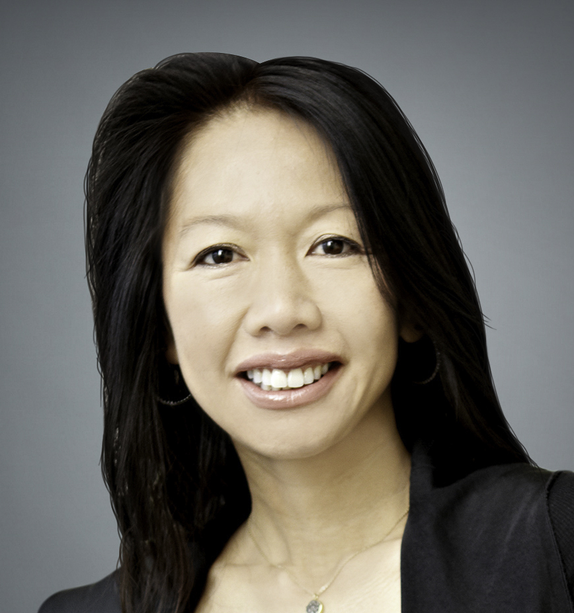
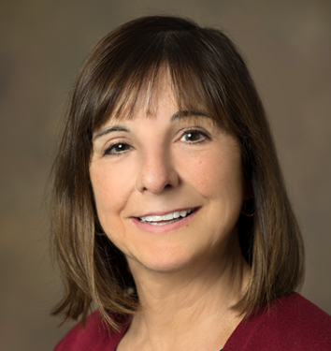
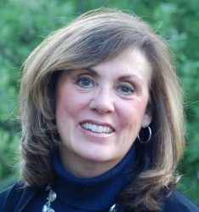
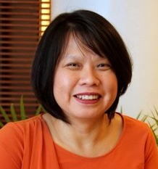
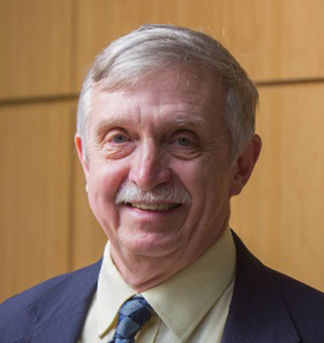
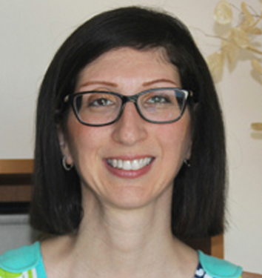
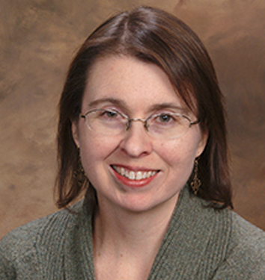
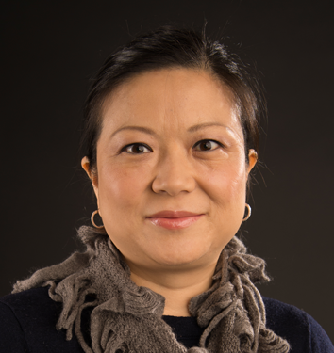
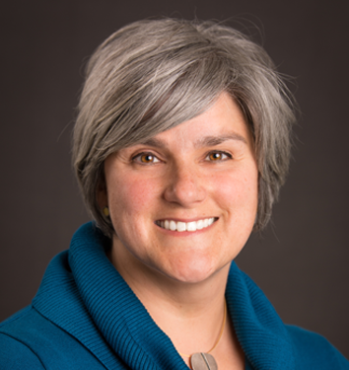
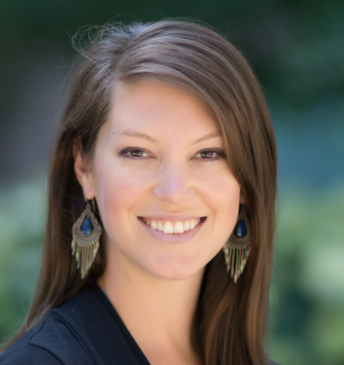
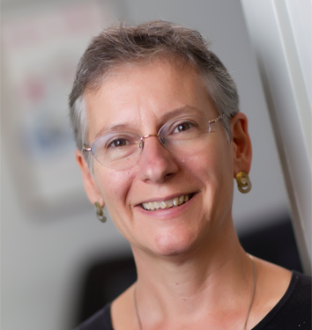
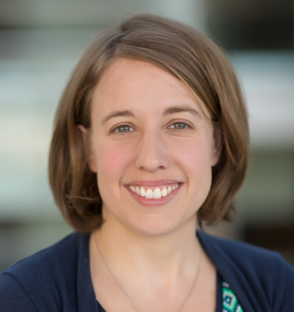
Chau Trinh-Shevrin, DrPH
New York University
Cyndi Thomson, PhD
University of Arizona
Betsy Risendal, PhD
Colorado School of Public Health
Cam Escoffery, PhD
Emory University
James R. Hébert, ScD
University of South Carolina
Daniela Friedman, PhD
University of South Carolina
Peggy Hannon, PhD
University of Washington
Linda Ko, PhD
University of Washington
Natoshia Askelson, PhD
University of Iowa
Stephanie Wheeler, PhD
University of North Carolina
Jennifer Leeman, DrPH
University of North Carolina
Alison Brenner, PhD
University of North Carolina
CPCRN Principal Investigators

Slide 5
Overview of Current Cross-Center Projects
Survivorship
Rural Cancer
iCollab
Organizational Theory for Implementation Science
CPCRN Scholars
Cancer & COVID-19
Health Behaviors
Modeling Evidence-Based
Intervention Impact
Multiple Cancer Prevention and Control
Workgroups
Interest Groups
www.cpcrn.org/projects
Previous Projects

Slide 6
Impact of the CPCRN
By the Numbers
1791 Publications
$669 million in Funded Grants
2000
Presentations
54
Trainings*
(*past 3 years)
Beyond the Numbers
Disseminating Science
Creating Awareness
Catalyzing Action
Effecting Change
CPCRN Supplemental Issue of Preventive Medicine
Putting Public Health Evidence Into Action Training
UW Local Project – Point of Care
Changes
Kentucky Senate Bill 101 Pharmacist-Administered HPV Vaccine
https://www.cpcrn.org/news?open_id=73
https://www.cpcrn.org/training
Ko, L. K., Jang, S. H., Friedman, D. B., Glanz, K., Leeman, J., Hannon, P. A., Shannon, J., Cole, A., Williams, R., & Vu, T. (2019). An application of the Science Impact Framework to the Cancer Prevention and Control Research Network from 2014-2018. Preventive medicine, 129S, 105821.

Slide 7
Opportunities for Collaboration
CPCRN Affiliate Membership is open to those with interest in and capability to contribute to the mission and goals of the CPCRN.
To apply for membership,
complete the application form at https://www.cpcrn.org/member-resources?open_col=51
Send a completed application and CV to stephanie_wheeler@unc.edu
The CPCRN Scholars Program strives to educate students, postdoctoral fellows, junior faculty, practitioners, and other health professionals in dissemination and implementation (D&I) science focused on cancer prevention and control and health equity.
For further information, email dfriedma@mailbox.sc.edu and cescoff@emory.edu

Slide 8

Connect with CPCRN
Find us on the web
@ www.CPCRN.org
Stephanie B. Wheeler, PhD MPH
Principal Investigator
CPCRN Coordinating Center
919.966.7374
stephanie_wheeler@unc.edu
@StephWheelerUNC
Follow us on Twitter @CPCRNCancer
Becky Lee, MS
Project Director
CPCRN Coordinating Center
919.966.2812
beckylee@unc.edu
Like us on Facebook
@CPCRN

